Slide 1
Strategic Partnerships 2019, 2020 and Beyond
Jeff Marsh, BSN
Vice President, Strategic Partnerships

Slide 2
2019 – A year of transformation
2019 Results:
National growth and expansion of our existing Strategic Partnerships with Optum and Genesis!
Signing of 9 new partnerships, with 2 more already in 2020!
Diversification of partnerships throughout several healthcare verticals
Hospital Systems
Payors and Providers
Long-Term Care
Further refinement to our care collaboration model, reporting and expression of value proposition

Slide 3
New Strategic Partnerships
Signed 2019
Signed 2020
Payors and
Providers
Health Services
Long-Term
Care
Hospital
Systems

Slide 4
New Partnership Admissions and ADC
700+ ADC Opportunity

Slide 5
Strategic Partnership Admissions and ADC

Slide 6
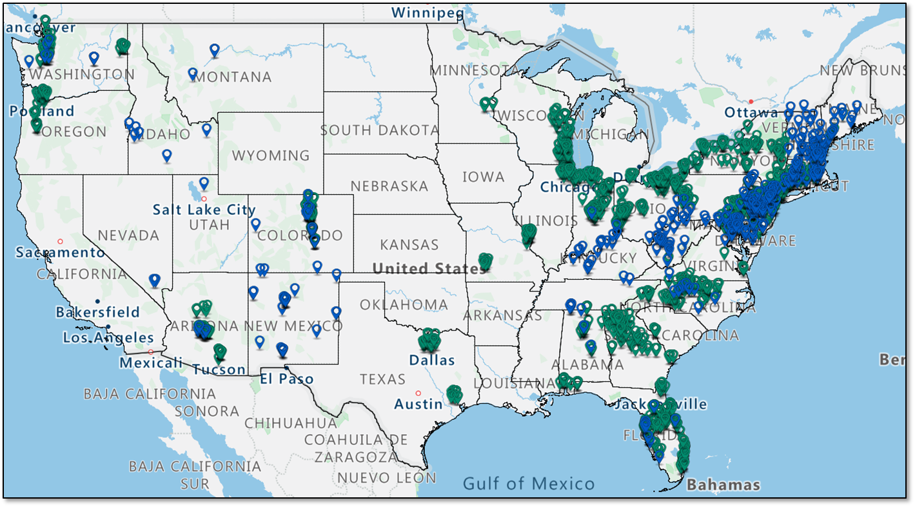
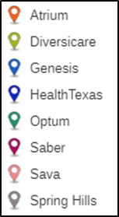
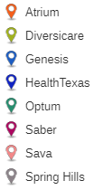
2019 Strategic Partnership Locations of Care
Partnerships help inform our home health, palliative and hospice growth strategy

Slide 7
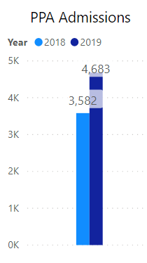
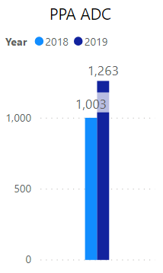
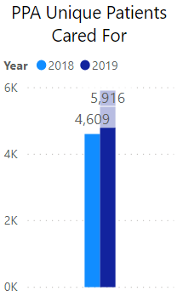
2019 – A year of Growth
+1,101 (31%)
+260 (26%)
+1,307 (28%)
Compassus supported 1,101 (31%) more patients and families in 2019
Our Strategic Partnership Average Daily Census increased by 260 (26%) over 2018
Compassus cared for 1,307 (28%) more patients and families compared to prior year

Slide 8
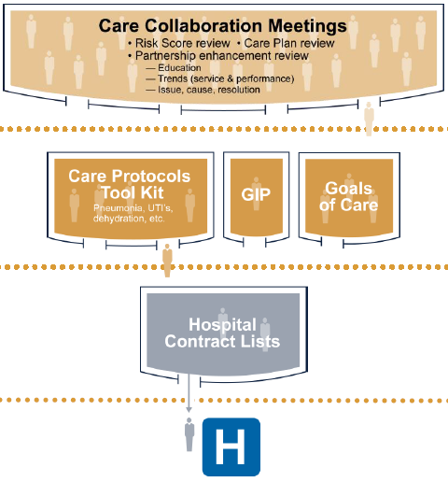
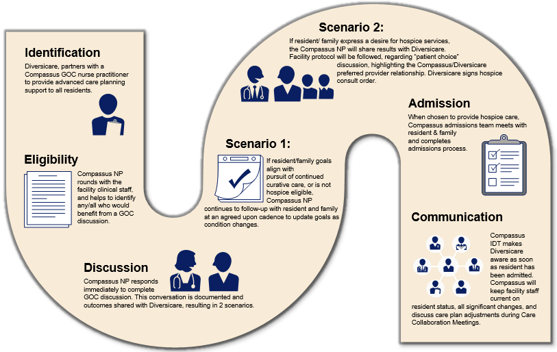
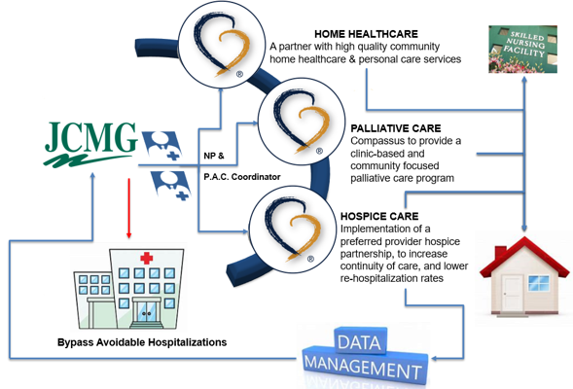
2019 – A year of Innovation
Collaborative Care Model Advancement

Slide 9
2019 – A year of Quality and Service Enhancement
Our Partners have been impressed with our national installation of the Care Delivery Model
“’I’m on my way’ is brilliant! It makes our nurses feel like Compassus is part of the team!”
- Michelle Darr
SAVA Senior Care, Division VP of Clinical Services
“Thank you for everything that you and your team have done for our patients, residents, and staff. We treasure our relationship with Compassus!”
- Dr. James Avery
Diversicare, National Medical Director

Slide 10
2020 – A year of…continued evolution
The healthcare community continues to…
Narrow their post-acute provider network and make decisions using outcomes data
Expect more and more from their selected partners
More than “good communication”
More than “timely response”
Increase their standards for high quality care and service
Evolve its impression of Compassus
From Vendor/Provider to Trusted Advisor
Trusted
Advisor
Strategic Partner
Value-Add Supplier
Vendor/Provider

Slide 11
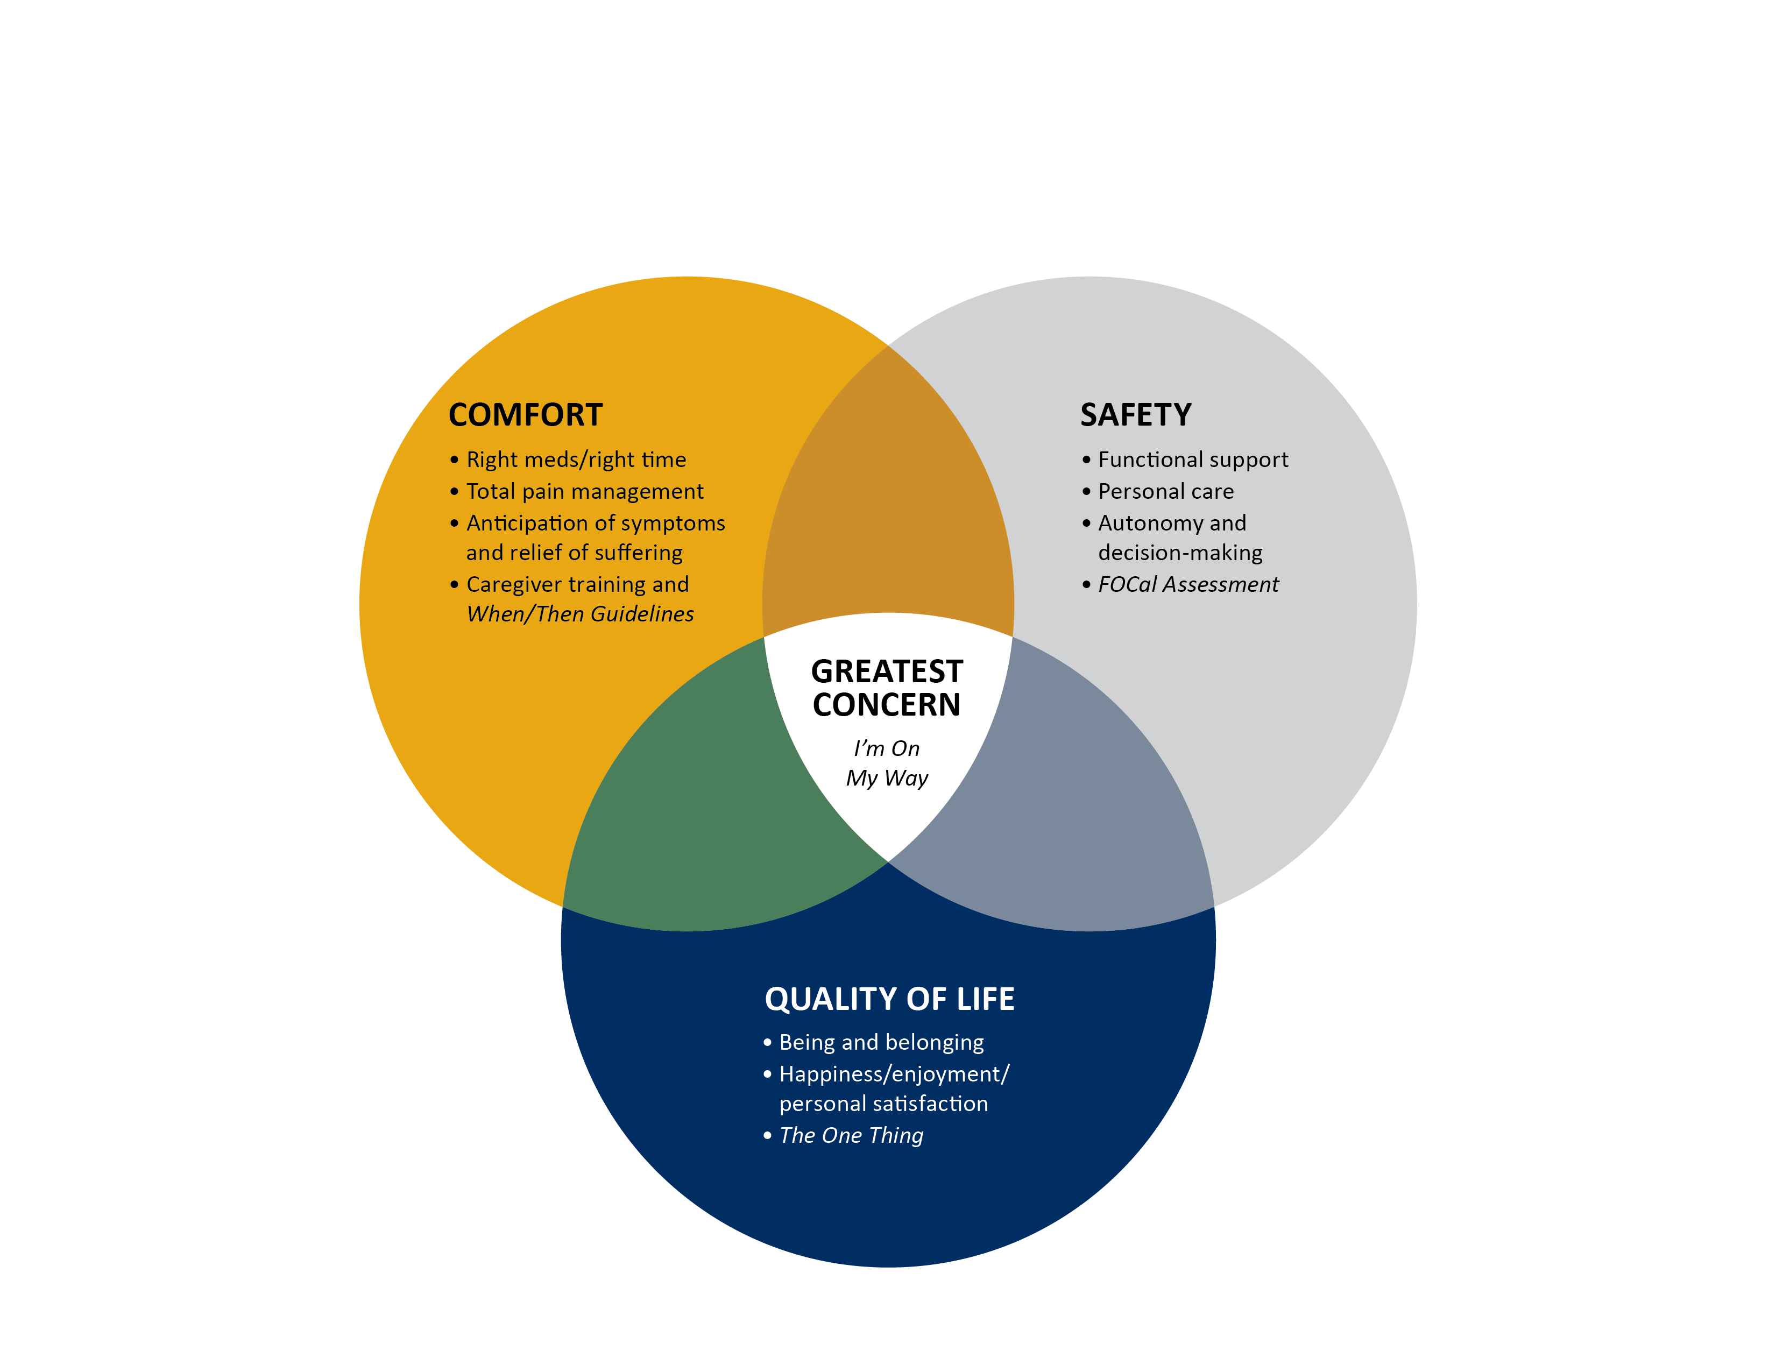
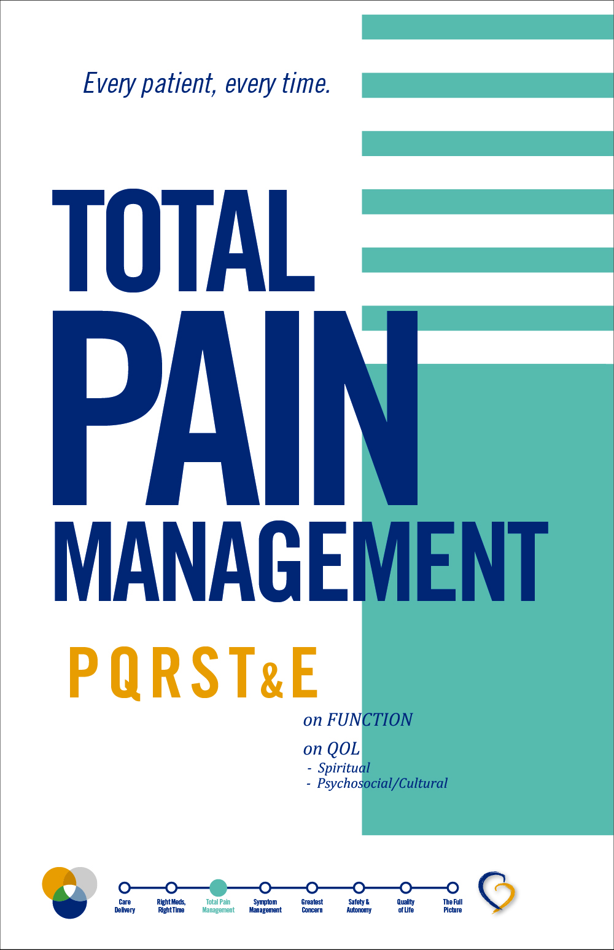
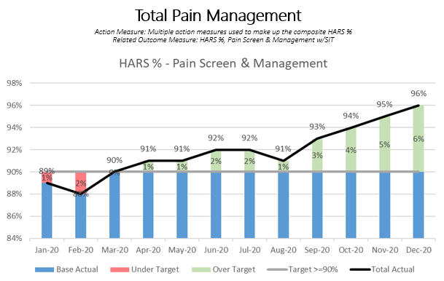
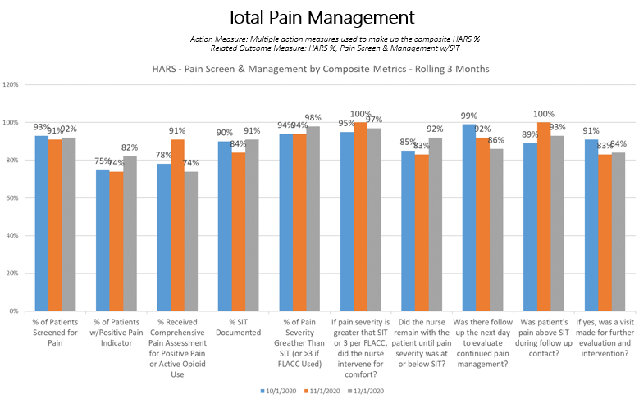
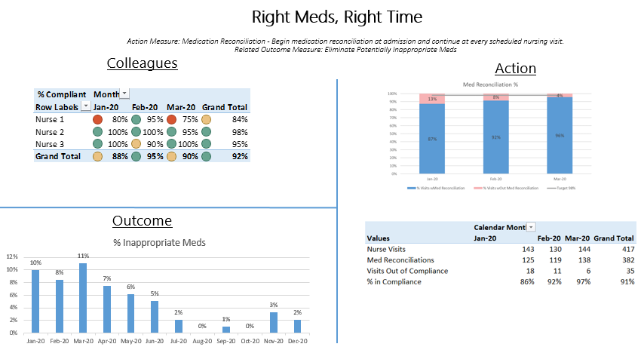
2020 – A year of… Bringing it all Together
Model to Action
Action to
Outcomes

Slide 12
2020 – A year of Ascension Integration
Compassus is a nationwide network of community-based hospice, palliative and home health care services.
We are a Nashville, Tennessee-based company founded in 2006, with roots in hospice reaching back to 1979.
Today, we have more than 126 locations in 29 states across the U.S.
Our Higher Purpose is “to profoundly advance the well- being and honor the dignity of those we serve, helping make the world a better place — one family at a time.”
Our Vision is “to lead the transformation of healthcare delivery: continuously and measurably improving the quality of person-centered, physician-driven, team-based care.”
Our Core Values:
Our Mission, Vision and Values guide everything we do at Ascension. They are foundational to our work to transform healthcare and express our priorities when providing care and services, particularly to those most in need.
Our Mission: Dedicated to spiritually-centered, holistic care that sustains and improves the health of individuals and communities
Our Vision: We envision a strong, vibrant Catholic health ministry in the United States which will lead to the transformation of healthcare. We will ensure service that is committed to health and well-being for our communities and that responds to the needs of individuals throughout the life cycle. We will expand the role of laity, in both leadership and sponsorship, to ensure a Catholic health ministry in the future
Our Values:
Compassion
Integrity
Excellence
Service of the poor: Generosity of spirit, especially for persons most in need
Reverence: Respect & compassion for the dignity and diversity of life
Integrity: Inspiring trust through personal leadership
Wisdom: Integrating excellence and stewardship
Creativity: Courageous innovation
Dedication: Affirming the hope and joy of our ministry

Slide 13
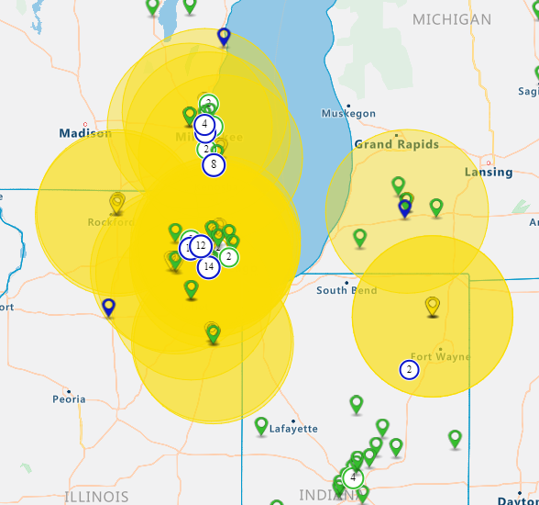
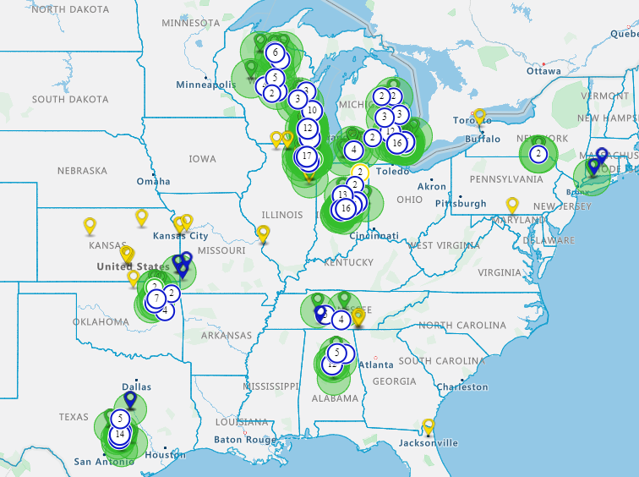
2020 – A year of Ascension Integration
Ascension and Compassus have significant coverage overlap
With 80% hospice overlap with Ascensions hospitals throughout the country, a significant opportunity exists for integrating standardized clinical processes, aimed at reducing patient risk for re-hospitalization & improved end-of-life care
Also 45 senior living facilities throughout the country (WI, IL, MI, IN, MO, TX)

Slide 14
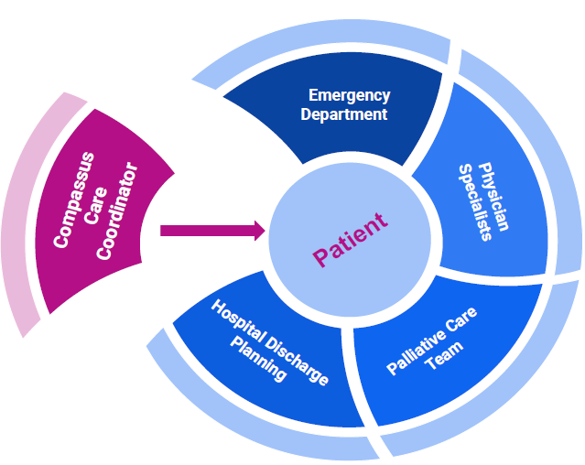
2020 – A year of Improved Care Coordination
Compassus & Ascension
Compassus Care Coordinator
Providing the integrated connection to:
Hospitals
Home Care
Hospice
Palliative Care
Skilled Nursing

Slide 15
2020 – Is Our Time
2020 Opportunity:
Proven Partnership Strategy
Extensive Pipeline of Future Partners
Industry Leading Care Delivery Model
Unparalleled sophistication with data and outcomes management
Continued Investments in Leadership Development
Scalable Organizational Design
…The Opportunity is Limitless

Slide 16
2020 Is Your Time
Quality Outcomes
Market Operations
Clinical Operations
2020 Opportunity:
Each of you has a critical role in further developing Strategic Partnerships and our continued success depends on you!

