Slide 1

Regional Vice President Breakout
Jeff Mongonia, Hospice COO
Laura Templeton, Division President

Slide 2
Agenda
RVP Overview
Labor
New Organization Structure

Slide 3
RVP Overview
Responsibility | Outcomes/KPI Measurement | Reports/Tools for Measurement
Regulatory Compliance | Meets all regulatory standards. 90% or greater on internal scorecard. 5% or less in technical errors. | Clinical compliance with regulatory and accreditation standards. No conditional level deficiencies. Timely response to internal and external audits.
Colleague Retention | Colleague retention greater than or equal to 80%, and NPS improving every survey | Workday Turnover/Retention Report, Perceptyx NPS
Service | Recommend above national average | CAHPS
Growth | Ensures region meets or exceeds admit and ADC targets (including PPA targets), CAP mitigation | DCR, PPA Admission Reports
Financial Performance | Operating income exceeds budget and all programs meet or exceed pillar key statistics benchmarks | Financial statements, PPD rollup, shaping performance excellence, pillar key statistics
Strategic Partnerships | PPA market penetration meets or exceeds expectations | Powerbi PPA reporting and scorecard
Labor Management | Labor frequency, mix, CMHPPD at model | Labor report, service intensity
CAP | $0 CAP Liability with 25% cushion for all programs | CAP Report and Quality CAP Planning Tools
HARS/HIS | 97% HIS rollup, 95% HARS compliance | Clinical scorecard and SHP
Write-offs/ Unbilled | Less than 1% on unbilled/write off days | Monthly/annual write off report

Slide 4
Labor
Opportunity and need for improvement
Project team
Weekly call rotation

Slide 5
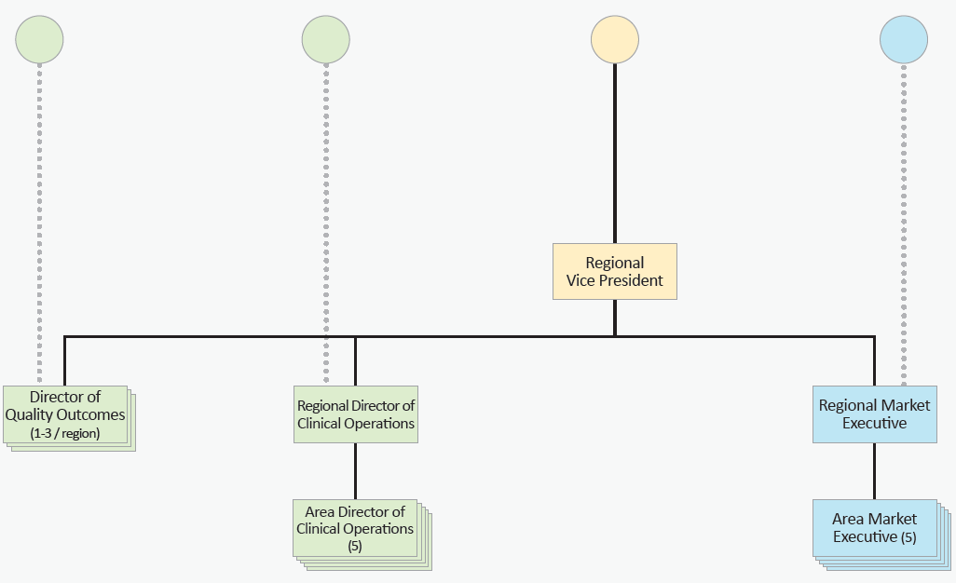
Organization

Slide 6
Discussion
Positives of the new functional structure
Concerns and challenges of the new functions
The three most important supports the company (and other functions) can do to best help support:
  Directors of Clinical Services
  Area Director of Clinical Operations
  Regional Director of Clinical Operations
  Area Market Executives
Reporting Out: We will have six minutes when we return to
General Session to report out on our discussion.

