Slide 1
Leadership Through Change
Laura Templeton, Division II President Dana Mastropieri, VP Talent Management

Slide 3
The way we observe a situation in real-time is what gives us the range of actions we are prompted to take in that situation.

Slide 4
Observation
Is more than what our eyes see, and our ears hear (pure perception)
Perception is always colored by our interpretation
Observation = perception + interpretation
Notes:
In module 2, we will learn about assessments. And after that, we will say perception + assessments.

Slide 5
Example
The wife of a potential hospice patient
Observation 1: I am failing my husband by letting others take care of him.
Action: She is reluctant to support his enrollment into hospice care.
Result: ?
Observation 2: Hospice care will provide support that will allow me to better take care of my husband’s other needs.
Action: She is likely to support his enrollment.
Result: ?
Different observations prompt different actions.
observation = perception + interpretation

Slide 6
Objective vs. Subjective Reality
While we think we are responding to objective reality, we only ever act and interact with what is subjectively real to us.
If humans responded to what was objectively so (the facts), the situation would look the same to each person… we would always agree on what was happening, the explanation for it, and what actions to take.

Slide 7
Example
You ask nurse aides to take on more responsibilities with their patients
Observation 1: This is an opportunity to learn and increase my skills!
Observation 2: This is unfair. What an inconvenience!
Observation 3: I am trusted and appreciated.
Each will act consistent with their observation of the request, not the request itself.
observation = perception + interpretation
Notes:
Ask participants likely action for each observation and consequent result.

Slide 8
Discussion
Everyone observes things through their own filter.
Let’s talk about how you originally observed what was happening when you learned of our structural changes.
observation = perception + interpretation

Slide 9
Discussion 1
What are the possible different ways colleagues around you have observed the changes?
What kind of questions does each way of observing ask?
What actions are available with each way of observing?
What are the likely results for each?
observation = perception + interpretation

Slide 10
Discussion 2
How has your observation shifted over last few days? What prompted those shifts?
As a result of that, what new or different actions might open up for you?
How can that change the results you may get?
observation = perception + interpretation

Slide 11
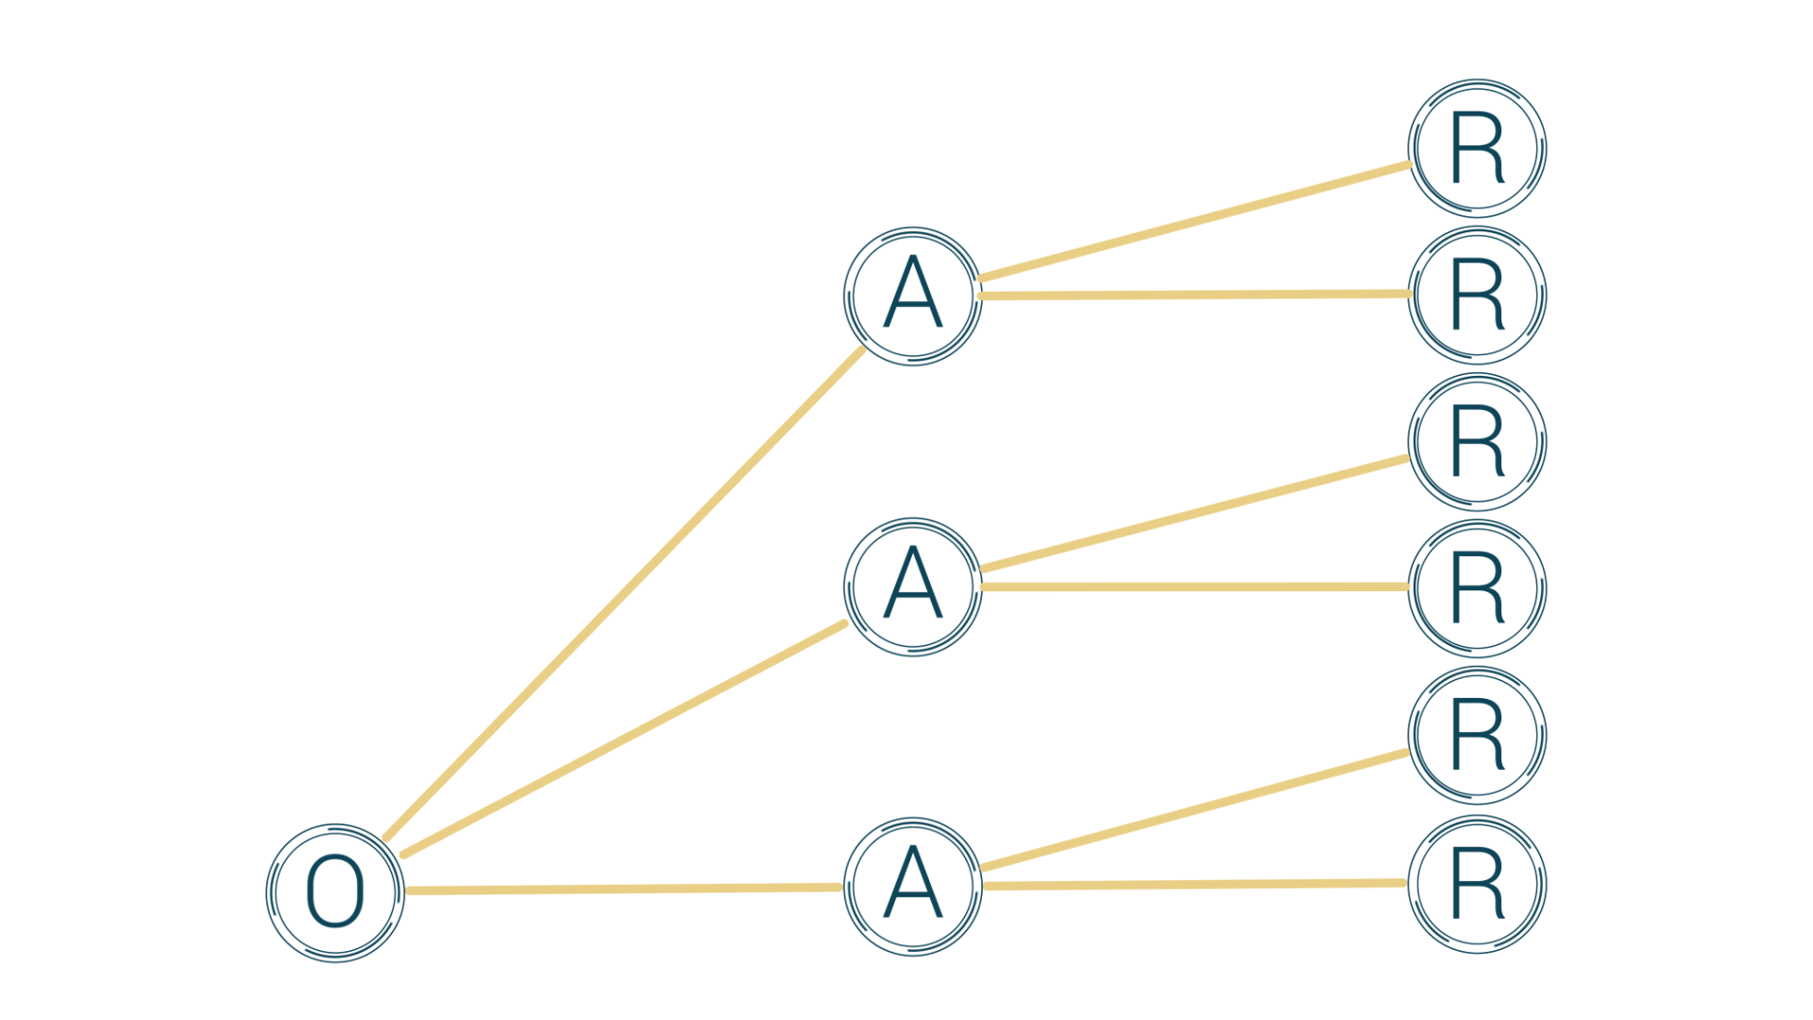

Slide 12
Observation and Change
When people observe that – in this change – their fundamental cares are addressed, they are more likely take productive action.
HOW DO YOU SHIFT OBSERVATION? Connect it to fundamental cares.
LEADERSHIP DEFINITION: The realization of a future that was not going to happen anyway; a future that addresses the fundamental cares of the relevant parties.

