Slide 1




Slide 2
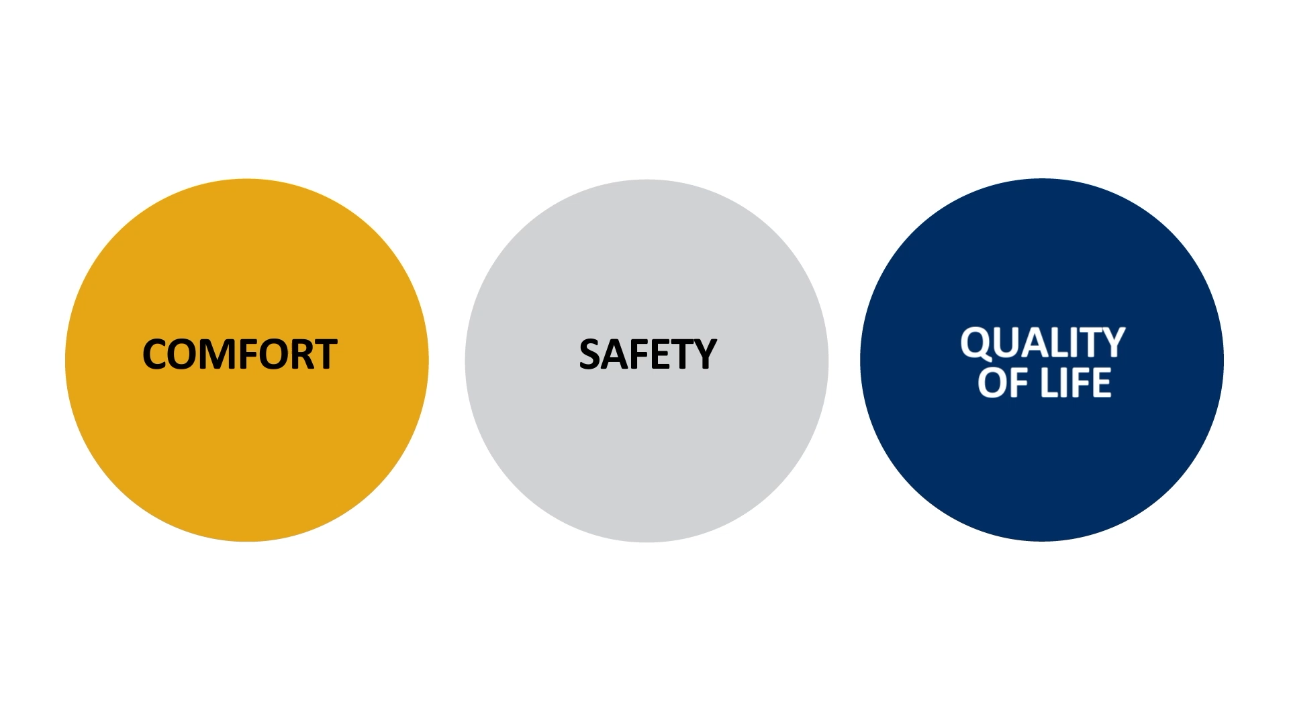

Slide 3
Care Delivery, the Compassus Way
Drive out variances
Greatest Concern
Individualized care in a standardized way

Slide 4


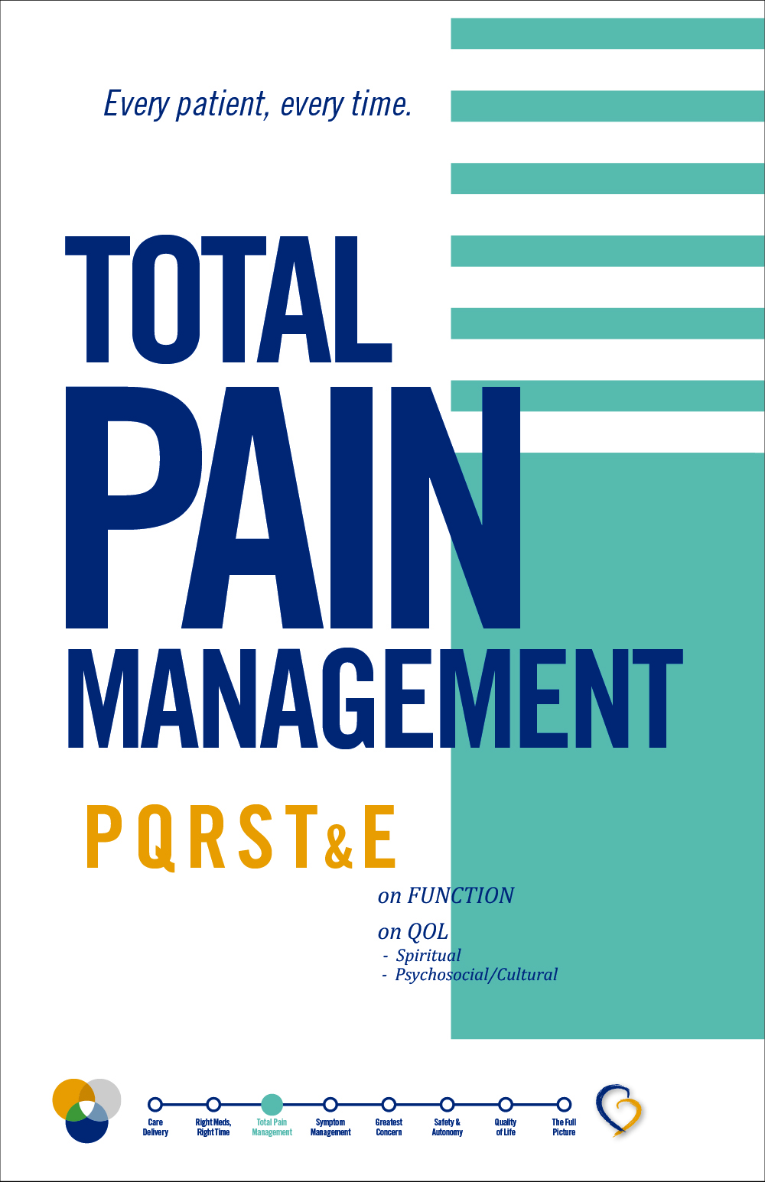




Slide 5
Care Delivery
New perspective
Person-centered care
Comfort, Safety, Quality of Life

Slide 6

Right Meds/Right Time
Medication reconciliation
Deprescribing Guide and Formulary
Skillful conversation with patients and caregivers

Slide 7
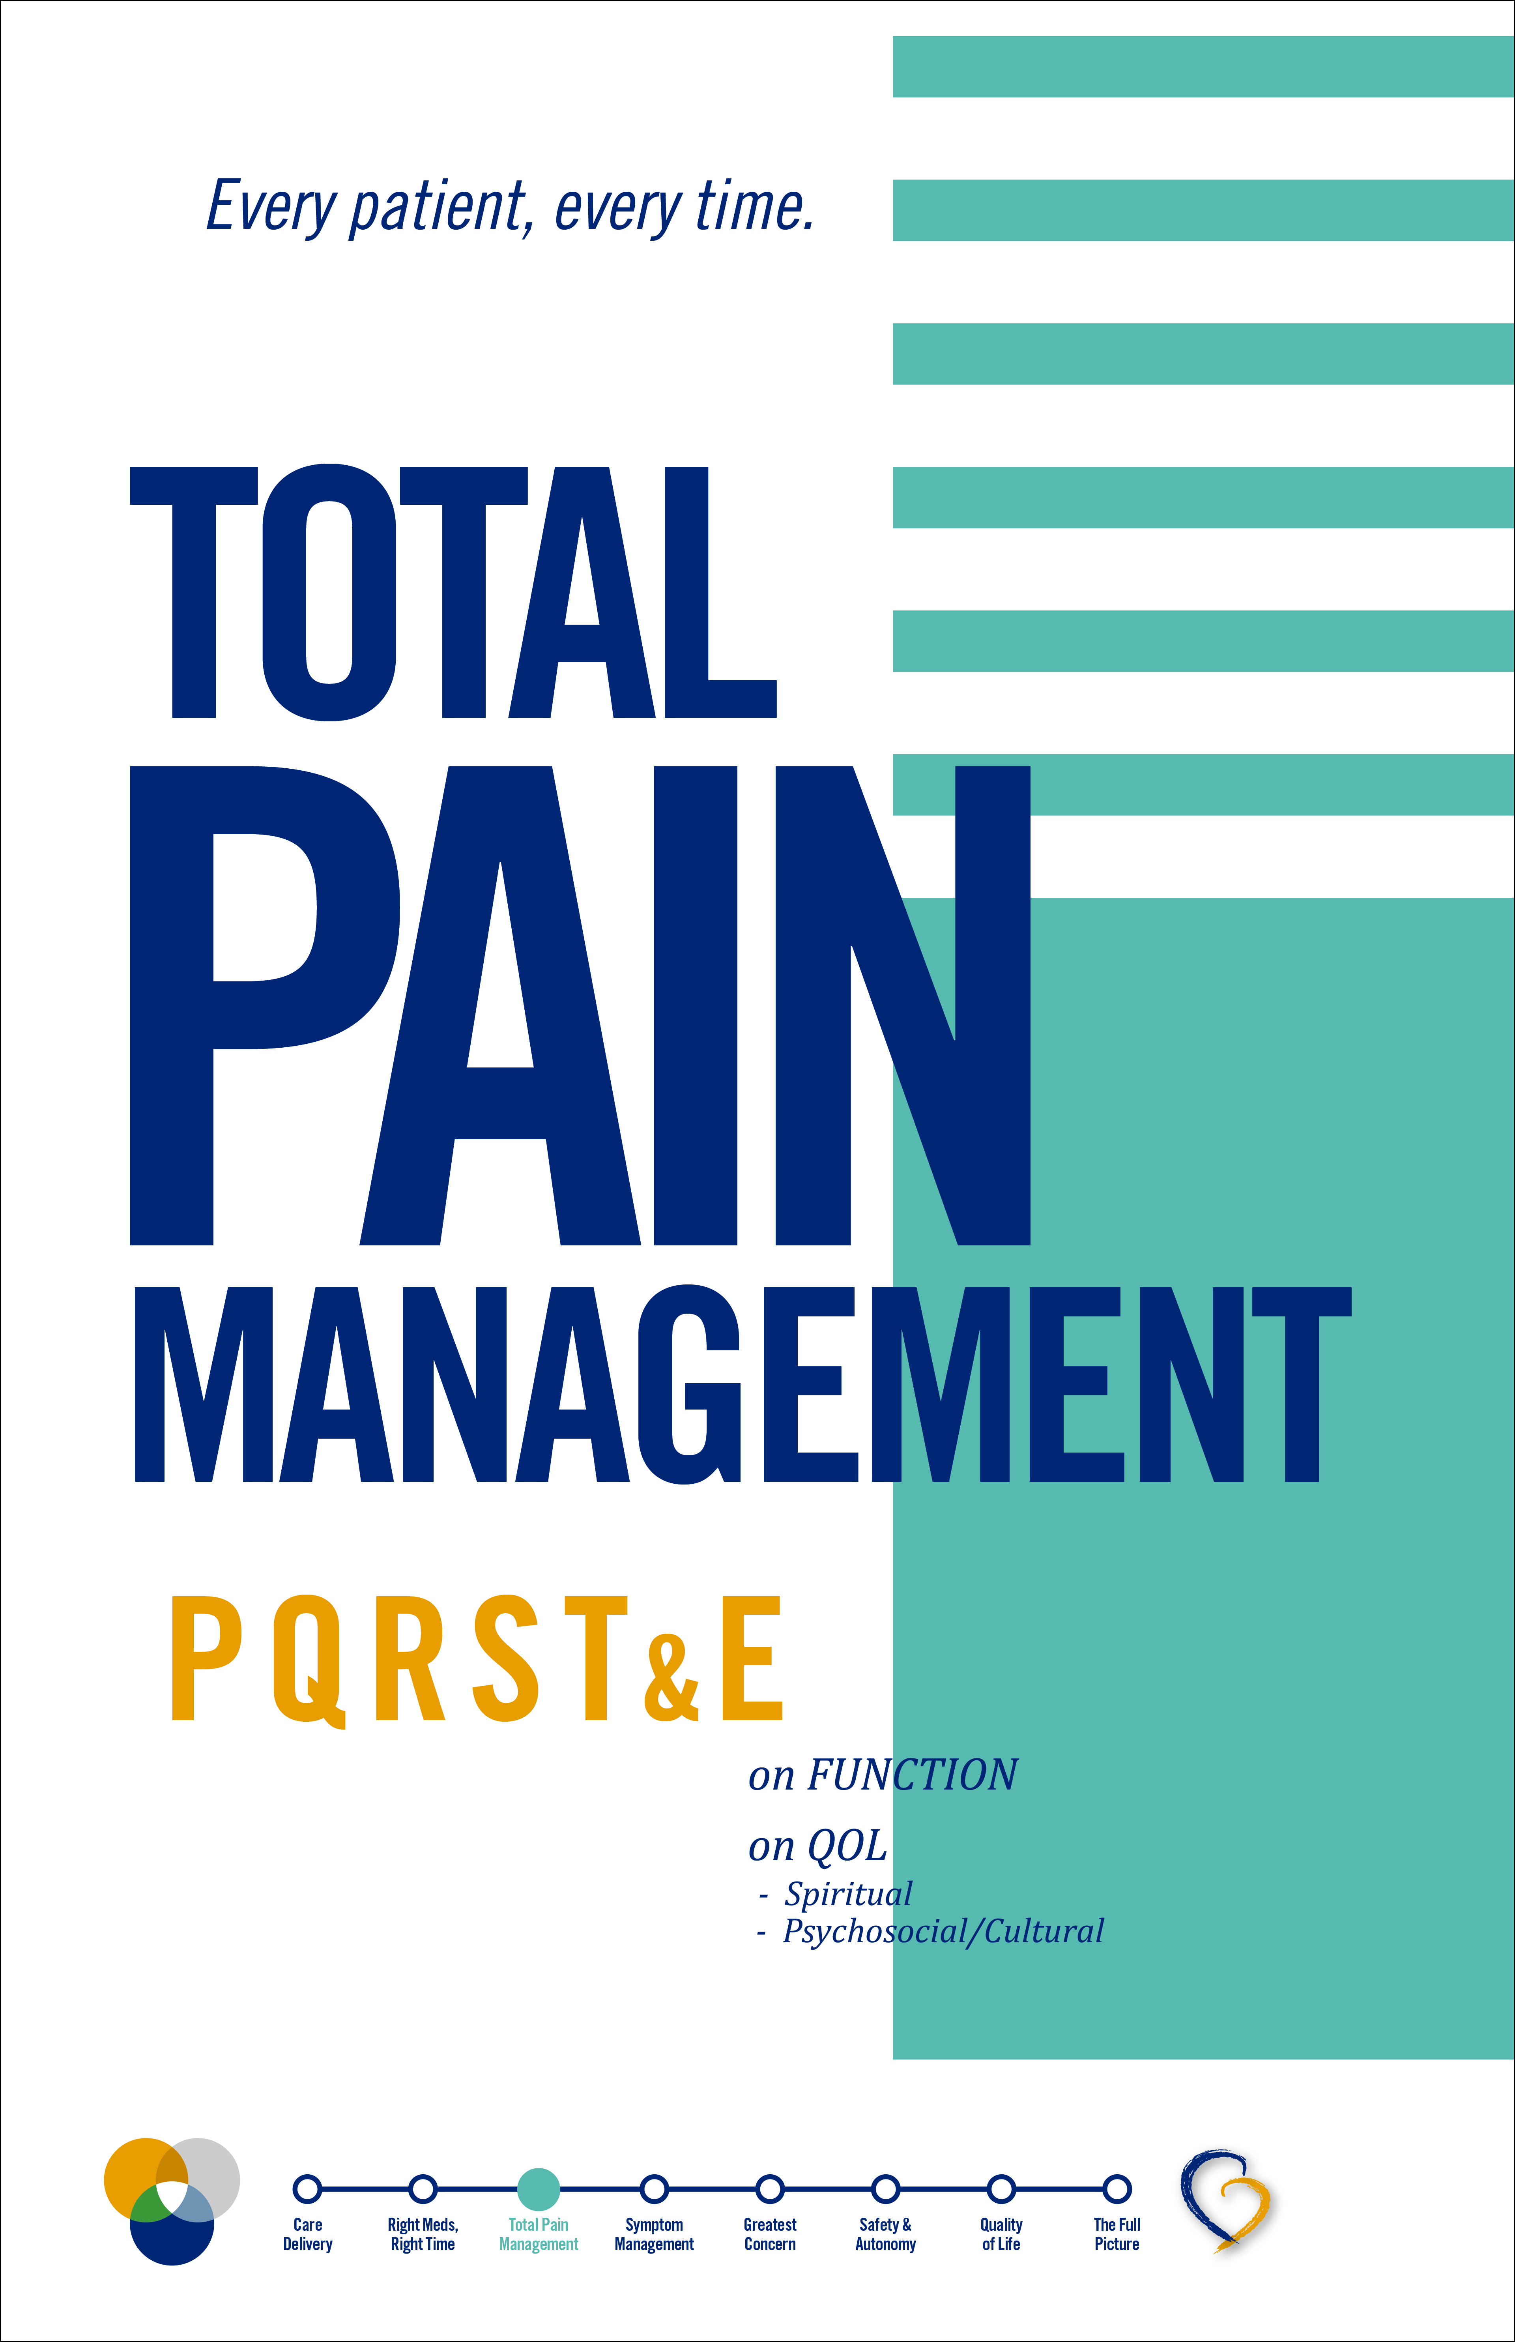
Total Pain Management
Standardized, sequential steps
Total Pain: physical, emotional, social, spiritual and functional
Patient-identified goals

Slide 8

Symptom Management
Normal process of dying
Changes/symptoms to expect
Management of changes/symptoms

Slide 9

Greatest Concern
Greatest Concern
Patient’s perspective
Provide relief, satisfaction
I’m On My Way

Slide 10

Safety & Autonomy
Live fully in declining health
Safety triggers
Communication with IDT
Environment of safety and autonomy

Slide 11


Slide 12



Slide 14
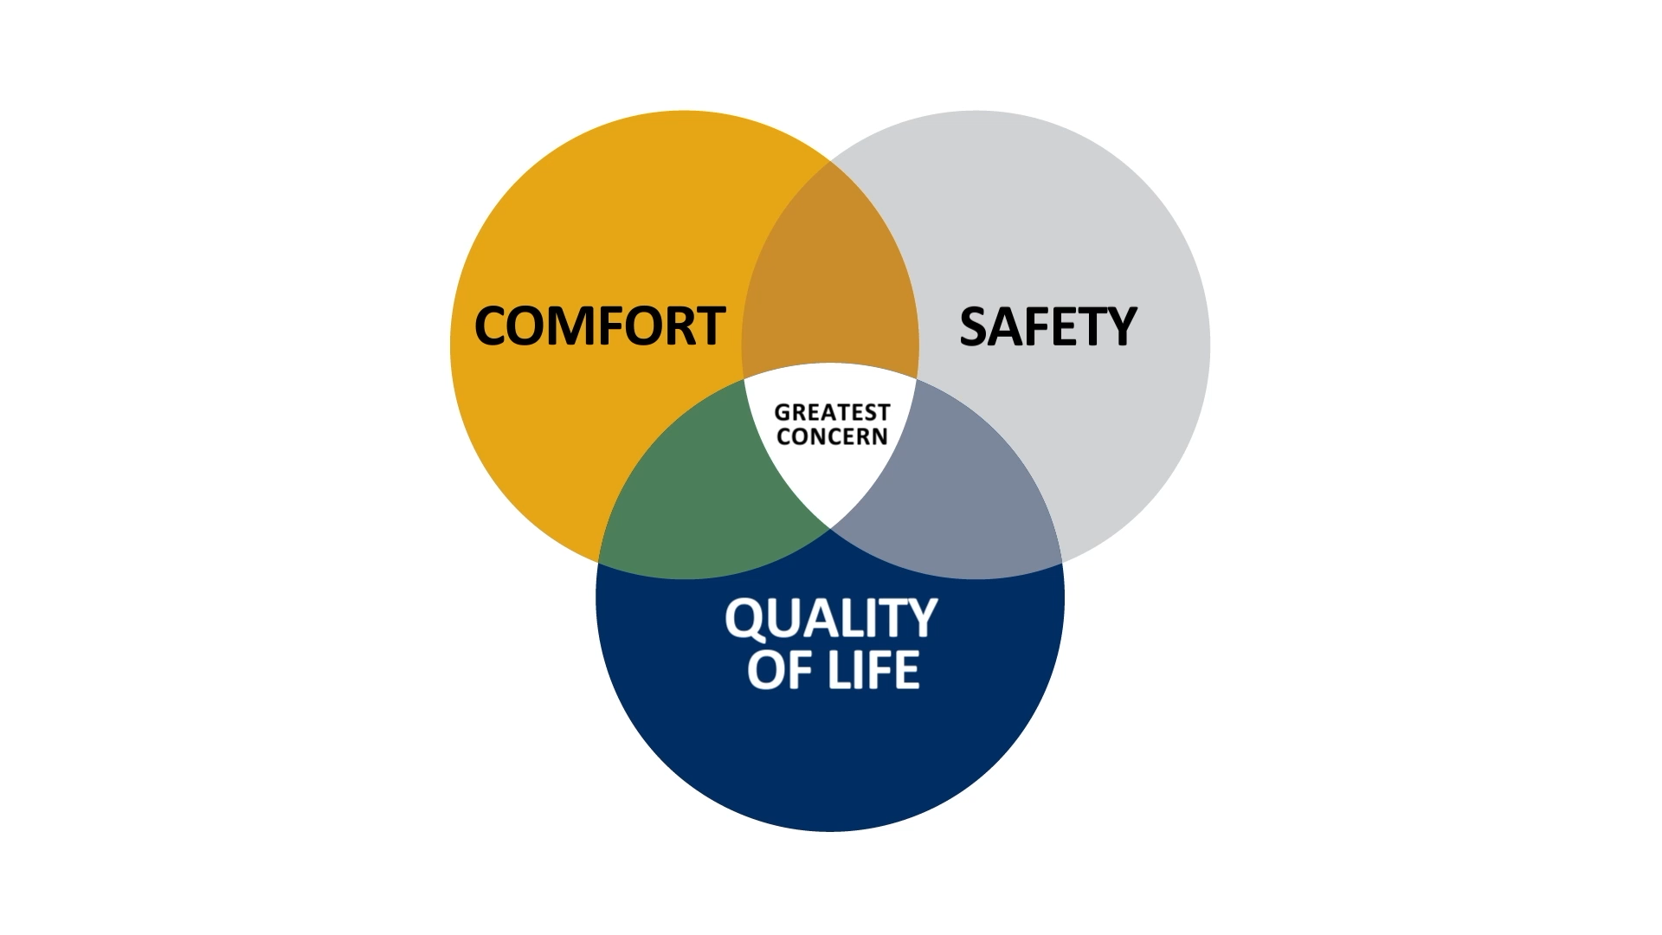

Slide 15
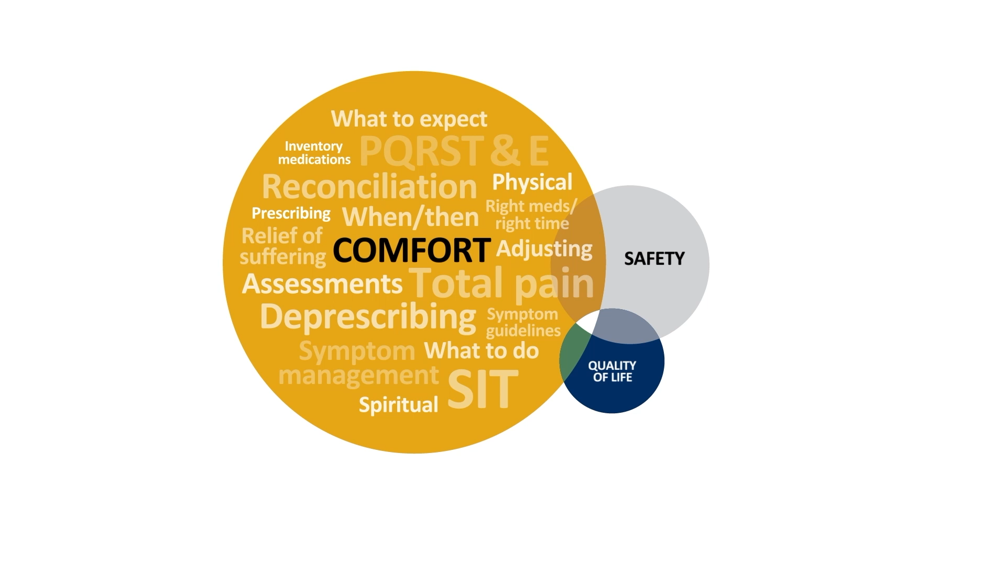

Slide 16
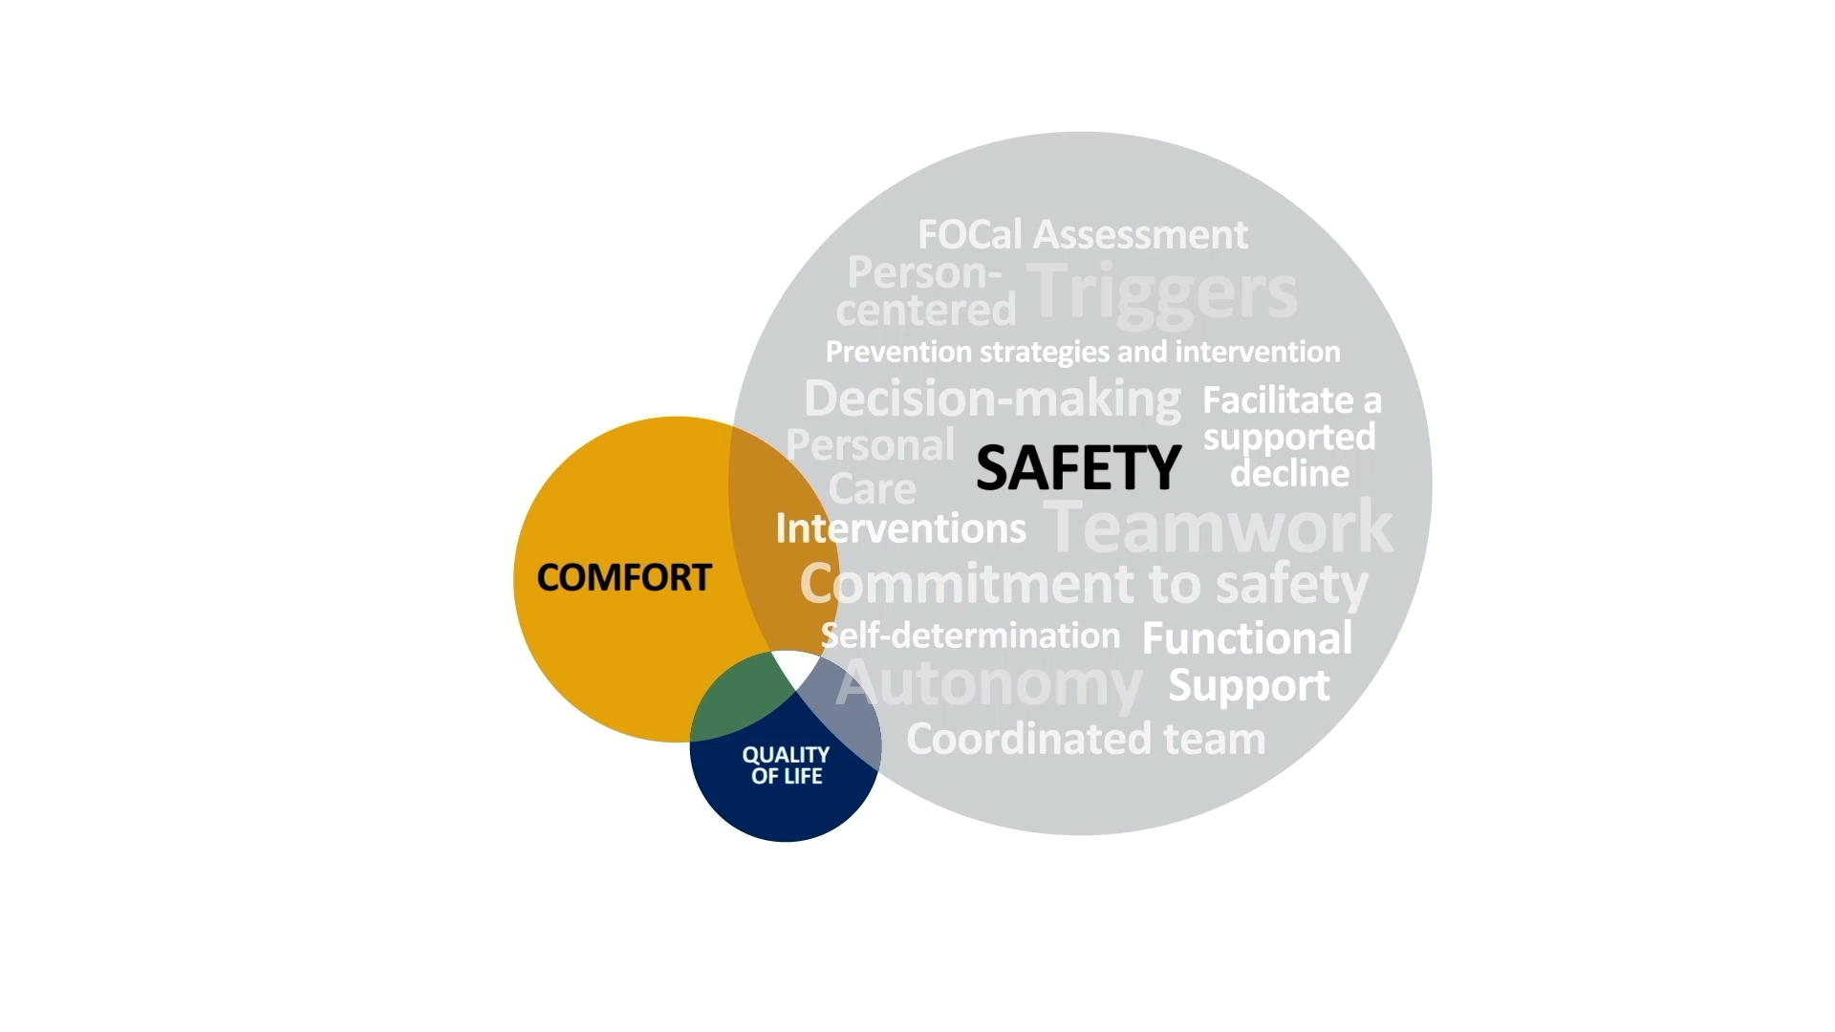

Slide 17


Slide 18


Slide 19
Care Delivery, the Compassus Way
Proven, positive results

Slide 20
CAHPS

Slide 21
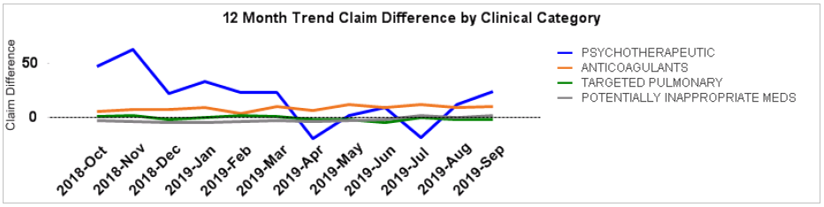

Comfort
Right Meds, Right Time
SAMPLE
Psychotherapeutic
Anticoagulants
Cholesterol Meds
Bisphosphonates
Vitamins & Minerals
Antidiabetics
Dementia Meds
“*Medications in this category are identified as potentially inappropriate for hospice care and could be evaluated for discontinuation.”
Medications in this category include Cholesterol Meds, Bisphosphonates, Vitamins & Minerals, Antidiabetics, Dementia Meds

Slide 22

Comfort
Symptom Management
SAMPLE
Values are the average for the decedent population in the last 7 days of life.

Slide 23

Greatest Concern
I’m On My Way
SAMPLE

Slide 24
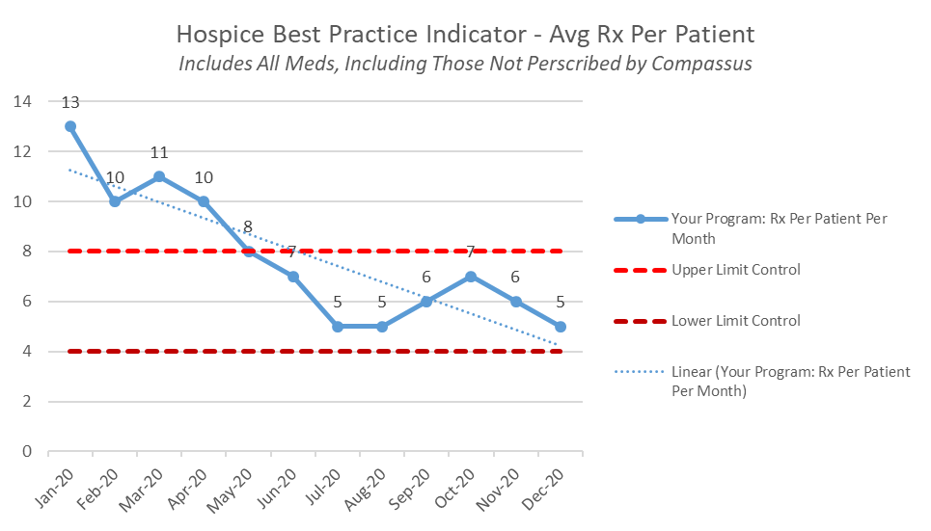
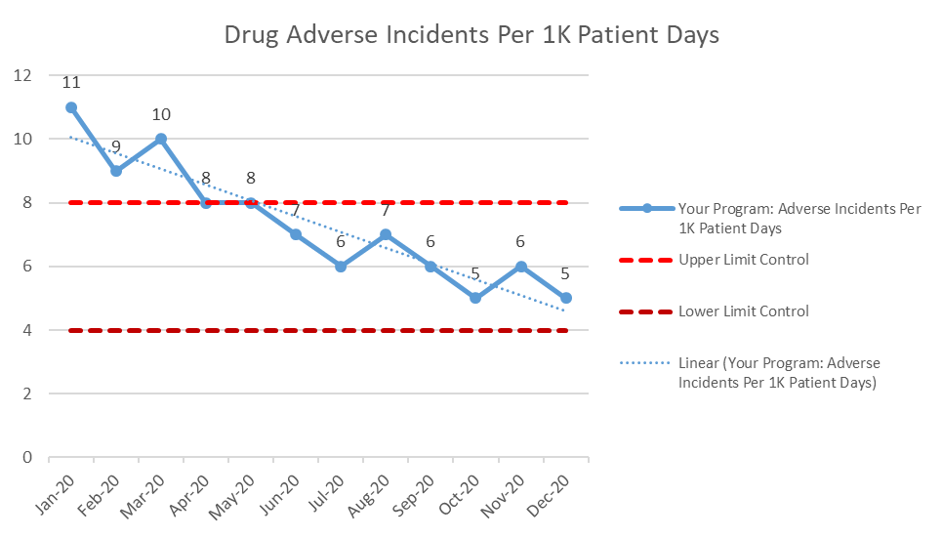
Safety
Right Meds, Right Time
SAMPLE

Slide 25


Slide 26







Slide 27

Right Meds
Right Time
Aricept
Namenda
Exelon
Namzaric
Seroquel
Haldol
Risperdal
Pill Burden
Swallowing dysfunction

Slide 28

Total Pain Management
Unable to communicate
Swallowing dysfunction
How to access
Too strong

Slide 29

Symptom Management
Sleep disturbance
Agitation
Dysphagia
Incontinence
Anxiety
Fear
Insomnia

Slide 30

Greatest Concern
Loss of identity
Loss of life lived
Caregiver burnout
Goals of care
Safety

Slide 31

Safety & Autonomy
Wandering
Falls
Injury
Hydration
Mobility
Pressure sores
Abuse — emotional, financial, physical
Swallowing difficulties — eating safely
Advance directives

Slide 32

Quality of Life
Honoring dignity
Memories
Supporting wellbeing
Being. Becoming. Belonging.
Opportunities for happiness
Loss of function
Personal care
Hygiene

Slide 34

Compassus is leading the transformation of healthcare delivery: continuously and measurably improving the quality of person-centered, physician-driven, team-based care.

