Slide 2
CAHPS

Slide 3
Comfort
Right Meds, Right Time
SAMPLE
Psychotherapeutic
Anticoagulants
Cholesterol Meds
Bisphosphonates
Vitamins & Minerals
Antidiabetics
Dementia Meds
“*Medications in this category are identified as potentially inappropriate for hospice care and could be evaluated for discontinuation.”
Medications in this category include Cholesterol Meds, Bisphosphonates, Vitamins & Minerals, Antidiabetics, Dementia Meds

Slide 4
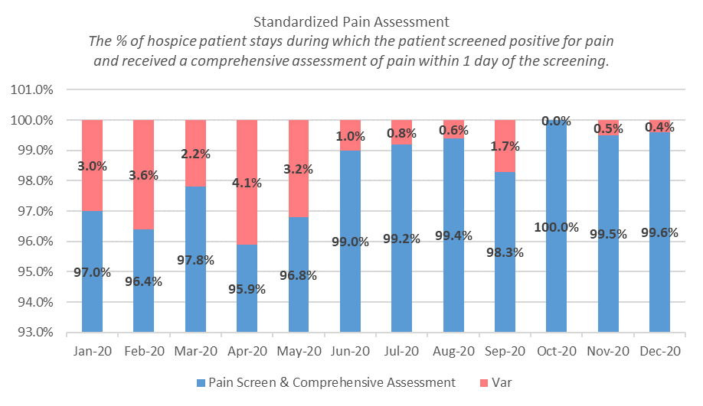
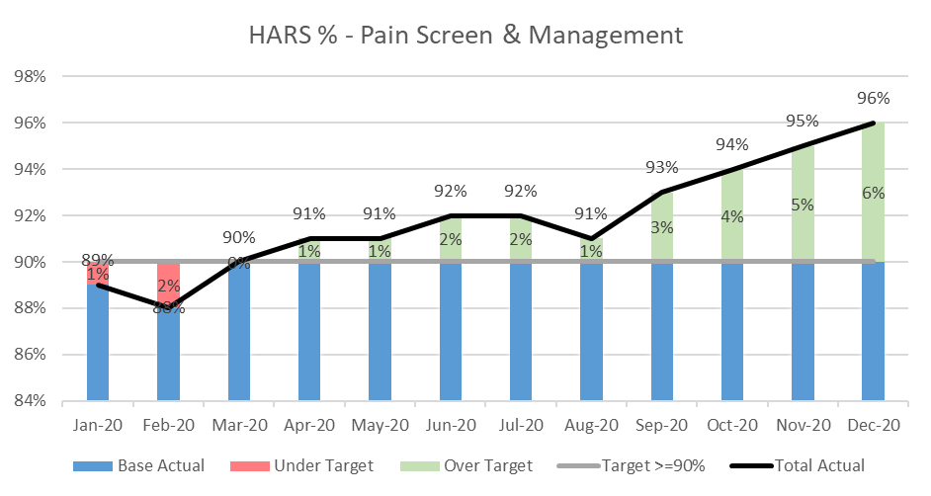
Comfort
Total Pain Management
SAMPLE
Routine HARS Actions Taken by Compassus:
- Hospice Aide Supervision completed every 14 days by the RN
- Assessment of skin and wound management every scheduled visit
- Reconciliation and management of medications
- Screening for pain and intervening for comfort (includes the SIT)

Slide 5
Comfort
Symptom Management
SAMPLE
Values are the average for the decedent population in the last 7 days of life.

Slide 6
Greatest Concern
I’m On My Way
SAMPLE

Slide 7
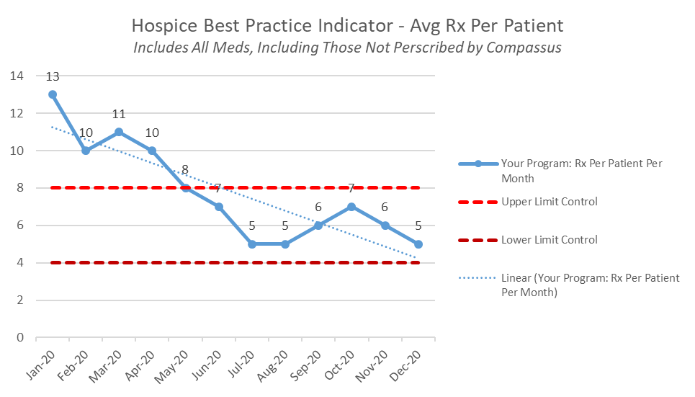
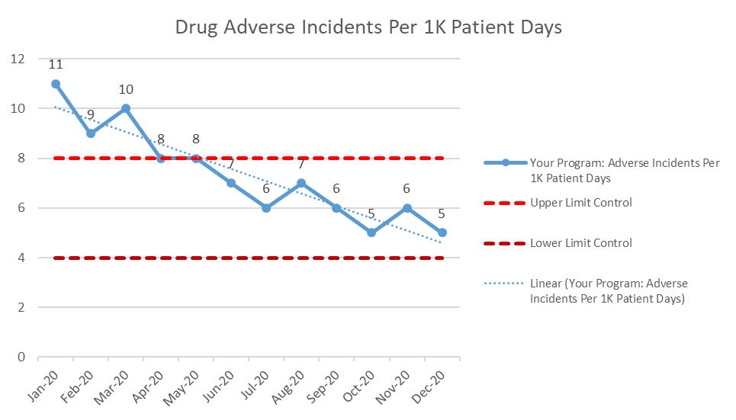
Safety
Right Meds, Right Time
SAMPLE

Slide 8
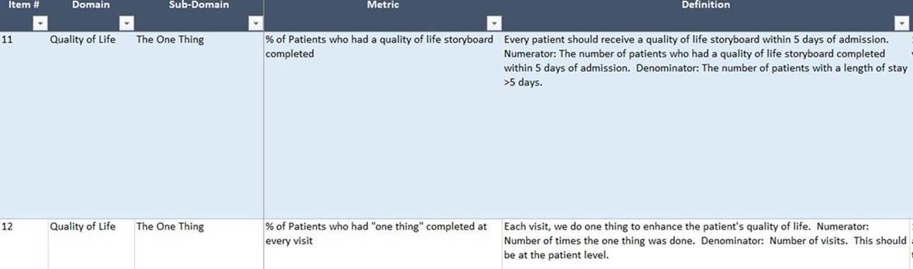
Quality of Life
The One Thing
SAMPLE
Scaling the attributes of our best care providers
We’re flipping the paradigm on how QOL is viewed, and we’re putting performance metrics in place to guide our clinicians in delivering the type of care we want for ourselves and our loved ones

