Slide 1
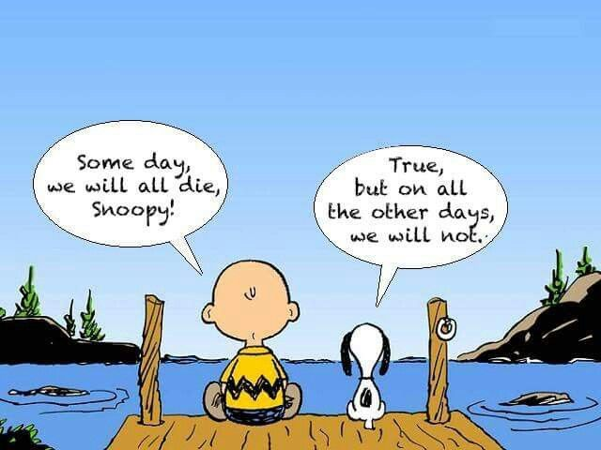
Tough Conversations
Kevin Craig, MD
Kelley Newcomer, MD

Slide 2
Why should you talk to your patients about prognosis in serious illness?
Enable treatment decisions
How can a patient/family make a decision if they aren’t fully informed?
Begin planning for the future
Move up a family member’s wedding date, etc
Reduce anxiety of not knowing

Slide 3
Why don’t health care providers talk about prognosis in serious illness?
Difficult to predict for an individual
We want to help (we offer what we know/do)
We don’t want to upset people
Worried about patient/family reaction

Slide 4
Barriers/Communication breakdowns
Patient unable to participate in agenda setting (intubated, demented, delirious)
Patient is accompanied by family or friend w/different agenda (you must elicit and factor into your discussion)
Some pts wonder why you are asking for their input
They haven’t been included in the past
YOU are their advisor, not their parent – it is YOUR job to inform them of their prognosis & options so they may make an INFORMED decision
(“How do you want to be involved?”)
(“I believe it is important for us to work together.”)

Slide 5
Pitfalls/Common Barriers to Good Communication
Assuming that cure is the goal of all patients (some people do not want to suffer in exchange for living longer)
Feeling responsible for maintaining the patient’s hope
Not assuming your role as an expert (recommend DNAR, just as you would a particular antibiotic)
Ignoring your own feelings
Making assumptions about what the patient knows/doesn’t know
Talking too much

Slide 6
Pearl: decision making
We assume that patients/families:
think rationally in stressful situations
can tell us their own moral appraisals
draw on ethical principles
In reality:
How decisions are framed by clinicians is important
“Do you want me to pound on your chest & break your bones?”
“You don’t want hospice – you are a transplant candidate” – to a patient w/hepato-renal syndrome who died a week later
Preferences are unstable and change over time
Don’t realize how much emotion plays a role

Slide 7
CPR vs DNAR – an important decision
Should a patient be able to desire and receive CPR (be “Full Code” status) regardless of the situation?
Is it ethical to perform CPR on a patient’s body when you know it will cause the body/family/care team harm without benefit (widely metastatic cancer patient, for example)?

Slide 8
CPR Effectiveness¹

Slide 9
CPR Effectiveness²

Slide 10
CPR Effectiveness³
Age | % of Patients Surviving with Good Neurologic Function or Minimal Deficits Upon Discharge
<70 | 12.6%
70-74 | 10.2%
75-79 | 8.6%
80-84 | 7.6%
≥85 | 4.5%

Slide 11
Vital Talks
A Specific format
Good acronyms to keep you on track
Common vocabulary for teaching learners
Mastering multiple small skills over time

Slide 12
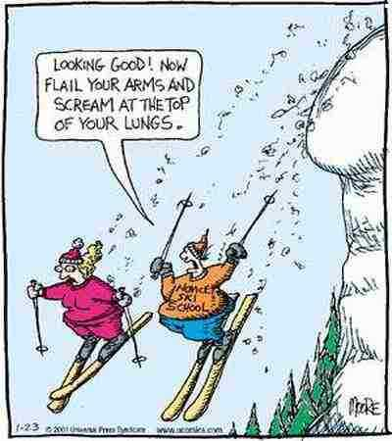
How we learn

Slide 13
Demonstration

Slide 14
What went wrong?
The patient was unprepared for what was coming
There was too much information given
The information was too technical
The Practitioner was uncomfortable when the patient expressed emotion

Slide 15
REMAP
Reframe why the status quo isn’t working.
Expect Emotion- respond with empathy
N ame
U nderstand
R espect
S upport
E xplore
Notes:
This is equivalent to what is happening in conversations B,C, And D that Dr. Merkelz refers to, and will present more tomorrow.

Slide 16
Reframe
Convey information (labs, scans, conversations)
Ask/Tell/Ask
Tell me what you understand about…
Can I tell you what I understand about…
So I’m sure we’re on the same page…

Slide 17
Fire a warning shot
Serious news is coming
Things have not gone the way we had hoped.
We’re in a different place now.

Slide 18
Delivering an Effective Headline
Concise, direct, with a prognosis
Lower your voice, slow your speech a bit
No jargon, 5th grade level
What the medical facts mean
One or two sentences that convey core facts

Slide 19
Headline Errors
Too much information
Clear, concise headline
Headline is lost in information
Give more details as needed

Slide 20
Headline
I wish… But I’m worried…
Given this new information, …
Overall, my experience tells me that ____ (more chemo, additional hospitalization, additional consults) would do more harm than good at this point.
Although you have had excellent care, your (condition) is much worse, and no longer responding to treatment.

Slide 21
After the Headline
Notes:
You may to give more information, but let them process then ask questions. Let the emotion come, and respond
Silence until the patient responds is a good rule of thumb.

Slide 22
Expect Emotion
Anger
Sadness
Denial
Disappointment
Overwhelmed
Worried about the future
Suspicious
Notes:
What are some common responses to serious news?

Slide 23
Nurse Statements
Step Examples
Name “It sounds like you are ____”
Understand “This helps me understand what you are thinking.”
“This gives me a glimpse of what you’ve been going thru.”
Respect “I can see that you have done everything you can for your illness”
“You have been an excellent advocate for your _____”
Support “I will do my best to be sure you have what you need.”
“We are here throughout your journey.”
Explore “Could you say more what you mean when you say that….”
“What did you mean when you said….”
Notes:
Statements for articulating empathy
Name- in general, turn down the intensity a notch when you name the emotion (frustrated instead of angry)
Understand- Don’t actually use the words “I understand”
Respect-praise helps the person feel you are on their side.
Support- Making a commitment is a powerful statement
Explore-Asking a focused question prevents this from seeming obvious

Slide 24
Good communication takes time, but poor communication takes even more time.

Slide 25
Demonstration

Slide 26
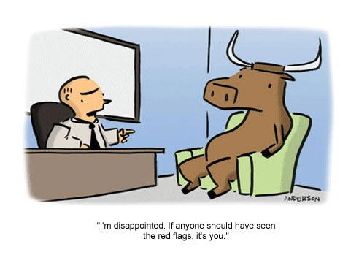
Getting off track
What went well?
Ask/Tell/Ask
Fired a warning shot
Delivered a good headline
Processed the emotion
How did the conversation go off the rails?
The Practitioner didn’t try to understand what is important to the patient before moving forward with a recommendation.

Slide 27
REMAP
Map Out-big picture, values, what’s important
Align-Yourself and the team with the patient’s or family member’s values.
Plan-medical interventions that match the patient’s values.
Notes:
Once you have delivered the headline, and dealt with the emotion, the patient or family member is usually in a good place to discuss plans going forward.

Slide 28
REMAP
Map Out-big picture, values, what’s important
Given this situation, what is most important for you now?
Understanding how things have changed, how would you like to live your life moving forward?

Slide 29
REMAP
Align-Yourself and the team with the patient’s or family member’s values.
“It sounds like what is most important to you is… (family, being free of pain, maintaining as much independence as possible)

Slide 30
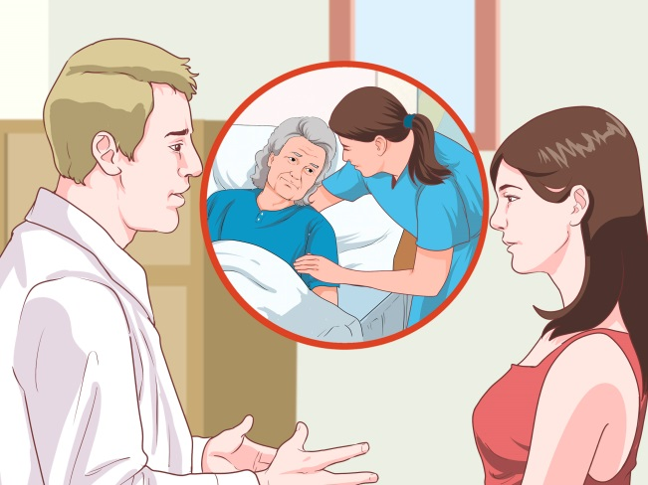
REMAP
Plan-medical interventions that match the patient’s values. (home health, hospice, referrals)
Based on what you have told me, the next best step might be_____.”
For this situation, here are some things we can offer you.”
Notes:
Don’t forget lymphedema therapy!

Slide 31
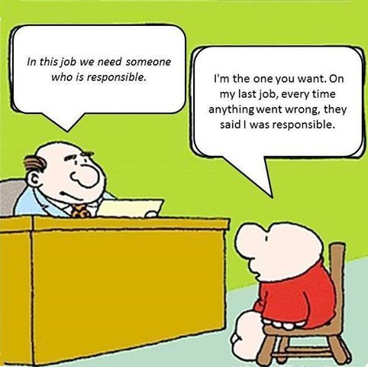
Summing up
Questions?
More Information:
www.vitaltalk.org
Vital talk tips app for iPhone and android

Slide 32
Serious Illness Conversation Guide
© 2015 Ariadne Labs: A Joint Center for Health Systems Innovation
(www.ariadnelabs.org) and Dana-Farber Cancer Institute

Slide 33
Conversation Guide
Prognosis
Share prognosis as a range, tailored to information preferences
“Here’s the best case, worst case, and most likely”
Use 25th %ile, 75th %ile
Hours, days, weeks, months, years?

Slide 34
Competence vs. Decisional Capacity
Competence
Legal determination (a judge determines)
Decisional Capacity
Determined by a physician
Does NOT require evaluation by a psychiatrist
Used by a jud

Slide 35
Serious Illness Conversation Guide
1. Set up the conversation
۰ Introduce purpose
۰ Prepare for future decisions
۰ Ask permission
“I’d like to talk about what is ahead with your illness and do some thinking in advance about what is important to you
so that I can make sure we provide you with the care you want — is this okay?”
2. Assess understanding
and preferences
“What is your understanding now of where you are with your illness?”
“How much information about what is likely to be ahead with your illness would you like from me?”
3. Share prognosis
۰ Share prognosis
۰ Frame as a “wish…worry”,
“hope...worry” statement
۰ Allow silence, explore emotion
4. Explore key topics
۰ Goals
۰ Fears and worries
۰ Sources of strength
۰ Critical abilities
۰ Tradeoffs
۰ Family

Slide 36
5. Close the conversation
۰ Summarize
۰ Make a recommendation
۰ Check in with patient
۰ Affirm commitment
7. Communicate with key clinicians
“I want to share with you my understanding of where things are with your illness...”
Uncertain: “It can be difficult to predict what will happen with your illness. I hope you will continue to live well for
a long time but I’m worried that you could get sick quickly, and I think it is important to prepare for that possibility.”
OR
Time: “I wish we were not in this situation, but I am worried that time may be as short as ___ (express as a range,
e.g. days to weeks, weeks to months, months to a year).”
OR
Function: “I hope that this is not the case, but I’m worried that this may be as strong as you will feel, and things are likely
to get more difficult.”
“What are your most important goals if your health situation worsens?”
“What are your biggest fears and worries about the future with your health?”
“What gives you strength as you think about the future with your illness?”
“What abilities are so critical to your life that you can’t imagine living without them?”
“If you become sicker, how much are you willing to go through for the possibility of gaining more time?”
“How much does your family know about your priorities and wishes?”
“I’ve heard you say that ___ is really important to you. Keeping that in mind, and what we know about your illness,
I recommend that we ___. This will help us make sure that your treatment plans reflect what’s important to you.”
“How does this plan seem to you?”
“I will do everything I can to help you through this.”
6. Document your conversation

Slide 37
Suggested Resources/Readings
Missouri “Life Choices” – free advance directive
CAPC (Center to Advance Palliative Care) – you may enroll for free with a health.missouri.edu email
Geri-pal blog http://www.geripal.org/2013/09/outcomes-of-in-hospital-cpr-not-as-rosy.html
Being Mortal: Medicine and What Matters in the End by Atul Gawande, MD
Dying Well: Peace and Possibilities at the End of Life by Ira Byock, MD
The Best Care Possible: A Physician’s Quest to Transform Care Through the End of Life by Ira Byock, MD
When Breath Becomes Air by Paul Kalanithi, MD

Slide 38
Summary
Conversations regarding poor prognosis, end-of-life options including hospice, DNAR status and “bad news” are difficult –
But they are vitally important
You must master balancing Honesty with Empathy and Hope
Develop your own framework so you are not “shooting from the hip…”
Serious Illness Conversation Guide, ADAPT, SPIKES, etc

Slide 39
Citations
Chan, et al. Long-Term Outcomes in Elderly Survivors of In-Hospital Cardiac Arrest. N Engl J Med 2013; 368:1019-1026March 14, 2013
http://www.geripal.org/2013/09/outcomes-of-in-hospital-cpr-not-as-rosy.html
Development and Validation of the Good Outcome Following Attempted Resuscitation (GO-FAR) Score to Predict Neurologically Intact Survival After In-Hospital Cardiopulmonary Resuscitation. Ebell, et al. JAMA Intern Med. 2013;173(20):1872-1878.

