Slide 1
Targeted Therapies: The Cancer Revolution
Implications in Hospice Patients
Notes:
Good morning ladies and gentleman. Thank you for the kind introduction. It is my pleasure and honor to be presenting to this audience. I have been assigned the task of reviewing the huge influx of targeted therapies that have been approved in the last 8-10 years which has not only caused some distress to the general medical community but has overwhelmed oncologists as well. Getting impossible to keep up with this avalanche of new agents that get approved almost on a daily basis Initially I wondered how I can integrate this talk in a Hospice meeting but I soon realized that this may be very timely. These treatments are making many cancers a chronic disease like Diabetes or Hypertension the hospice medical directors will come across these names as they admit patients for diseases like end stage COPD or CHF.
In the time allotted I can probably just scratch the surface but will try to do the best to give a working knowledge to the Hospice personnel

Slide 2
Cancer Trajectory
A
Functional Status
Time
Cancer
Notes:
What is important to understand that we cannot lump all cancers together. CML, CLL breast cancer, prostate cancer, give example of Privett

Slide 3
Cancer Trajectory
A
Functional Status
Time
Cancer
Notes:
What is important to understand that we cannot lump all cancers together. CML, CLL breast cancer, prostate cancer, give example of Privett

Slide 4
Objectives
Review mechanism of action of targeted therapies-
The Basics – Targeted therapies 101
Discuss diseases with greatest impact on outcome with targeted therapies
Discuss side effects of these agent, as it relates to Hospice physicians
Discuss checkpoint inhibitors- Immunotherapy
CART cell

Slide 5
Drugs with Major Impact
Imatinib for CML
Transtuzumab for HER-2 positive breast cancer
Rituximab for B-cell malignancies

Slide 6
Diseases impacted by targeted therapies
CML,
Lymphomas/ CLL
Breast cancer
Colon cancer
Kidney cancer
Lung cancer

Slide 7
Cancer treatments
Notes:
Now scientists are figuring out the molecular pathways. We are finding out what makes the cancer cells tick. We are blocking these pathways. These treatments are attacking the cancer cell but in most part not the rest of the body. They are more effective, less toxic and the effects are more durable

Slide 8
Chemotherapy
Notes:
Alk agents- cyclophoamamide, Busulfan, chlorambucil, bendamustine
Antimetabolites- 5 flourouracil, capecitabine fludarabine, gemcitabine pemetrexed
Topoisomerase inhibitors, Irinotecan, topotecan, etoposide teniposide
Microtubule Taxanes, vinca alkaloids like VCR, Vinblastine

Slide 9
Notes:
Tkis, EGFR inhibitors, MToR inhibitors , Pi3 kinase inhibitors, hedgehog inhibitors, angiogenesis inhibitors

Slide 10
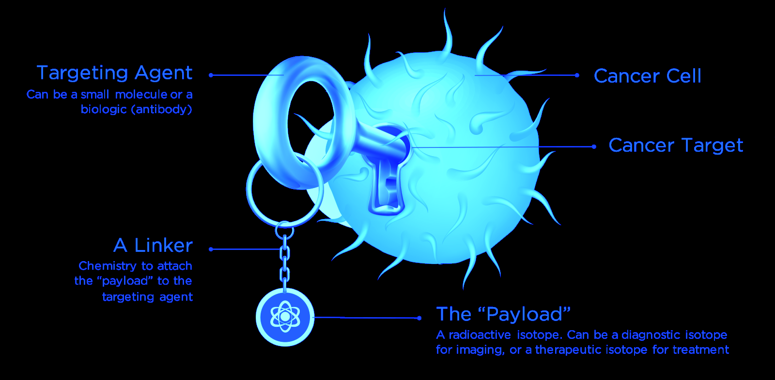

Slide 12
Radio-immuno-conjugates

Slide 13
Ibritumomab Tiuxetin - Zevalin

Slide 14
Targeted agents with a linker
Targeted agent conjugated with chemotherapeutic agent
TDM-1 – Ado-Transtuzumab- HER-2 target linked to Mtansine
Brentuximab CD30 targeted agent linked to a microtubule.
Hodgkin’s lymphoma
Anaplastic large cell Lymphoma
Targeted agent conjugated to a radioisotope
Ibritumomab Tiuxetin (Zevalin) radio-isotope linked to Rituxan
Low grade lymphomas

Slide 15
Targeted therapies
Small molecule
Imatinib - Gleevec
Sunitinib - Sutent
Sorafenib - Nexavar
Pazopinib - Votrient
Ibrutinib – Imbruvica
Antibody therapy
Rituximab - Rituxan
Transtuzumab - Herceptin
Bevacuzumab - Avastin

Slide 16
Targeted therapies
Tyrosine Kinase inhibitors
Imatinib - Gleevec
Sunitinib - Sutent
Sorafenib - Nexavar
Pazopinib - Votrient
Ibrutinib – Imbruvica
Pi-3 Kinase inhibitors
Idealalisib
Copanlisib

Slide 17
Targeted therapies
Hedgehog inhibitors
Vismodegib
Sonidegib
MToR inhibitors
Everolimus
Temsirolimus
Antibody therapy
Rituximab - Rituxan
Transtuzumab - Herceptin
Bevacuzumab - Avastin

Slide 18
Notes:
Obinotuzumab, Transtuzumab, Mumabs- Panitumumab, Ililumumab

Slide 19
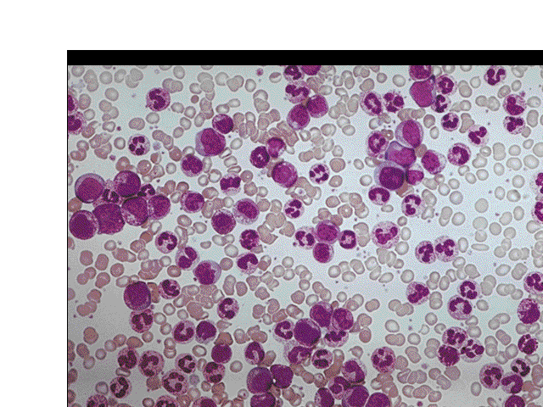
Targeted Therapies
Chronic Myeloid Leukemia

Slide 23
Timeline of CML
2000:Imatinib
1990:Transplant
1980: Interferon
1970:Hydroxyurea
1960: Busulphan
1950: Splenic Irradiation
More than 90% surviving after 60 months
8-10 years
Only potentially curative option
6-7 years
41/2 years
4 years
3 years

Slide 24
Survival in Early Chronic-Phase CML
1.0
Year
Total
Dead
Imatinib
276
14
1990-2000
960
357
0.8
90%
1982-1989
365
266
1975-1981
132
127
1965-1975
123
122
0.6
Proportion Surviving
0.4
0.2
0.0
0
3
6
9
12
15
Years From Referral
The University of Texas M. D. Anderson Cancer Center database.
Notes:
24
24
CML, chronic myeloid leukemia.
Data from the University of Texas M. D. Anderson Cancer Center in Houston show gradual, incremental changes in the proportion of patients who received SCT or interferon alfa therapy surviving over the years from the time of referral. By comparison, the proportion of patients who received imatinib therapy was 90%, despite the short follow-up period.

Slide 25
CML targeted therapies
Imatinib – Gleevec
Dasatinib (Sprycel)
Nilotinib (Tasigna)
Ponatinib (Iclusig)
Bosutinib (Bosulif)
Notes:
T 315I

Slide 26
Side Effects of selective TKIs
Imatinib-
Nausea, abdominal pain, Diarrhea, peripheral edema, anemia
Dasatinib-
Pleural effusion, CHF, pericardial effusion,
Nilotinib –
IHD, edema, PAD, pericardial effusion QT prolonged, death 0.4%
Ponatinib-
IHD, Arrythmias, PAD, edema, rash, intestinal perforation
Bosutinib-
Rash, diarrhea, vomiting abdominal pain
Notes:
T315I

Slide 27
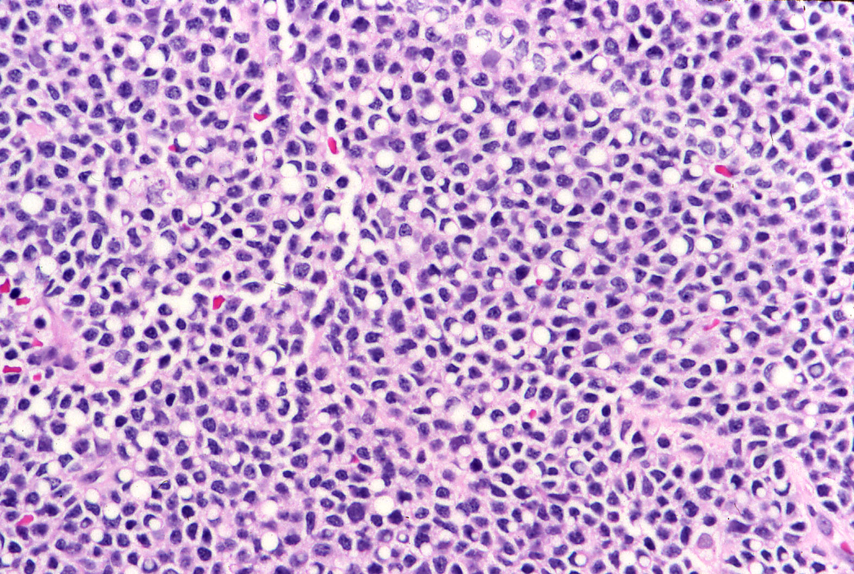
Targeted Therapies
B-cell Malignancies
Lymphomas CLL

Slide 28
Targeted Therapies In Lymphomas and CLL
IL-2 Receptor
(CD25, CD122, CD132)
ONTAK®
(denileukin diftitox)
Lymphocide®
(epratuzumab)
Rituxan®
(rituximab)
Gazyva
Obinotuzumab
Zevalin®
(⁹⁰Y- Ibritumomab)
CD22
CD20
CD44
HLA-DR
Campath®
(alemtuzumab)
CXCR4
CD52
Hulkkonen. Leukemia. 2002;16:178; Tsilivakos. Leukemia. 1994;8:1571;
Rosolen. Blood. 1989;73:1968; Nakase. Leukemia Res. 1994;18:855.

Slide 29
Improving Survival of Follicular NHL: Impact of Antibody-Based Therapy
OS by Treatment
100
1990s-2000s
80
60
1990s
Overall Survival (%)
40
1980s
4-Year
N Death Estimate
CHOP + Mab 179 18 91%
ProMace 425 189 79%
CHOP 356 226 69%
20
0
0
2
4
6
8
10
Years After Registration
Reprinted with permission. © 2008 American Society of Clinical Oncology. All rights reserved. Fisher RI, et al. J Clin Oncol. 2005; 23:8447-8452.

Slide 30
Treatment of aggressive NHL
CHOP
CYTOXAN 750 mg/m2 DAY 1
DOXORUBICIN 50mg/m2 DAY 1
VINCRISTINE 1.4mg/m2 mg DAY 1
PREDNISONE 100mg /day 1- 5

Slide 31
National High Priority Lymphoma Study- S8516
100
CHOP
m-BACOD
80
ProMACE-CytaBOM
MACOP-B
60
Patients (%)
40
20
0
0
1
2
3
4
5
6
Year
Adapted from Fisher. N Engl J Med. 1993;328:1002.

Slide 32
CHOP ± Rituximab in DLBCL: 7-Yr Survival Results
OS (N = 399)
1
CHOP
0.8
R-CHOP
0.6
Survival Probability
0.4
0.2
P = .0004
0
*P < .05 (multivariate analysis).
0
1
2
3
4
5
6
7
8
Years
Coiffier B, et al. ASCO 2007. Abstract 8009.
Notes:
CHOP, cyclophosphamide, doxorubicin, vincristine, prednisone; DLBCL, diffuse large B-cell lymphoma; LDH, lactate dehydrogenase; OS, overall survival; R-CHOP, rituximab, cyclophosphamide, doxorubicin, vincristine, prednisone.
The benefit of chemoimmunotherapy over chemotherapy held with subsequent follow-up of the GELA LNH-98.5 study. These results were published and presented by the group from France. Shown here are the 7-year survival data from the GELA trial, demonstrating continued benefit of R-CHOP over CHOP chemotherapy.

Slide 34
Side effects of Rituximab
Need to check for Hep-B as it can reactivate hepatitis
Serious allergic reactions
Rash, skin peeling, mouth ulcer
Low wbc counts- increased risk of infections
Tumor Lysis syndrome
Nausea, vomiting fatigue
Cardiac, kidney, stomach issues
Progressive multifocal leukoencephalopathy

Slide 35
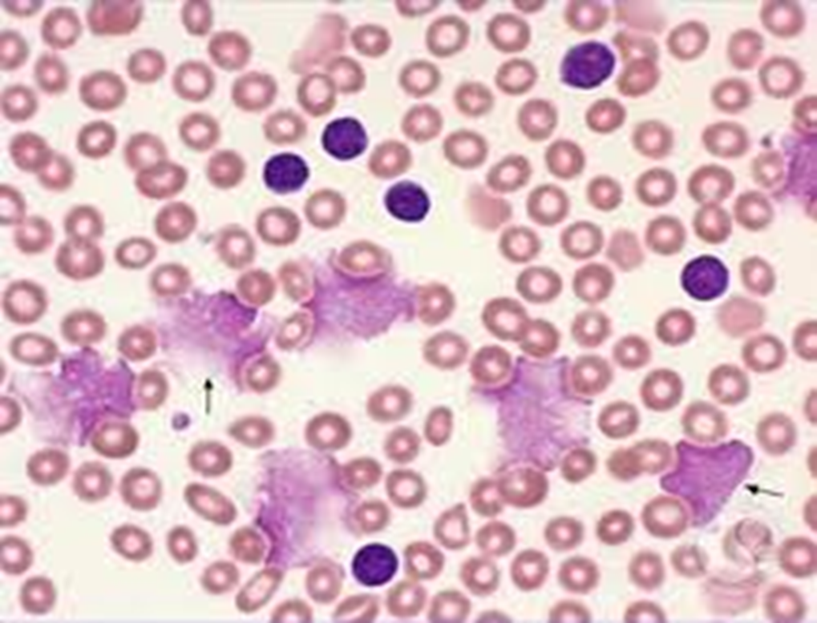
Targeted Therapies
CLL

Slide 36
CLL- Diagnosis
Massive lymphadenopathy
Axillary lymphadenopathy

Slide 38
CLL11 Trial: Obinotuzumab PFS Head-to-Head Comparison
Obinutuzumab-chlorambucil Rituximab-chlorambucil
1.0
0.9
Stratified HR: 0.39 (95% CI: 0.31-0.49; P < .0001)
0.8
0.7
0.6
Probability of PFS
0.5
0.4
0.3
0.2
0.1
15.2
26.7
0
0
3
6
9
12
15
18
21
24
27
30
33
36
39
Mos.
Goede V, et al. N Engl J Med. 2014;[Epub ahead of print].
Notes:
PFS, progression-free survival.

Slide 39
BTK Inhibitor
Burger JA et al N Engl J Med 2015; 373: 2425-2437

Slide 40
Side effects of BTK Inhibitors- Ibrutinib
Bleeding- Gi bleeding, Hematuria, post procedural hemorrhage
Cardiac arrythmias- Atrial fibrillation
Infections, PML, PJP have occurred
Rebound elevation of WBC count
HTN, tumor lysis, embryo-fetal toxicity
Cytopenias, nausea, fatigue, musculoskeletal pain

Slide 41
Targeted Therapies
Breast Cancer

Slide 42
Current Clinical Subtypes in Breast Cancer

Slide 44
Targeted therapy
Selective estrogen receptor modulators – SERM’s
Tamoxifen (Nolvadex)
Raloxifene (Avista)
Fulvestrant (Faslodex) SERD
Aromatase inhibitors
Anastrozole ( Arimidex)
Letrozole ( femara )
Exemestane ( Aromasin)

Slide 45
Side effects of SERM’s and AI’s
SERM’s
Hot flashes
Vaginal dryness
Thromboembolism
Uterine cancer
Mood swings
AI’s
Osteopenia/osteoporosis
Arthralgias
hyperlidemia

Slide 46
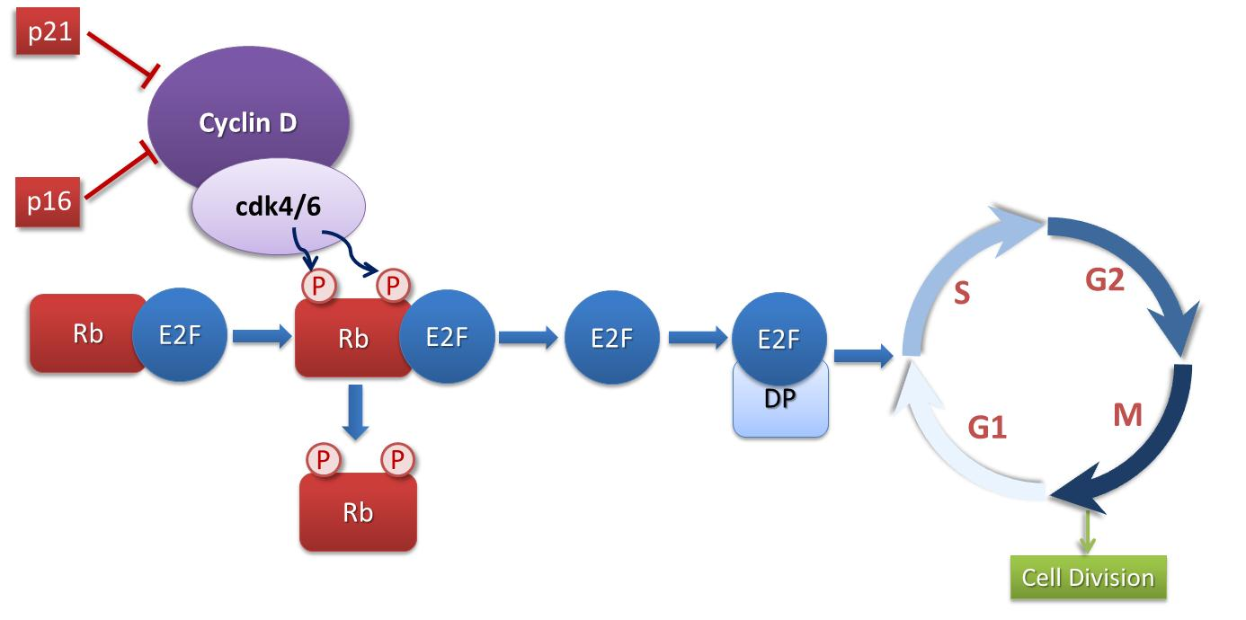
CDK 4/6 Regulates G1➔S Cell Cycle Progression
Palbociclib
Abemaciclib
Ribociclib
CDK 4/6, cyclin-dependent kinase 4/6; M, mitosis; Rb, retinoblastoma.
Adapted from Finn et al, Breast Cancer Res. 2016; DOI: 10.1186/s13058-015-0661-5.
Notes:
Finn RS, Aleshin A, Slamon DJ, et al. Targeting the cyclin-dependent kinases (CDK) 4/6 in estrogen receptor-positive breast cancers. Breast Cancer Res. 2016; DOI: 10.1186/s13058-015-0661-5.
CDK4/CDK6 phosphorylates Rb, which lifts pRb’s transcriptional repression of E2F, resulting in transcription of S-phase–specific target genes.
The cyclin D/cyclin-dependent kinase 4/6/retinoblastoma pathway and the cell cycle. The mammalian cell cycle is tightly regulated. In the context of breast cancer, both steroid and peptide growth factors drive proliferation through cyclin D/CDK 4/6 activation. This results in the hyperphosporylation of pRb as G1 progresses. When retinoblastoma protein (pRb) is hyper-phosphorylated, the transcription factor E2F is released and the cell cycle progresses through S phase. Small molecule kinase inhibitors of CDK 4/6 aim to block the hyper-phosphorylation of pRb inducing a G1 arrest and preventing proliferation.

Slide 47
CDK 4/6 inhibitors
Palbociclib – Ibrance
Neutropenia, fatigue, nausea
Ribociclib
Neutropenia, QT prolongation
Abemaciclib
CNS penetration, less neutropenia, diarrhea
M-ToR Inhibitor
Everolimus- Mucositis, Pneumonitis

Slide 48
PFS: Investigator-Assessed (ITT Population)
March 2017: Palbociclib received regular FDA approval for HR+/HER2- advanced or metastatic breast cancer in combination with an aromatase inhibitor as initial endocrine based therapy in postmenopausal women
100
75
50
Progression-Free Survival, %
25
Letrozole +Palb
Letrozols + placebo
0
0
3
6
9
12
15
18
21
24
27
30
33
Time, mo.
Finn RS, Martin M, Rugo HS, et al J Clin Oncol 2016;34: abs 507
ITT, intention to treat; LET, letrozole; NR, not reached; PAL, palbociclib; PCB, placebo; PFS, progression-free survival.
Finn et al. J Clin Oncol. 2016;34: abstract 507.
Notes:
Finn RS, Martin M, Rugo HS, et al. PALOMA-2: Primary results from a phase III trial of palbociclib (P) with letrozole (L) compared with letrozole alone in postmenopausal women with ER+/HER2– advanced breast cancer (ABC). J Clin Oncol. 2016;34: abstract 507.
Palbociclib combined with letrozole significantly improved median PFS compared with placebo plus letrozole as first-line therapy in women with ER+/HER2- advanced breast cancer
>10 month improvement in median PFS was observed
Clinical benefit from palbociclib was also demonstrated across all pre-specified subgroups
These data confirm PALOMA-1 results and represent the longest front-line improvement in median PFS seen to date in women with advanced ER+ breast cancer

Slide 49
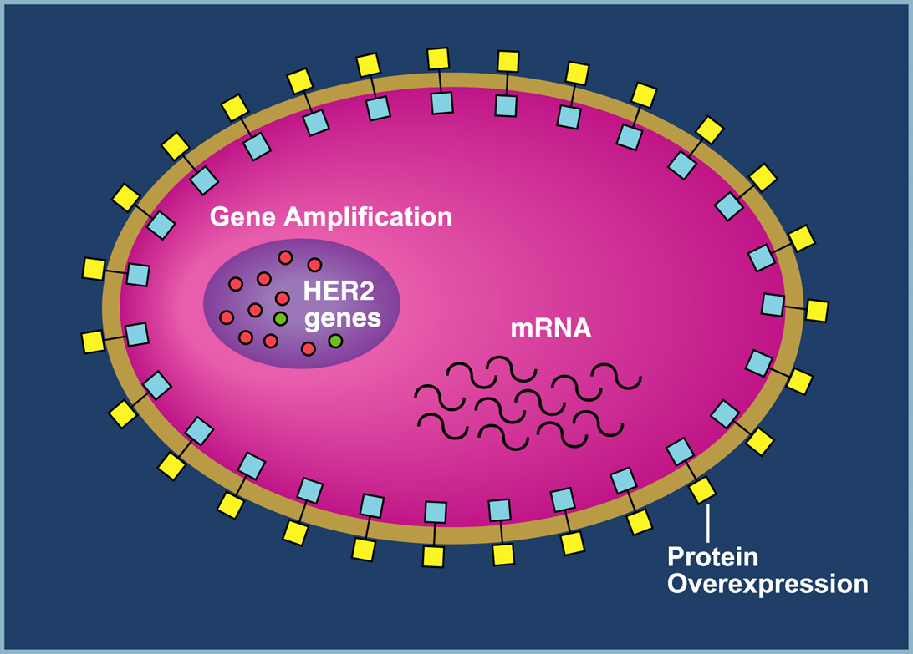
Targeted Therapies
HER-2 Positive Disease

Slide 50
HER-2 positive breast cancer

Slide 51
HER-2 signaling pathway

Slide 52
Transtuzumab, Pertuzumab

Slide 53
Small Molecules Lapatinib, Neratinib

Slide 54
Ado-Transtuzumab- TDM-1

Slide 55
B31/N9831: Transtuzumab + Chemo (DFS)
100
AC→TH
90
87%
85%
AC→T
80
75%
67%
70
n Events
AC→T 1679 261
AC→TH 1672 134
60
HR = 0.48; P < .0001
50
0
1
2
3
4
5
Years From Randomization
Romond EH et al. ASCO 2005. Oral presentation; Romond EH et al. N Engl J Med. 2005;353:1673-1684.
Notes:
Disease-free survival (DFS) was significantly longer in the AC→TH (trastuzumab) group compared to the AC→T (control) group (hazard ratio [HR] = 0.48; P <.0001) with 134 events in the AC→TH (trastuzumab) group versus 261 events in the AC→T (control) group.^{1,2}
At 3 years, the percentage of patients alive and disease-free was 87% in the AC→TH (trastuzumab) group versus 75% in the AC→T (control) group, an absolute difference of 12%.
At 4 years, the absolute difference was greater than 3 years at 18%. The percentage of patients alive and disease-free was 85% in the AC→TH (trastuzumab) group versus 67% in the AC→T (control group).
References
1. Romond EH, Perez EA, Bryant J, et al. Doxorubicin and cyclophosphamide followed by paclitaxel with or without trastuzumab as adjuvant therapy for patients with HER-2 positive operable breast cancer. Combined analysis of NSABP-B31/NCCTG-N9831. American Society of Clinical Oncology 41st Annual Meeting; May 13-17, 2005; Orlando, Fla. Oral presentation.
2. Romond EH, Perez EA, Bryant J, et al. Trastuzumab plus adjuvant chemotherapy for operable HER2-positive breast cancer. N Engl J Med. 2005;353:1673-1684.
Slide 6

Slide 56
HER-2 targeted therapies
Monoclonal antibodies
Transtuzumab Herceptin
Pertuzumab Perjeta
Monoclonal antibodies linked to chemotherapy
TDM-1 Ado-Transtuzumab
Small molecules
Lapatinib
Neratinib

Slide 57
HER-2 directed therapies
90% of patients with HER-2 positive disease died in the past
Now 90% of patients are living or are cured
HER-2 positivity has gone from worst to best
New staging system downstaging HER-2 positive disease because of the good prognosis

Slide 58
Side effects of HER-2 directed therapies
Serious
Cardiac toxicity
Respiratory toxicity
Infusion reactions
Common side effects
Nausea, vomiting headache
Body pain, weakness, rash

Slide 59
Targeted Therapies
Colon Cancer

Slide 60
EGF Pathway
EGFR
Shc
Grb2
Sos-1
PI3K
Ras
AKT
MEKK-1
Raf
MKK-7
MEK
mTOR
JNK
ERK
Apoptosis Resistance
Proliferation
Transcription

Slide 64
Targeting VEGF: The Bevacizumab Story
Bevacizumab
VEGF
P
P
P
P

Slide 66
Targeted therapies for colon cancer
KRAS wildtype
-- Cetuximab
Panitumumab
BRAF mutation
Vemurefenib
VEGF inhibitor
Bevacuzumab (Avastin)
Multitargeted inhibitor
regorefenib

Slide 67
Side effects of EGFR directed therapies
Cetuximab
Anaphylactic reaction
Rash- acneform eruption
Chest pain, wheezing , shortness of breath
Redness or crusting around hair follicles
Panitumumab
Less anaphylaxis

Slide 68
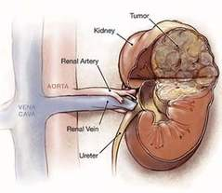
Targeted therapies
Kidney Cancer

Slide 69
Renal Cell Carcinoma
HIF
VHL GENE
Temsirolimus
Everolimus
=
Bevacizumab
VEGF
PDGF
TGF
Sunitinib & Sorafenib, Pazopanib, Axitinib
Cabozentanib, Lenvatinib,

Slide 70
Therapeutic Inhibition of VEGF in RCC
Binding antibodies to the VEGF protein
Bevacizumab
VEGFR inhibitors
Sunitinib, Sorafenib, Pazopinib, Axitinib
Cabozentenib, Lenvatinib
MTOR Inhibitors
Temsirolimus Inhibits HIF directly
Everolimus

Slide 71
Side effects of non-selective TKI’s
Hypertension
Fatigue, asthenia
Hand/foot syndrome/ Rash
Diarrhea
Nausea vomiting
Taste changes
Bowel perforation
Thrombo-embolic phenomenon

Slide 72
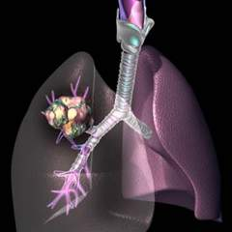
Targeted Therapies
Non-Small Cell Lung Cancer

Slide 74
Targets for NSCLC
EGFR -10-15% - Erlotinib, Gefitinib, Afatinib, Osimertanib
EML/ALK 2-3 % - Crizotinib, Ceritinib, Alectinib, Brigatinib
ROS-1 -1-2% - Crizotinib
Splicing 14 mutation (1-2%) – Crizotinib
BRAF – (1-2%) Trametenib + Dabrefinib, Vemurafenib
HER-2 – (1-2%) Lapatinib ( HER-2 insertion 19 del, not HER-2 amplified)
RET – (2-3%)- MEK inhibitors- Cabozentenib, Vandetenib
NTRK 1- (1-2%) Larotrectinib
PDL-1 – Immunotherapy-

Slide 75
Immunotherapy
Checkpoint Inhibitors

Slide 76
Immunotherapy

Slide 77
Immunotherapy

Slide 78
Immunotherapy

Slide 79
Immunotherapy

Slide 80
Immunotherapy

Slide 81
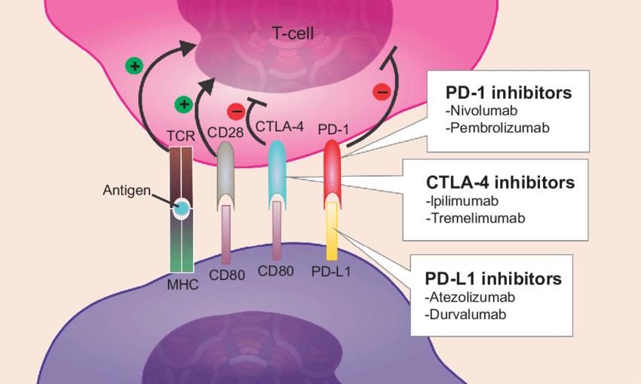

Slide 82
Side effects of Immuno-therapy
Immune mediated side effects
Colitis
Pneumonitis
Thyroiditis
Dermatitis
Myocarditis
Hepatitis
Nephritis
Hypopitutiarism
Hypoadrenalism
Exacerbation of underlying autoimmune diseases

Slide 83
Pallimedinib
Low cost/ cost savings
High patient and family satisfaction
Improves quality of life
Improves pain scores
Lowers depression scores
decreases 30 day hospital readmission
Above all “improves survival”

