Slide 2
Compassus Care Model
What’s Different and How Does it Work? Making it work in the IDT
Paul Tatum MD MSPH CMD FAAHPM AGSF
JefCo Region Medical Director

Slide 3
My tasks to address:
What does all of this mean for quality?
Why is the objective measure of a subjective experience so important to achieving quality?
How do we as medical directors make that happen at IDT, because this is where our influence is – so how is the IDT experience changed by the model?

Slide 4
My tasks to address:
What does all of this mean for quality?
Why is the objective measure of a subjective experience so important to achieving quality?
How do we as medical directors make that happen at IDT, because this is where our influence is at – so how is the IDT experience changed by the model?

Slide 5
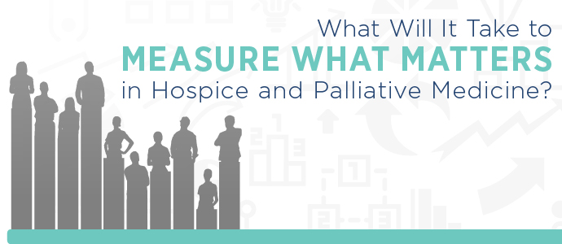

Notes:
Joe Rotella article in AAHPM quarterly
Measure what matters 2015 emphasize quality measurement in early stage of development and measures not ready fo ruse in pay for performance
Serious limitationsin measures, but the good news is
Quality for our field focused on triple aim
Btter care of patients
Better care of populations
Lower costs
Hospice is well positioned to succeed and compassus is working to make it happen

Slide 6
Compassus Vision
Compassus is the preeminent American health care provider dedicated to delivering unsurpassed comfort to those needing compassionate navigation through life’s closing chapters.
Compassus adheres to and promotes the model of patient-centered, evidence-based care delivery that has reformed American health care and generates unparalleled value by having reversed the twin health care trends of inferior patient outcomes and upward-spiraling costs.
Compassus achieved and maintains this leadership position by serving the needs and fulfilling the expectations of patients, physicians and colleagues.

Slide 7
Compassus Vision
Compassus is the preeminent American health care provider dedicated to delivering unsurpassed comfort to those needing compassionate navigation through life’s closing chapters.
Compassus adheres to and promotes the model of patient-centered, evidence-based care delivery that has reformed American health care and generates unparalleled value by having reversed the twin health care trends of inferior patient outcomes and upward-spiraling costs.
Compassus achieved and maintains this leadership position by serving the needs and fulfilling the expectations of patients, physicians and colleagues.

Slide 8
Compassus Vision
Compassus is the preeminent American health care provider dedicated to delivering unsurpassed comfort to those needing compassionate navigation through life’s closing chapters.
Compassus adheres to and promotes the model of patient-centered, evidence-based care delivery that has reformed American health care and generates unparalleled value by having reversed the twin health care trends of inferior patient outcomes and upward-spiraling costs.
Compassus achieved and maintains this leadership position by serving the needs and fulfilling the expectations of patients, physicians and colleagues.

Slide 9
Compassus Vision
Compassus is the preeminent American health care provider dedicated to delivering unsurpassed comfort to those needing compassionate navigation through life’s closing chapters.
Compassus adheres to and promotes the model of patient-centered, evidence-based care delivery that has reformed American health care and generates unparalleled value by having reversed the twin health care trends of inferior patient outcomes and upward-spiraling costs.
Compassus achieved and maintains this leadership position by serving the needs and fulfilling the expectations of patients, physicians and colleagues.
NOT IDT-Centered Care

Slide 10
Compassus Vision
Compassus is the preeminent American health care provider dedicated to delivering unsurpassed comfort to those needing compassionate navigation through life’s closing chapters.
Compassus adheres to and promotes the model of patient-centered, evidence-based care delivery that has reformed American health care and generates unparalleled value by having reversed the twin health care trends of inferior patient outcomes and upward-spiraling costs.
Compassus achieved and maintains this leadership position by serving the needs and fulfilling the expectations of patients, physicians and colleagues.

Slide 11
OUR MISSION:
The Colleagues of Compassus are committed to keeping The Hospice Promise by delivering the highest quality of care, serving the needs of patients and families and spreading the stories of hospice to those with whom they come into contact.
OUR PHILOSOPHY:
Compassus recognizes death as a natural part of the life cycle, and promotes pain relief and symptom management as appropriate clinical goals.
Compassus affirms life and provides hospice interventions that will seek neither to hasten death nor to postpone it.
Compassus understands that psychosocial and spiritual pain is often as significant as physical pain, and that addressing all three requires the skills of an interdisciplinary team.
Compassus believes that patients and loved ones are an integral part of our Plan of Care.

Slide 12
OUR MISSION:
The Colleagues of Compassus are committed to keeping The Hospice Promise by delivering the highest quality of care, serving the needs of patients and families and spreading the stories of hospice to those with whom they come into contact.
OUR PHILOSOPHY:
Compassus recognizes death as a natural part of the life cycle, and promotes pain relief and symptom management as appropriate clinical goals.
Compassus affirms life and provides hospice interventions that will seek neither to hasten death nor to postpone it.
Compassus understands that psychosocial and spiritual pain is often as significant as physical pain, and that addressing all three requires the skills of an interdisciplinary team.
Compassus believes that patients and loved ones are an integral part of our Plan of Care.

Slide 13
OUR MISSION:
The Colleagues of Compassus are committed to keeping The Hospice Promise by delivering the highest quality of care, serving the needs of patients and families and spreading the stories of hospice to those with whom they come into contact.
OUR PHILOSOPHY:
Compassus recognizes death as a natural part of the life cycle, and promotes pain relief and symptom management as appropriate clinical goals.
Compassus affirms life and provides hospice interventions that will seek neither to hasten death nor to postpone it.
Compassus understands that psychosocial and spiritual pain is often as significant as physical pain, and that addressing all three requires the skills of an interdisciplinary team.
Compassus believes that patients and loved ones are an integral part of our Plan of Care.
NOT IDT-Centered Care

Slide 14
Quality Care Model
Specific tools are utilized to achieve
meaningful clinical outcomes.
Notes:
To support you in your effort to drive meaningful outcomes, we provide a toolkit to help in identifying and delivering patient directed care. The outcomes that are important to patients include having their health care managed. To be safe and having basic needs of cooking, cleaning, hygiene, shopping, etc. be met. To not be a burden onto family and friends. To enjoy some quality of life. To be a part of the decision making process, and to have some say about their own needs. To prepare for ones own death, and ultimately choose to die where they want in the circumstances they have decided.

Slide 15
My tasks to address:
What does all of this mean quality?
Why is the objective measure of a subjective experience so important to achieving quality?
How do we as medical directors make that happen at IDT, because this is where our influence is at – so how is the IDT experience changed by the model?

Slide 16

Well ask yourself: How are we doing?
Compassus achieved and maintains this leadership position by serving the needs and fulfilling the expectations of patients, physicians, colleagues.

Slide 17
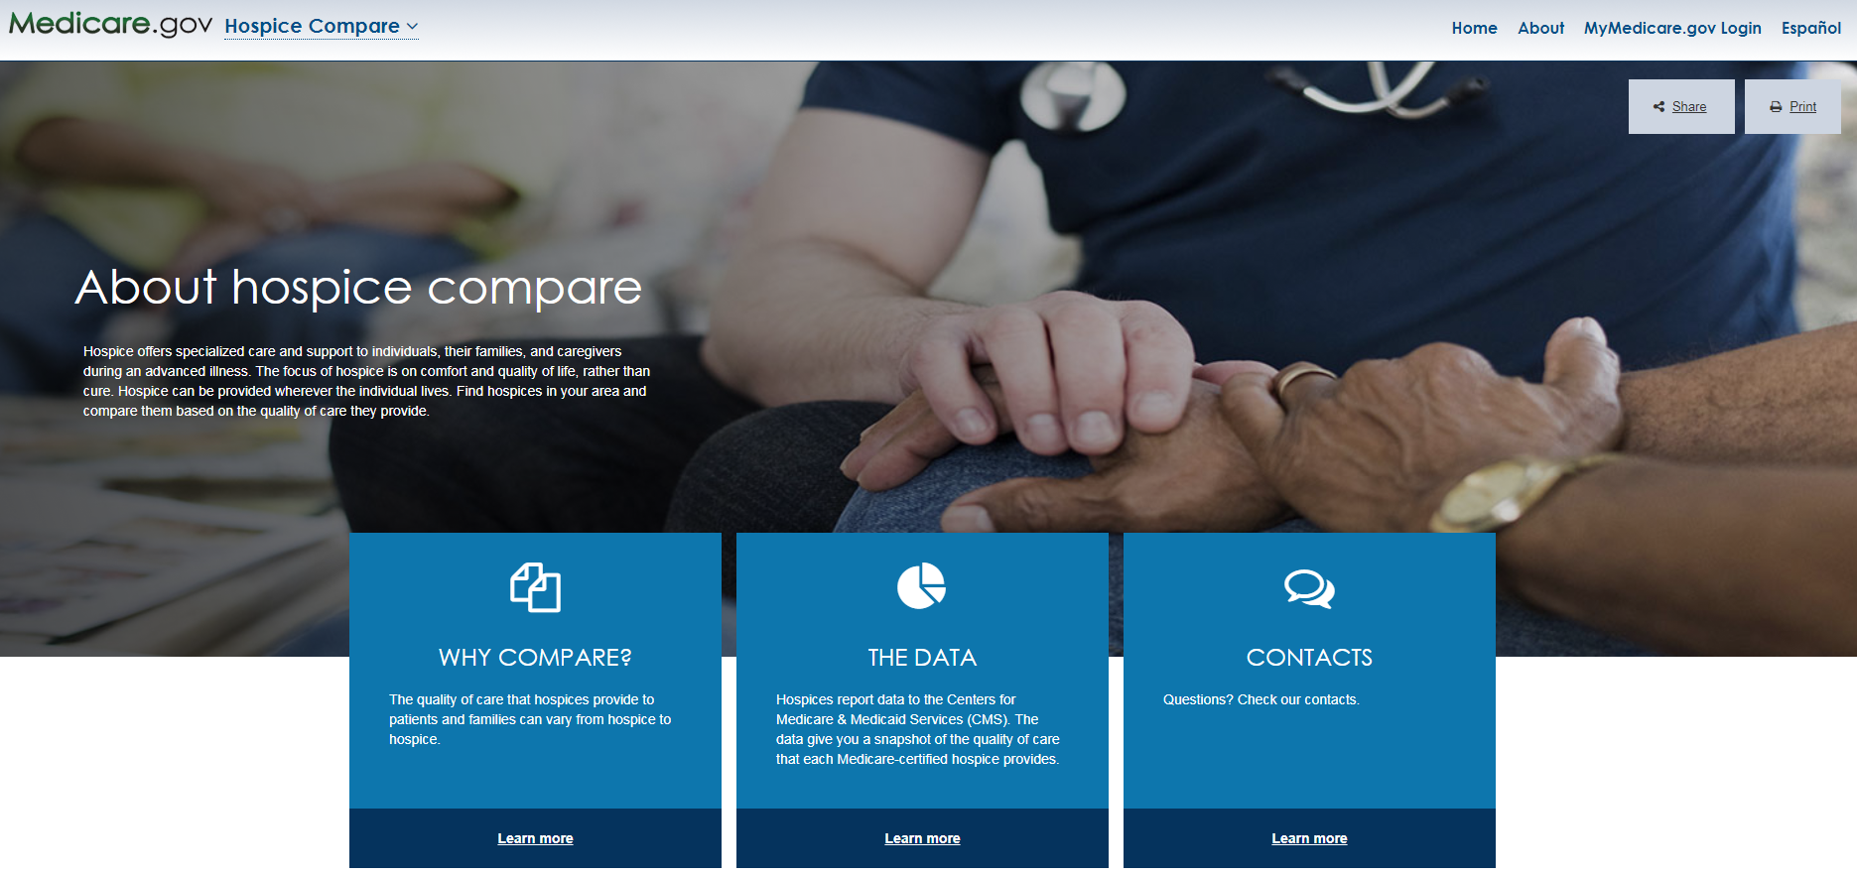

Slide 18
Reminder:
Description of the Seven HQRP Quality Measures
Measure Title (NQF ID) | Measure Description
Treatment Preferences (NQF #1641) | The percentage of hospice patient stays with chart documentation that the hospice discussed (or attempted to discuss) preferences for life-sustaining treatments.
Beliefs/Values Addressed (if desired by the patient) (NQF #1647) | The percentage of hospice patient stays with documentation of a discussion of spiritual/existential concerns or documentation that the patient and/or caregiver did not want to discuss.
Pain Screening (NQF #1634) | The percentage of hospice patient stays during which the patient was screened for pain during the initial nursing assessment.
Pain Assessment (NQF #1637) | The percentage of hospice patient stays during which the patient screened positive for pain and received a comprehensive assessment of pain within 1 day of screening. The data for this measure are collected only if the patient screened positive for pain.
Dyspnea Screening (NQF #1639) | The percentage of hospice patient stays during which the patient was screened for dyspnea during the initial nursing assessment.
Dyspnea Treatment (NQF #1638) | The percentage of hospice patient stays during which the patient screened positive for dyspnea and received treatment within 1 day of the screening. The data for this measure are collected only if the patient screened positive for dyspnea.
Patients Treated with an Opioid who are Given a Bowel Regimen (NQF #1617) | The percentage of patient stays with vulnerable adults treated with an opioid that are offered/prescribed a bowel regimen or documentation of why this was not needed. The data for this measure are collected only if the patient is treated with a scheduled opioid.

Slide 19
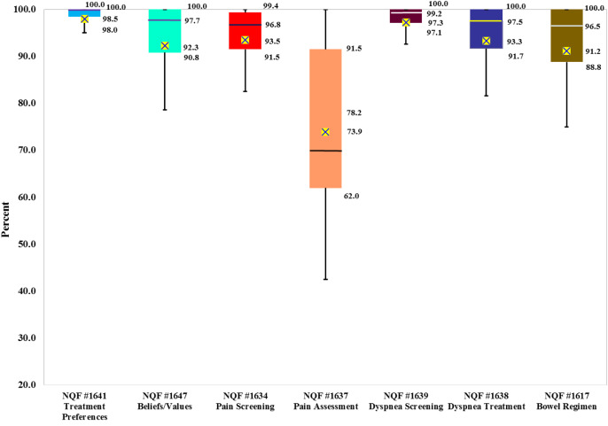
NOTE:
The boxes in the figure represent the interquartile range, and horizontal bars within the box represent the median scores.
The Xs are the mean scores.
The end bars out of the boxes represent the 10th and 90th percentile QM scores.
For NQF #1641, Treatment Preferences, the mean was 97.95%, slightly lower than the median, 98.46%.
Nan Tracy Zheng, Qinghua Li, Laura C. Hanson, Kathryn L. Wessell, Natalie Chong, Noha Sherif, Ila H. Broyles, Jennifer Frank, M. Alexis Kirk, Carol R. Schwartz, Alan F. Levitt, Franziska Rokoske
Nationwide Quality of Hospice Care: Findings from the Centers for Medicare & Medicaid Services (CMS) Hospice Quality Reporting Program (HQRP)
Journal of Pain and Symptom Management, 2017, Available online 10 October 2017
http://dx.doi.org/10.1016/j.jpainsymman.2017.09.016

Slide 20
Notes:
Joe Rotella article in AAHPM quarterly
Measure what matters 2015 emphasize quality measurement in early stage of development and measures not ready fo ruse in pay for performance
Serious limitationsin measures, but the good news is
Quality for our field focused on triple aim
Btter care of patients
Better care of populations
Lower costs
Hospice is well positioned to succeed and compassus is working to make it happen

Slide 21
Quality Care Model
Specific tools are utilized to achieve
meaningful clinical outcomes.
NOT IDT-Centered Care
Notes:
To support you in your effort to drive meaningful outcomes, we provide a toolkit to help in identifying and delivering patient directed care. The outcomes that are important to patients include having their health care managed. To be safe and having basic needs of cooking, cleaning, hygiene, shopping, etc. be met. To not be a burden onto family and friends. To enjoy some quality of life. To be a part of the decision making process, and to have some say about their own needs. To prepare for ones own death, and ultimately choose to die where they want in the circumstances they have decided.

Slide 22
My tasks to address:
Why does all of this mean quality?
Why is the objective measure of a subjective experience so important to achieving quality?
How do we as medical directors make that happen at IDT, because this is where our influence is – so how is the IDT experience changed by the model?

Slide 23

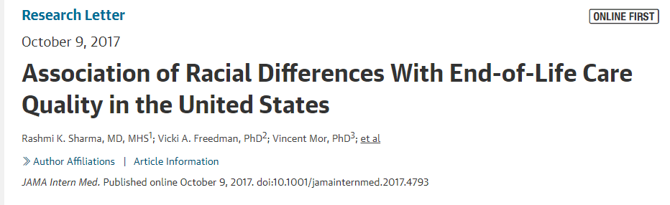
2011 to 2015 data
National Health and Aging Trends Study (NHATS)
Using National Quality Forum measurements
All settings: hospital, long-term care, home with/without hospice

Slide 24
X
2011 to 2015 data
National Health and Aging Trends Study (NHATS)
Using National Quality Forum measurements
All settings: hospital, long-term care, home with/without hospice

Slide 25
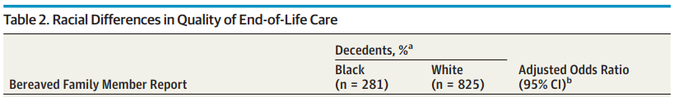
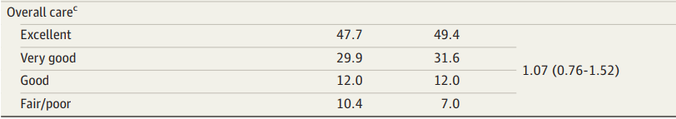
Overall Quality

Slide 26
Overall Quality

Slide 27
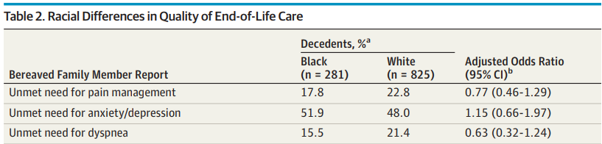
Unmet Symptoms

Slide 28
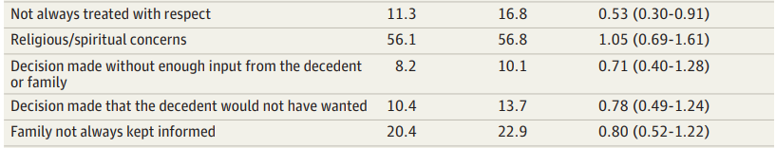
Quality communication/caring

Slide 29

Quality Care Model
Specific tools are utilized to achieve
meaningful clinical outcomes.
WHY is an objective measure of a subjective experience important?
Notes:
To support you in your effort to drive meaningful outcomes, we provide a toolkit to help in identifying and delivering patient directed care. The outcomes that are important to patients include having their health care managed. To be safe and having basic needs of cooking, cleaning, hygiene, shopping, etc. be met. To not be a burden onto family and friends. To enjoy some quality of life. To be a part of the decision making process, and to have some say about their own needs. To prepare for ones own death, and ultimately choose to die where they want in the circumstances they have decided.

Slide 30
My tasks to address:
What does all of this mean for quality?
Why is the objective measure of a subjective experience so important to achieving quality?
How do we as medical directors make that happen at IDT, because this is where our influence is – so how is the IDT experience changed by the model?

Slide 31
How do we as medical directors make that happen at IDT?
§ 418.102 Condition of participation: Medical director
This COP, focuses on medical directors and hospice physicians, requires a hospice to designate one physician as medical director. Another hospice physician may be pre-selected as the “physician designee” to fulfill the duties of the medical director as needed. It also reiterates that the hospice physician must:
  Have a formal relationship with the hospice (employment of contract);
  Certify and recertify the patient’s prognosis taking into account a variety of clinical information; and,
  Be responsible for the medical component of the hospice plan of care.

Slide 32


How do we as medical directors make that happen at IDT?
The 4 S’s Medical Director

Slide 33
How is the IDT experience
changed by the model?

Slide 34
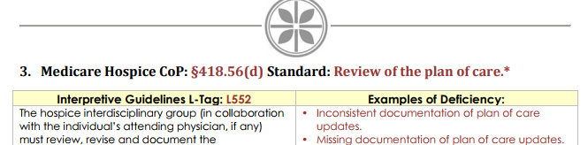
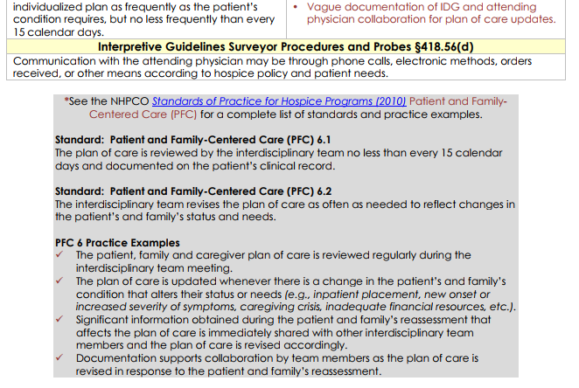
An IDT based on meeting regs

Slide 35

An IDT based on patients
Person-Centered Care
Compassus is leading the transformation of healthcare delivery: continuously and measurably improving the quality of person-centered, physician-driven, team-based care.

Slide 36
What do you really need to do at IDT?

Slide 37
Efficiently do things required!

Slide 38
What do you really need to do at IDT?
New patients’ care plans
Recertifications (and identify difficult recerts ahead of time!)
Address (and anticipate) symptom burdens
Address psychosocial and spiritual/existential issues

Slide 39
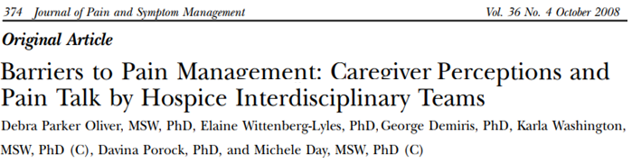
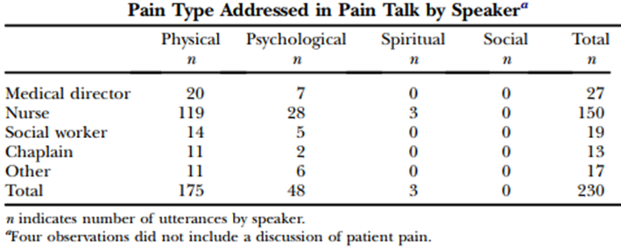

Slide 40
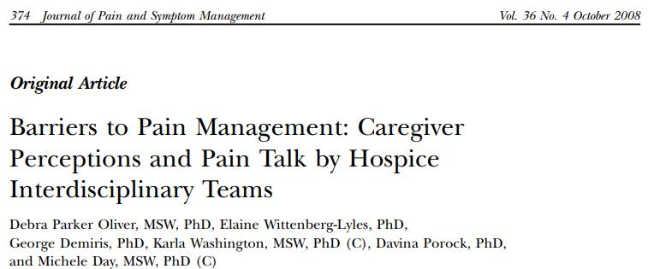
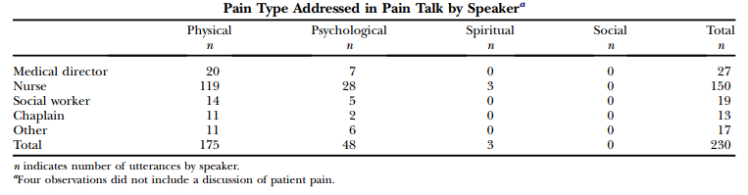
Quality Care Model
Specific tools
are utilized to
achieve
meaningful
clinical outcomes.

Slide 41
Quality Care Model
Specific tools are utilized to achieve
meaningful clinical outcomes.
BUT HOW CAN I ASK MY NURSE TO DO ONE MORE FORM????

Slide 42
Add one more thing
to my plate, and
I will break the plate
over your head!

Slide 43
Steps to implement the change
Enlist the support and involvement of key people
Craft an implementation
plan
Support the plan with consistent behaviors and messages
Develop enabling structures
Celebrate
milestones
Communicate relentlessly
Using
consultants

Slide 44
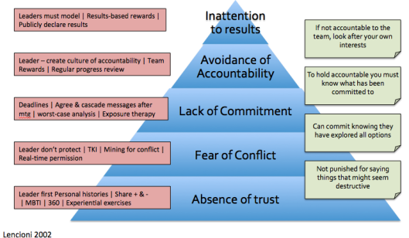
Model 2: Lencioni – The 5 Dysfunctions of a Team

Slide 45
Compassus Quality
Care Model
Profoundly advancing the wellbeing and honoring the dignity of those we serve, helping make the world a better place one family at a time.
Notes:
The care model is one of the answers to the vision set forth by Compassus. (see vision) We all know what we should be doing as health care providers. The quality model built around patient-centered care helps in delivering this goal.

