Slide 2
Profoundly advancing the well-being and honoring
the dignity of those we serve, helping make the world
a better place one family at a time
Notes:
What is it we must do?- understand best practice and how to implement it; lead our teams; abide by regulations
We all know what we should be doing as health care providers. What we lack is a standardized process that helps ensure that high quality care is delivered each and everytime.

Slide 3
Objectives
Introduce outcomes as a guiding methodology to our care process
Discuss establishing best practice that allows your expertise to shine
Notes:
The optimal model of care is one in which patients and families are measurably better because of the services we provided. A methodology puts into practice these key success factors. Central to this process is listening to the words of patients and caregivers – to gain an understanding of values, goals and preferences and to empower patients to make decisions about their care.

Slide 4

Notes:
Significant gaps exist between what patients want and the care they receive

Slide 5
Gap between what patient’s want and what they get
86% Medicare beneficiaries want to spend final days at home
–Barnato 2007
70% hospitalized last 90 days of life
–Teno, 2013
29% receive ICU care in last 30 days
–Teno, 2013
Notes:
Studies are showing that more people are dying at home, and Medicare is considering site of death as a quality measure for end-of-life care. Alarming is transitions in care in the last 90 days of life have increased by 50% to an average of 3 moves, and 10% faced a transition in their last 3 days of life. ICU admission and length of stay are both increasing. Finally although hospice utilization is increasing, the median LOS is less than 3 weeks and 28 percent of hospice users are enrolled for 3 days or less…

Slide 6
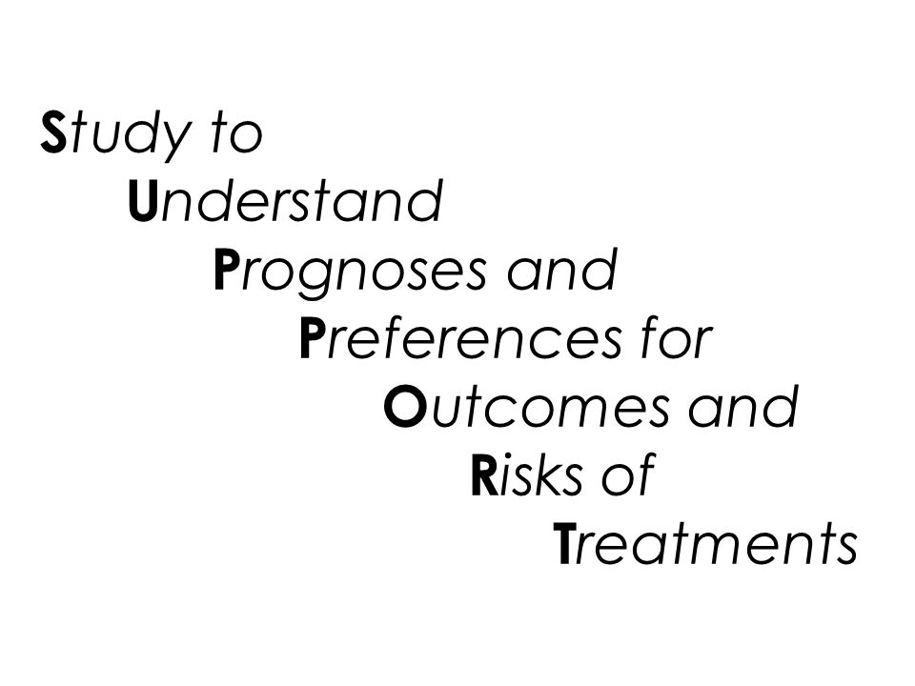

Notes:
In 1994 a landmark study was published that not only looked at how individuals died in the US, but included a project to improve the process: It began with a 2-year observational study (phase 1) followed by a 2-year controlled clinical trial (phase 2)
The objectives of the Robert Wood Johnson Supported study that cost $29 million dollars: To improve end-of-life decision making and reduce the frequency of mechanically supported, painful, and prolonged process of dying

Slide 7
SUPPORT Trial
JAMA 1995
A Controlled Trial to Improve Care for Seriously Ill Hospitalized
Patients: The Study to Understand Prognoses and Preferences
for Outcomes and Risks of Treatments (SUPPORT)
Notes:
PHASE 1: found serious shortcomings in communication, frequency of aggressive treatment, and characteristics of death
Study involving 10,000 patients in 5 teaching hospitals.
Only 50% of physicians knew when their patients preferred to avoid CPR
50% of DNRs were written within 2 days of death
50% of patients experienced moderate to severe pain
PHASE 2:
Intervention group in which physicians received estimates of 6 month survival (over 6 months); estimates of probable severe functional disability at 2 months, and included a specially trained nurse who had multiple contacts with pt, physician and hospital staff to elicit preferences to improve outcomes and encourage attention to pain control:
No improvement in communication, frequency of aggressive treatment and the characteristics of hospital death. Despite the trained nurse the phase 2 intervention failed to improve patient care or outcomes, enhancing opportunities for more pt-physician communication, although advocated, is likely inadequate to change established practices

Slide 8
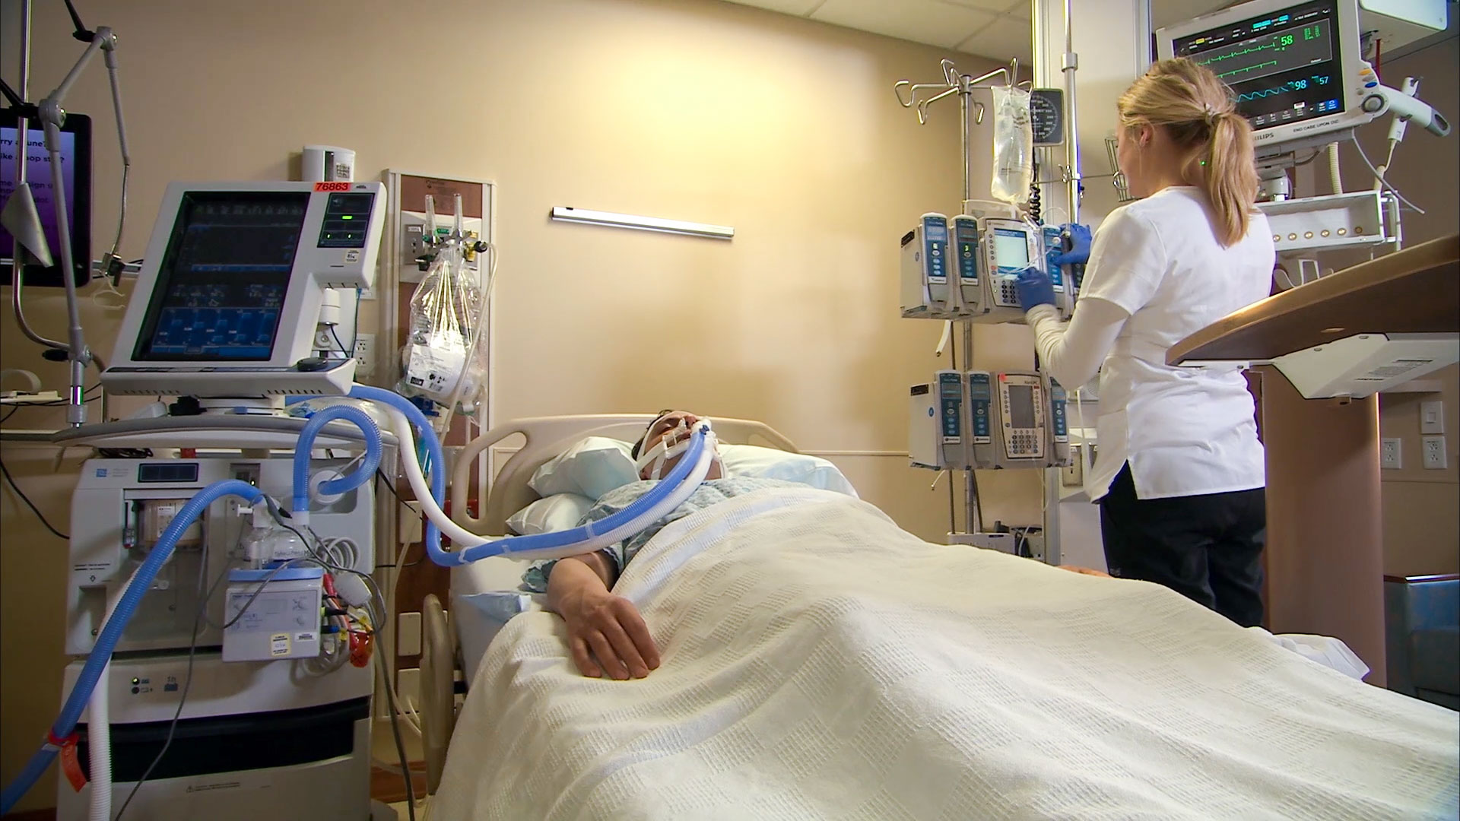
Notes:
This is not the model of quality end-of-life care. Patients deserve to be shown alternative models of care, but the alternative model must be able to demonstrate – through accountable, measurable outcomes- the benefit to the patient. Gaps between what patients want and the care they receive need to be addressed, and the answer comes from the most obvious source… the patient

Slide 9
Gap between what patient’s want and what they get
ASK, and LISTEN to the PERSON being cared for
Patients with serious illness have priorities besides living longer:
  Symptom management and QOL
  Sense of control and completion
  Strengthening relationships
              -Singer, JAMA 1999
              -Steinhauser, JAMA 2000
Notes:
Of course, saying to ask and listen to the patient seems obvious. Who believes this isn’t already happening? Most people believe the care that is being provided is done with full communication with the patient, with a shared understanding of the treatment plan and the risks and benefits of each option…what is actually happening is quite different. Considerable evidence suggests that patients commonly have misunderstandings about their prognosis, for instance: only 1 in 5 patients with advanced metastatic carcinoma who are receiving chemotherapy are fully aware that their treatment is only palliative, not curative.
Weeks JC, et al. Patients’ expectations about effects of chemotherapy for advanced cancer. N Engl J Med 2012; 367: 1616–25

Slide 10

Notes:
The picture of quality end-of-life care can look better. Challenges do exist, including, what outcomes are important for a patient to succeed?

Slide 11

Developing a better way…
One focus:
emphasize health needs, safety, function, and well-being
Compassus Quality Model
Notes:
Not everyone can be a unicorn---that’s why we need BEST PRACTICE. We know from research what outcomes are important to individuals at the end of life:
COMFORT
TO NOT BE A BURDEN
EXISTENTIAL PEACE and SPIRITUALITY
HAVING THEIR HEALTH CARE NEEDS TENDED TO
TO HAVE A SENSE OF WELL-BEING

Slide 12

Notes:
example is the The Stanford Letter Project supported by AMA : The letter project helps people write about what matters most to them at the end of life

Slide 13
Stanford Letter Project
What Matters Most to Me…
(examples: being at home, going to church, playing with my grandchildren).
Notes:
The letter project is a program that allows patients to communicate their desire for the type of treatment they want to receive at end-of-life. The first question on the tool…. Patient reported goals. Specifically, What Matters Most to Me

Slide 14

Notes:
Each of you has a tremendous amount to offer to the patients you are being asked to care for. The greatest asset we have as a company is the willingness and desire of staff like yourselves, to provide quality care at end-of-life. However, as clinicians, we have not been trained to meet the needs of individuals at life’s end and instead have medicalized the dying experience. In his book, Being Mortal, what matters most to individuals as they near EOL

Slide 15
Compassus is leading the transformation of healthcare delivery: continuously and measurably improving the quality of person-centered, physician-driven, team-based care.
Notes:
In an outcome based, person-centered care models, a broad range of health and functional needs are identified, and care is structured and targeted to address those needs
The Question of what outcomes are important to patients needs to be asked.

Slide 16
Symptom Management
Communicate individual healthcare goal
Expert symptom control
Access to necessary medications
Reconciled medication list
Follow medication and treatment regimen
Have an understanding of what to expect
An ability to manage problems that arise
Reliable continuity of care

Slide 17

Using Checklists
If a pill existed that could cut intraoperative death rates by 47 percent and reduce operative morbidity by 36 percent…Would a surgeon prescribe?
Notes:
One way to help follow the strategy of successful symptom management is by following a sort of checklist. Checklists can be very powerful tools in our management strategy.
In his book, The Checklist Manifesto, Dr. Gawande outlined how looking at the benefits seen from the airline industry, a simple checklist was put into place to reduce operative morbidity and mortality around the world. He formed a simple checklist to guide steps…
Before anesthesia – 7 steps: confirm identity; does patient have an allergy; correct surgical site marked
Before skin incision – 7 steps : all members introduced themselves, give antibiotic; needed x-ray images put up
Before pt. leaves OR - 5 steps: sponge count, ask “did problems arise we need to be aware of?”
When the steps were looked at following the standard approach, at least 1 step was missed 75% of time. And he met lots of resistance to implementation – its a waste of time, no benefit, takes to long, “I already do that”…
However it wasn’t a pill that reduced intraoperative death by 47 percent, it was following a process, a checklist of sorts that

Slide 18
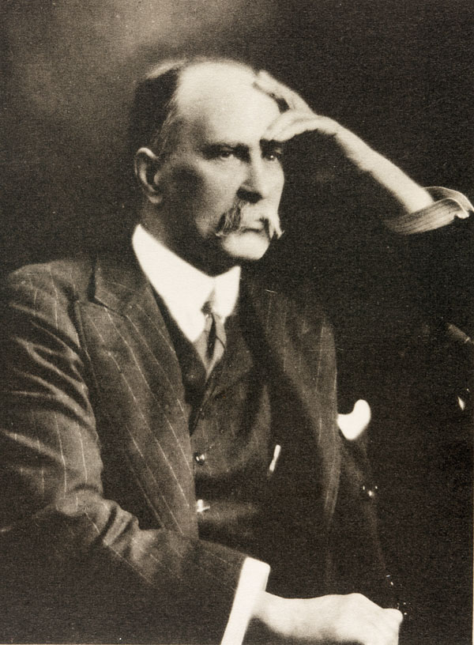
Oslerian Quote
“Without method, only the most brilliant can succeed.”
Notes:
Sometimes, individuals feel a checklist is beneath them, or really feel that everything we are talking about is already covered during a patient encounter. The truth is, most of us will benefit from following a structured, proven method for meeting peoples needs. By following a method, you will be able to drive outcomes, providing care that is meaningful, accountable, and measurable.

Slide 19
Checklists Work
Symptom Management Tool
4 Steps to complete
…and it starts by asking patients about their values and priorities in receiving healthcare

Slide 20
Symptom Management
Step 1
What Is Most Important To You Regarding Your Health?

Slide 21
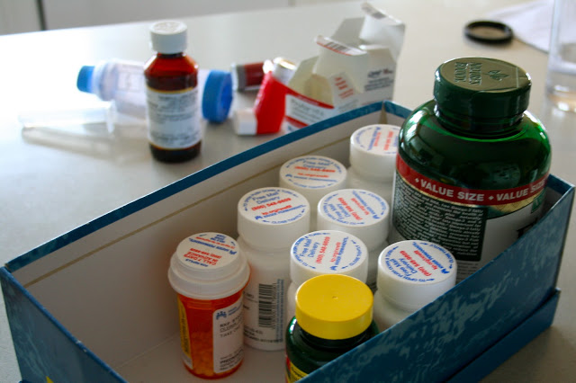
Symptom Management
Step 2
Medication Reconciliation
Reviewing the medication list from the hospital is not reconciling the medication list.
A fully reconciled medication list is an ongoing process

Slide 22
Symptom Management
Step 3
Supply
Adequate supply of all medications (as well as 2-3 days of prn use)
If treatments, adequate supplies available

Slide 23
Symptom Management
Step 4
Symptom Education
Educated regarding common symptoms
Patient/caregiver demonstrates understanding
SIT level for pain
Trained in IF/THEN
Pt/caregiver demonstrates knowledge of responding to IF/THEN instructions

Slide 24
Common Symptoms at End-of-Life
Pain
Dyspnea
Constipation
Delirium and Agitation
Diarrhea
Fever
Nausea and vomiting
Excess Secretions
Weakness and fatigue
Dry mouth
Depression and anxiety
Anorexia and cachexia
Notes:
A list of common end-of-life symptoms

Slide 25
Clinical Practice Guidelines
Clinical practice guidelines are systematically developed algorithms to assist practitioner and patient decisions about appropriate health care for specific clinical circumstances.
These guidelines are not fixed protocols that must be followed, but are intended for clinicians to consider as a pathway towards treatment
Notes:
Clinical practice guidelines have been created as algorithmic steps that may be followed in deciding treatment approaches with the attending or hospice physician. Remember these are only guidelines and the final prescription and treatment plan is decided by the prescribing provider.

Slide 26
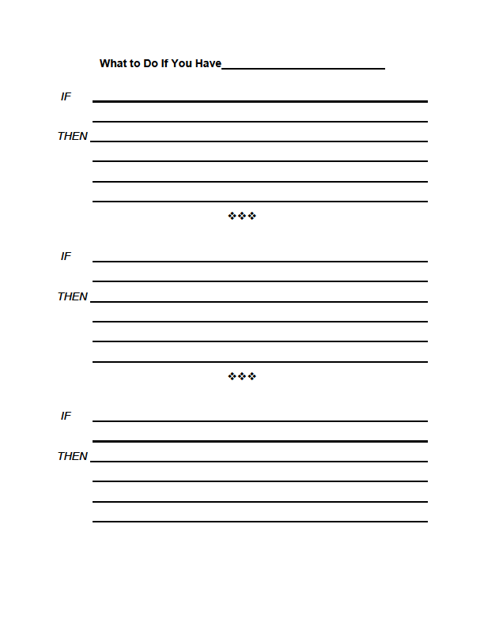
Developing IF/THEN Sheets
IF: nausea and vomiting
THEN: Compazine 10mg every 6 hours by mouth as needed
IF: nausea and vomiting continues
THEN: Take Compazine 10 mg every 6 hours scheduled

Slide 27
Safety
Decrease the likelihood of an unsafe occurrence from happening
Aging + Frailty = buildup of problems = fall/injury

Slide 28
Safety and Self-maintenance
Safety and Self \Maintenance Needs:
Designating a surrogate decision-maker
Getting emergency medical care, if needed
Mobility/access at home (stairs, entry, toilet)
Transferring (to chair, bed, toilet, etc.)
Nutrition/meal preparation
Chewing/swallowing
Insufficient caregiver support for patient
Hygiene (significant continence care, etc.)
Toileting
Oxygen tank handling & precautions
Abuse
Notes:
These items should be discussed and worked to resolution at every outcome meeting.

Slide 29
Wellbeing
“Knowing is not enough; we must apply.
Willing is not enough; we must do.”
-Goethe

Slide 30
Wellbeing
Step 1
Set-up the conversation – introduce the idea and benefits
“I’m hoping we can talk beyond just controlling
your symptoms. Is that okay?”
Notes:
defining patients goals represents one of the most important aspects to providing meaningful outcomes at end-of-life. Of paramount importance is allowing time and space to actualize those moments in individuals lives that have value, meaning and purpose…that bring happiness to one’s life.

Slide 31
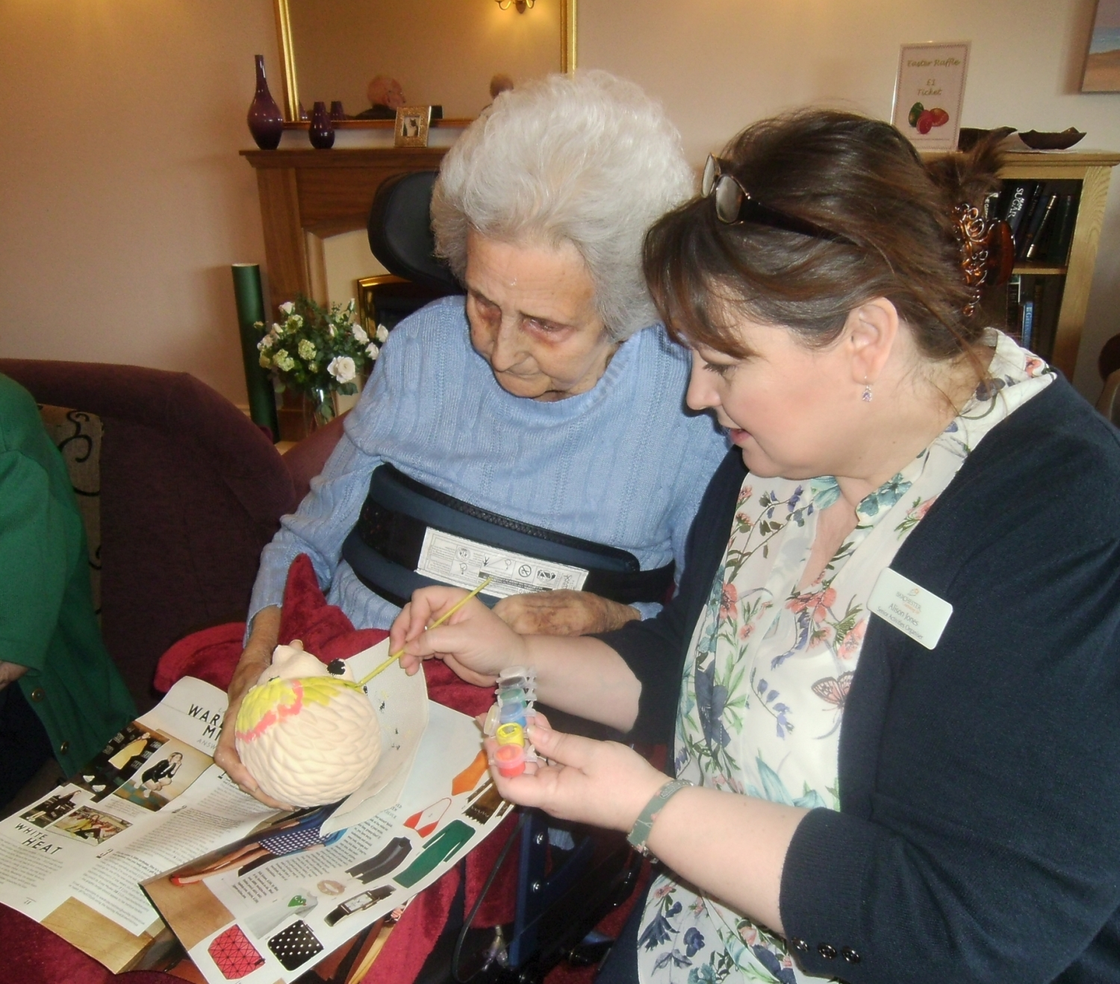
Wellbeing
Step 2
Share the concept
“We would like to help embrace qualities, likes, goals, that are unique to you.”

Slide 32
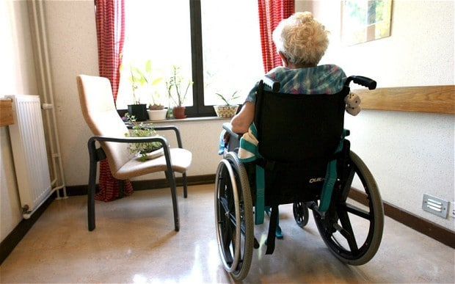
Wellbeing
Step 2
Share the concept
Research has proven that focusing on positive concepts:
Decreases pain
Improves sense of well-being
Decreases anxiety
Improves QOL
Decreases caregiver stress
Notes:
Having this understanding can help us better provide care to you, and can help us in controlling your symptoms beyond just prescribing medications.

Slide 33
Wellbeing
Step 3
Enhance the attributes unique to the patient
“A good place for me to know you better is to simply ask,
what makes you happy?”

Slide 34
Outcome Based Quality Care Model
Focuses on using the knowledge, skill and desire you already have…
It’s not about more work, more processes, … it’s about letting you do the work that matters most to your patients, and to you…
It’s about achieving outcomes for your patients that matter…you only have one opportunity to get your care right…

Slide 35
Compassus colleagues deliver care that honors our self-determined goals and preferences, centered on improving comfort, safety and quality of life while reducing family stresses
Notes:
Our vision for patients and families.

