Slide 2
Hospice Past, Present & Future Access: Palliative Medicine and Beyond
2016 Compassus National Medical Director Meeting
05/14/2016
Louis J. Lux, M.D.
Compassus Medical Director Austin, Texas
Notes:
Good morning
My aim is to provoke a discussion today that leads to reflection and action for you and your hospice site

Slide 3
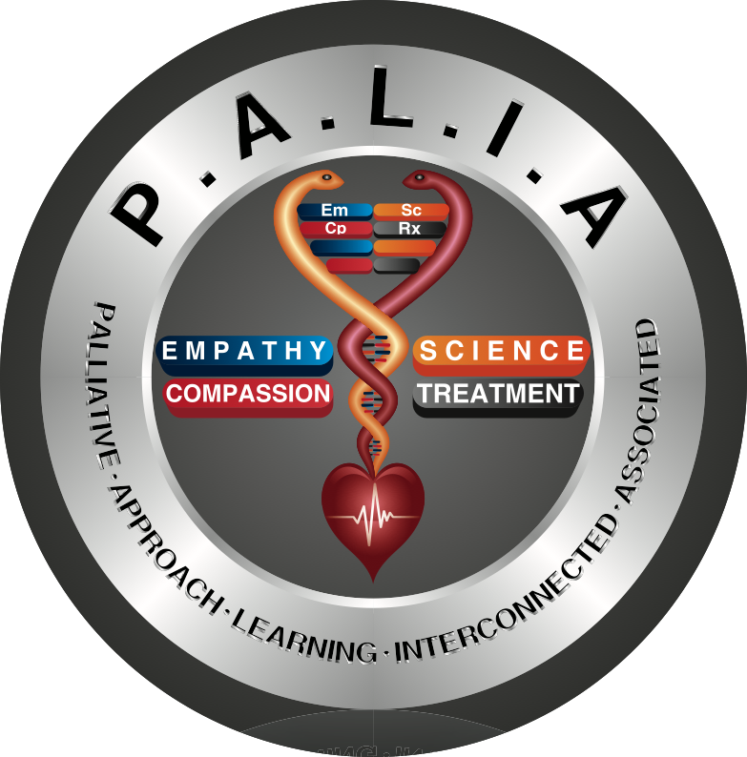
Disclosures
Compassus Medical Director – Austin, Texas
Palliative Medicine Consult Service, Seton Medical Center – Austin, Texas
Clerkship Director & Clinical Assistant Professor, IM, PM, Texas A&M, College of Medicine
Notes:
Medical Director, hospital palliative medicine consultant, and teacher
--3 kids ...3 jobs

Slide 4
WARNING: Non-useful material included!
Author believes one can be serious, without being solemn
Author has included material from the Internet which may be potentially offensive and/or humorous
Author understands these presentations are usually after a meal and attempts at introducing humor may be needed to give the illusion of audience attention and participation
Notes:
I freely admit that non useful material is embedded in my talk
Also: Sarcasm is my love language

Slide 5
HOSPICE PAST
Notes:
-Hospice is original medicine, we were the first form of medicine!
-Can’t know where you are going if you don’t know where you’ve been…

Slide 6
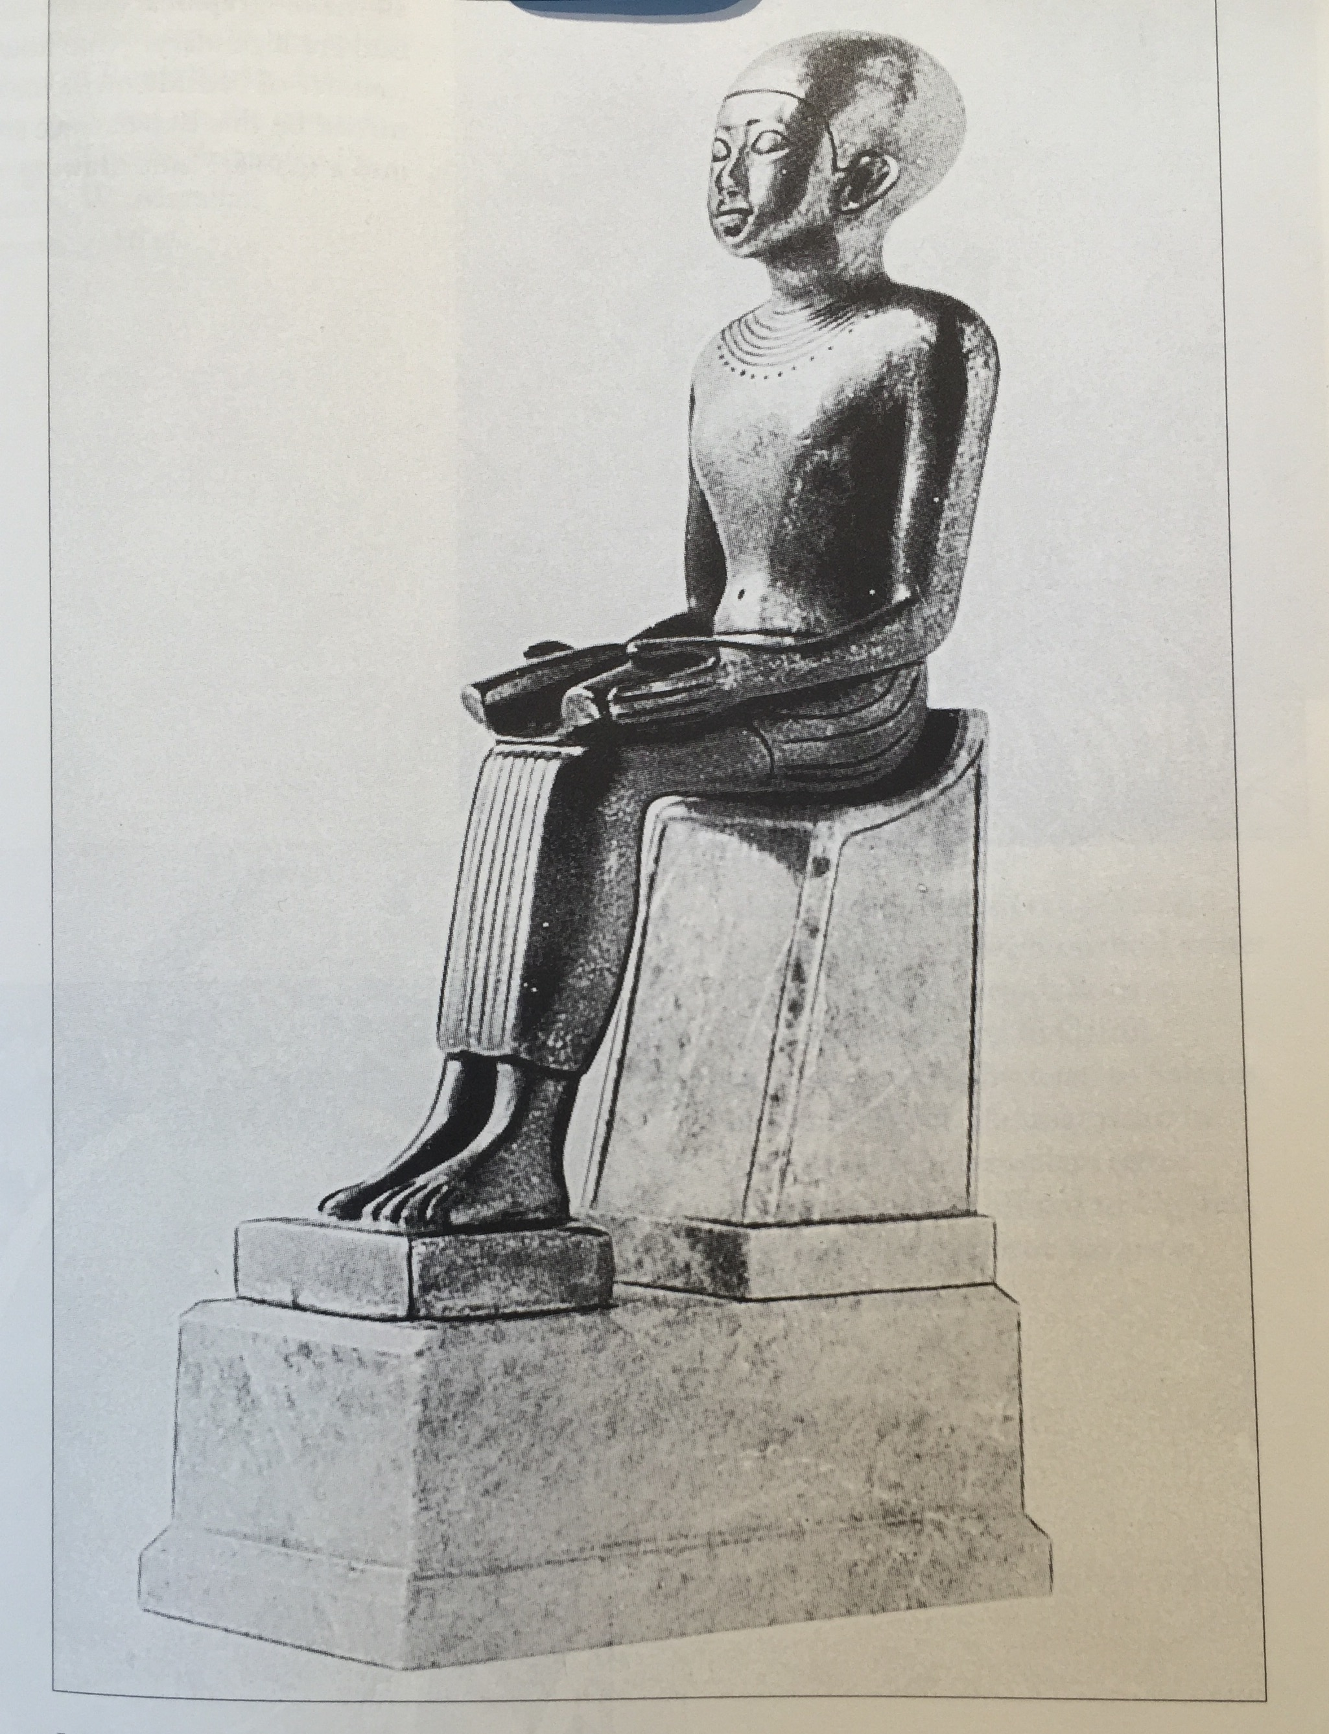
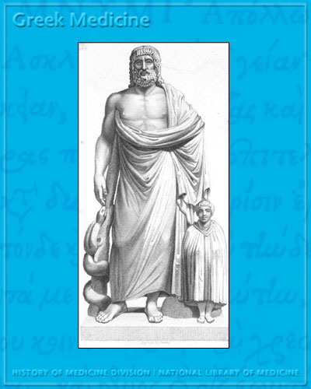
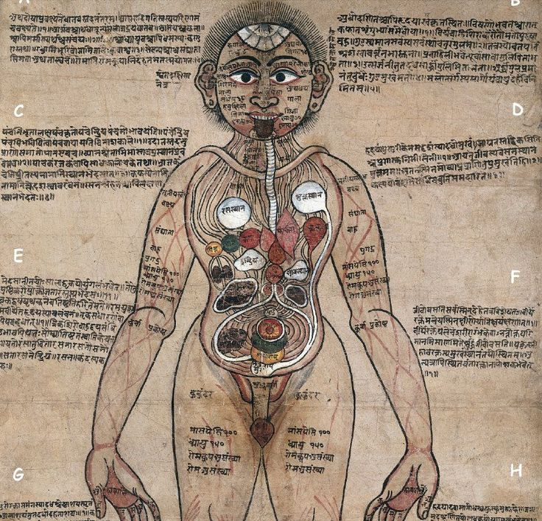
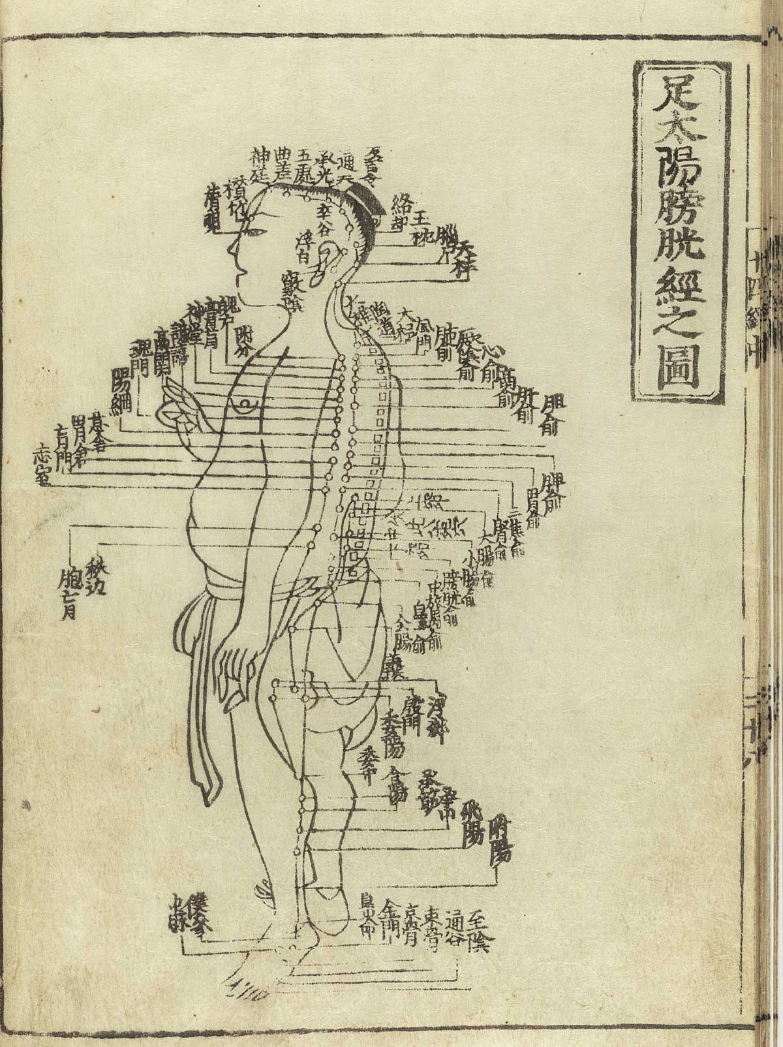
Early Medicine: Healers
Egyptian, Greek, Indian, Chinese
Notes:
Early Civilizations had rich traditions dedicated to RELIF OF SUFFERING
One weird Egyptian remedy: applying molded bread poultice to wounds…OR .early PCN,
Coincidence OR…

Slide 7
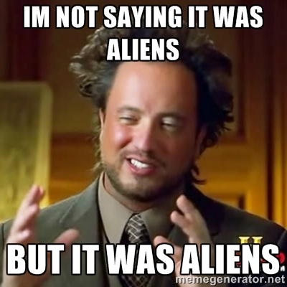
Early Medicine: Healers
Notes:
Its difficult to say

Slide 8
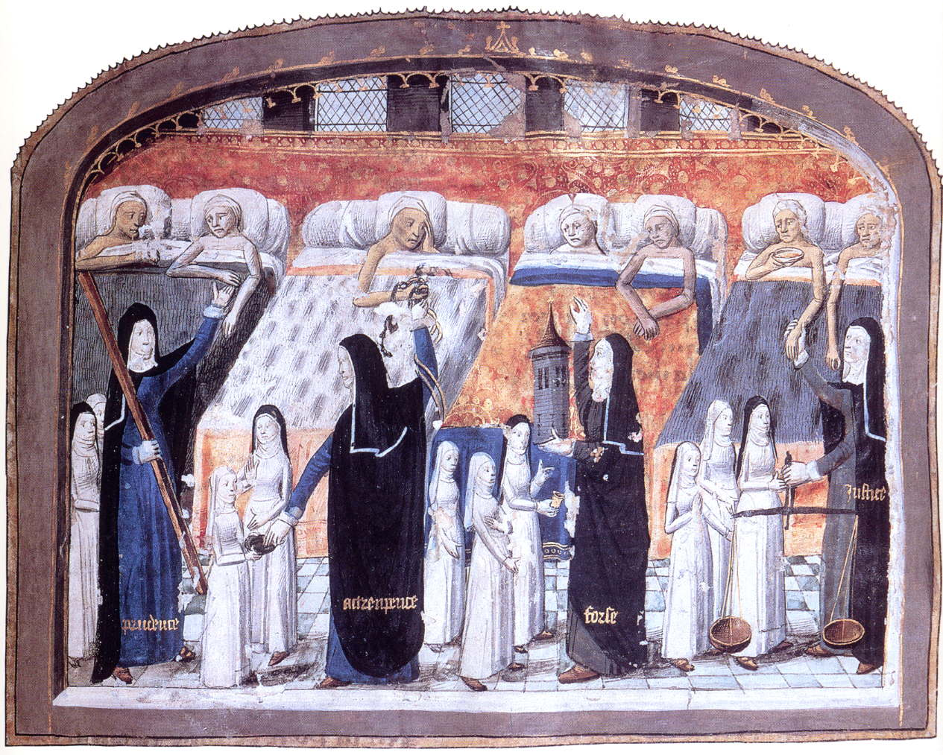
Hospice and the Hospital: Common Origins
Notes:
Hospice and Hospital share the same Latin root, Hospes, “meaning guest and host”
Early hospitals started in the middle ages and were places travelers could be cared for when ill and/or dying

Slide 9
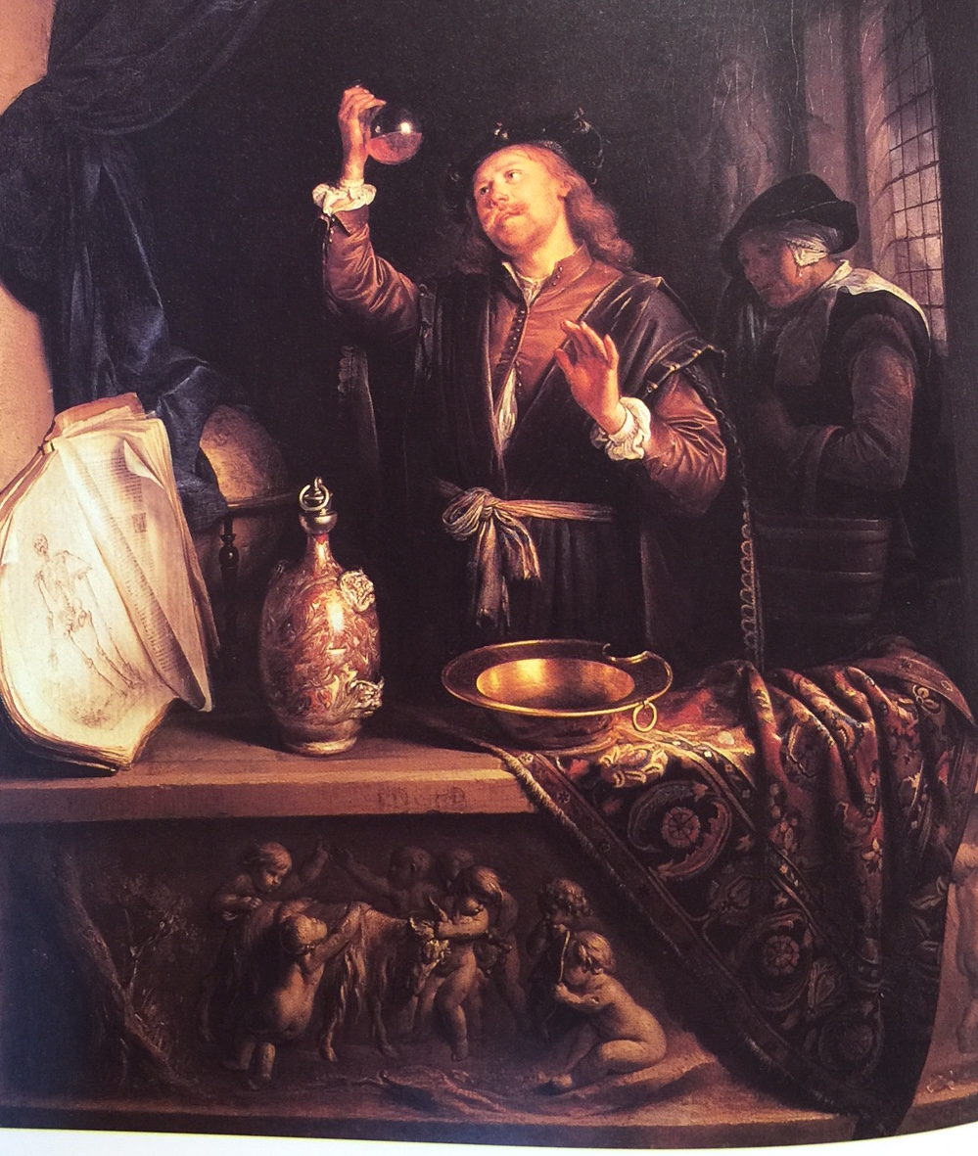
Pseudoscience & Medicine in the Middle Ages:
Urine Gazing
Notes:
Medicine in the middle ages did very little however to advance the health of the patient for hundreds of years
Urine gazing is an example of middle age pseudoscience.
The physician would make pronouncements about someone’ health by looking at flasks of urine like a sommelier looks a a glass of wine..

Slide 10
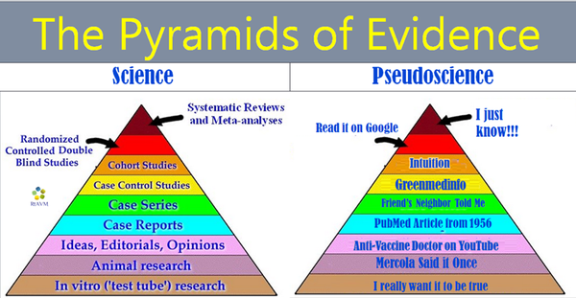
Pseudoscience & Medicine in the Middle Ages:
Urine Gazing
GMO Dangers
Copper underwear
Foil hats
Notes:
LUCKY FOR US: pseudoscience did not die and paved the way for today’s pseudoscience
Giving us copper underwear, foil hats, fears of GMOs and vaccines

Slide 11
So science said to medicine….
Notes:
So science said to medicine

Slide 12
Notes:
You’re doing it wrong!

Slide 13
The miracle of modern medicine
…OR how water polo, sex, war, chemical weapons, bondage and a dog named Marjorie changed medicine and raised life expectancy
Notes:
Enter the age of science
Random events (or aliens) and the new science began to change the health of patients

Slide 14
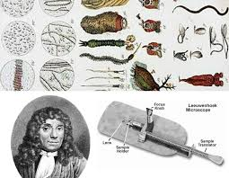
Science (observation) Begins to Influence Medicine: Anton Leeuwenhoek 1657
Notes:
Anton Leeuwenhoek created a microscope that magnified things 270 times,
He saw “creatures” living in rain water, discovered bacteria, protozoa, red blood cells and sperm

Slide 15
Science Begins to Influence Medicine: Edward Jenner 1796
Rural English physician
“Eavesdropped” upon girl’s conversation where girl claimed she couldn’t get smallpox
Noticed cowpox patients didn't get smallpox
Borrowed Turkish vaccination technique
Notes:
Edward Jenner validated a young girls comment that she could not get deadly smallpox since she already had the milder cowpox
It was EXACTLY 220 years ago TODAY—May 14, 1796, he gave the first “vaccination” to an 8 y/o boy .

Slide 16
Science Begins to Influence Medicine: Ignaz Semmelweis
Hungarian physician: 1847, appointed to Univ. of Vienna (contract not renewed)
Noticed high death rate (18%) due to lack of hand washing
Insisted upon washing hands in chloride of lime
Criticized fellow physicians, was ridiculed
Committed to insane asylum—died 2 weeks later
Notes:
Years later Hungarian Physician Semmelweis noticed a nearly 20% death rate among women delivering babies at the University of Vienna due to non-existant physician hand washing
He insisted upon sanitizing their hands with chloride
soluation, and the death rate went down to 2%
He was shunned by his collegues and later forced into an insane asylum
NO GOOD DEED GOES UNPUNISHED!

Slide 17
Science Begins to Influence Medicine: Louis Pasteur
Demonstrated Germ cell theory over “spontaneous generation”
First success aiding wine industry; later chickens, silk worms, milk
Created multiple vaccines, including rabies which was given to 9 y/o boy
Notes:
Louis Pasteur had better luck.
He solidified proof of the germ theory
He is most famous for increasing milk safety ( by heating) and vaccines
A 9y/o boy ,bitten by a rabid dog, was the 1st successful recipient of his rabies vaccine.

Slide 18
Science Begins to Influence Medicine: Florence Nightingale
Icon of nursing
Changed medical and nursing culture
Statistician
Notes:
I am openly pandering to the NURSE PROVIDERS now….IT’S NURSES WEEK!
Any nurse providers here?
Raise your lamp!

Slide 19
Florence Nightingale: “the lady with the lamp”
Notes:
Florence Nightingale made her name nursing sick and wounded soldiers in Crimean War.
Her greatest contribution to humanity however was arguably due to her graphic representation of the needless death of thousands of soldiers due to filthy physicians, nurses, and hospital sanitation.
The" lady with the lamp" was not only performing patient care, but COUNTING THE DEAD.

Slide 20
Florence Nightingale
Notes:
With these elegant graphs, she displayed the needless preventable deaths (in blue) compared to battlefield deaths (from bullets and swords)
And even the politicians could understand the numbers now.
This lead to public outrage and massive reforms in the medical care in hospitals and saving countless lives.

Slide 21
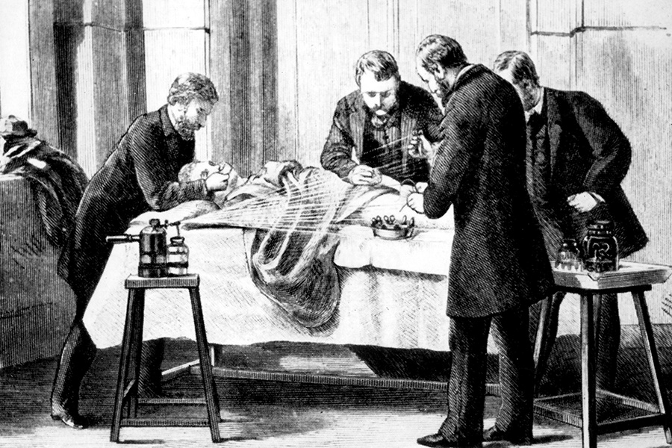
Science Begins to Influence Medicine: Joseph Lister and Antiseptic Surgery
Lister promoted use of carbolic acid to sanitize wounds and limit post-op infections
Previously carbolic acid was mainly used to treat sewage
Rashes caused by carbolic acid sprays on surgeons created development of rubber gloves
Notes:
Based upon Pasteur’s work on Germ Theory
Lister championed use of carbolic acid as disinfectants on patients and surgical instruments.
Carbolic acid was used then to take the smell out of sewage and garbage.
Post operative infections and deaths plummeted.

Slide 22
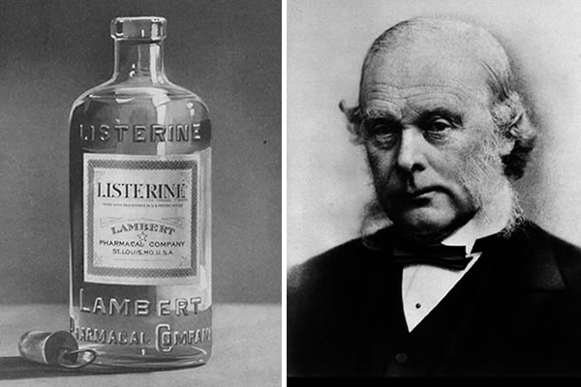
Lister & Listerine
Notes:
American mouthwash Listerine was named to capitalize upon Lister’s success: Lister was not affiliated with the product.
Listerine never saved a life but probably saved or extended countless conversations,
It was also marketed as a floor cleaner and treatment for gonorrhea.
Sex sells!

Slide 23
Science Begins to Influence Medicine: Robert Koch
Isolated Tb, vibrio cholerae, anthrax
Koch’s postulates for isolating pathogens
Notes:
Robert Koch isolated TB, cholera, and anthrax pathogens

Slide 24
Science begins to influence medicine: Paul Erlich
Coined “chemotherapy;” “Magic Bullet”
1st Injectable antibiotic: Salvarsan 606
Salvarsan used to treat syphilis—made of arsenic and other organic compounds
Notes:
His protégé Paul Erlich created Salvarsan 606, the worlds 1st injectable synthetic antibiotic.
It was formulated from arsenic and organic compounds.
Successfully treated syphilis.

Slide 25
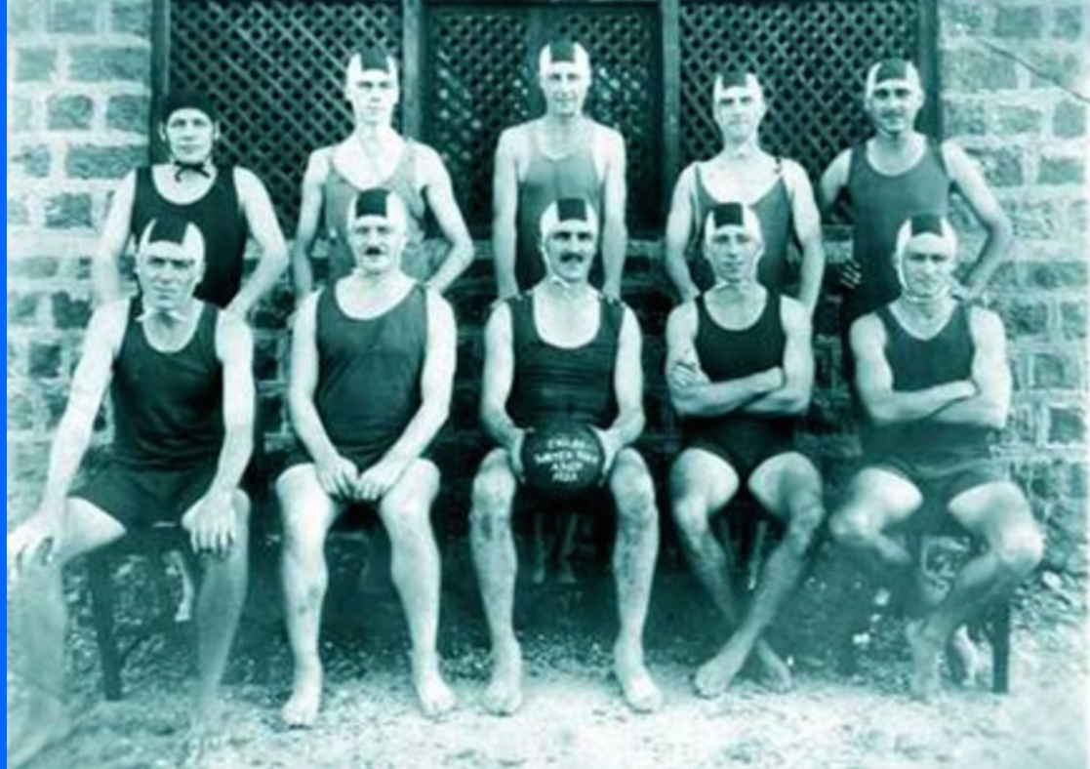
Alexander Fleming , water polo, and PCN
Notes:
Water polo player and hospital rifle team member Alexander Fleming….-→

Slide 26
Science Begins to Influence Medicine: Alexander Fleming 1928
Returns from vacay to his sloppy lab
Notices mold on a staph culture that inhibits its growth
Isolates PCN
Notes:
Returns from vacay to his sloppy lab to find PCN mold inhibiting growth on one of his errantly placed staph culture plates.
Fleming discovers PCN but does little with it..
and never thought of pcn as an injectable

Slide 27
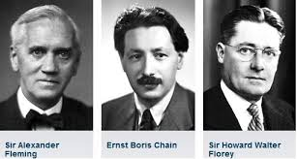
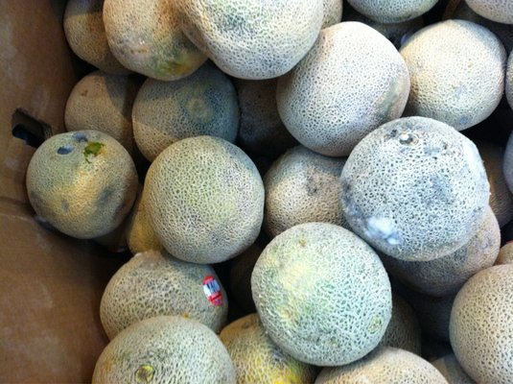
Nobel Prize for PCN
Notes:
12 years later Chain and Florey produced it in quantities sufficient to treat humans. All 3 won the Nobel Prize.
BTW: Early on PCN mold was grown best on cantaloupes

Slide 28
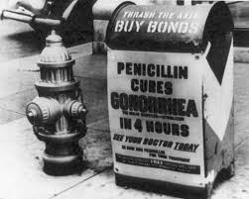
Notes:
Another major reason for PCN success: treating STDs …early “lifestyle drugs”
It worked better than Listerine

Slide 29
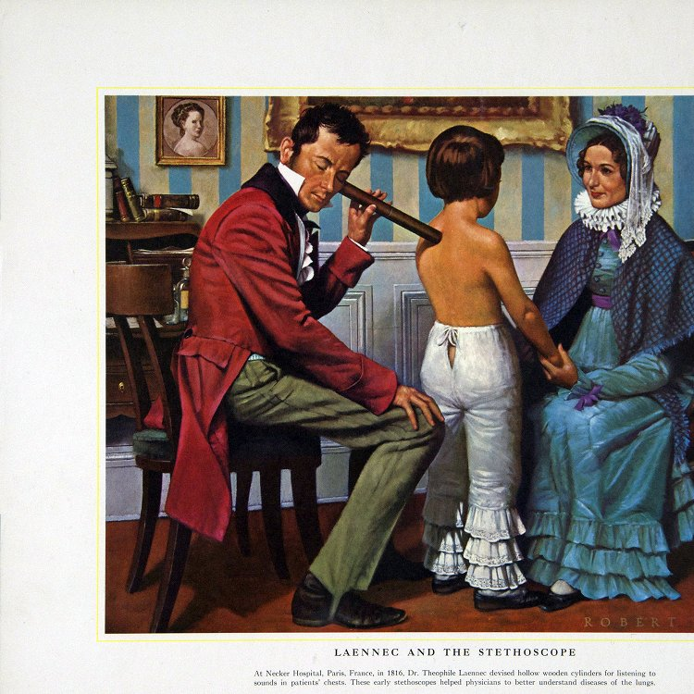
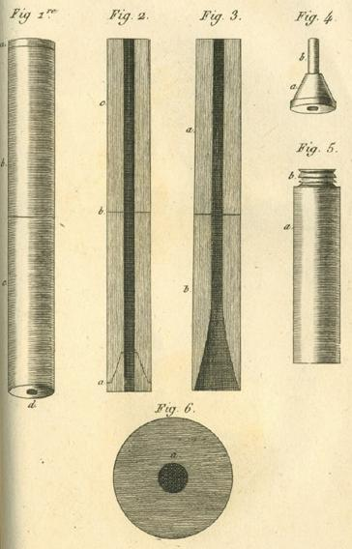
Science Begins to Influence Medicine: Rene Laennec ,1816
Physicians used to listen to heart/lung; Sounds by placing ear directly on chest
This would be awkward for most MDs examining a young woman
The wooden/brass tube amplified sound and helped maintain social boundaries
Notes:
Medical devices changed medicine.
Flute player and physician Rene Laennec, invented the stethoscope to amplify sound
And avoid the awkward practice of the time of listening to the heart by placing the physicians ears directly on the patients chest.

Slide 30
Science Begins to Influence Medicine: Wilhelm Einthoven: First EKG
Notes:
Medicine leapt into the age of electricity with the discovery of electric cardiac activity via the EKG

Slide 31
Science Begins to Influence Medicine: Dr. Werner Forssmann 1929
Notes:
Which lead to invasive cardiac diagnoses and treatment.
Rebel German med student Werner Forssmann
performs the world's first heart cath on himself using a urinary catheter.
Before the procedure he had to tie his assistant to a chair because she objected so vigorously

Slide 32
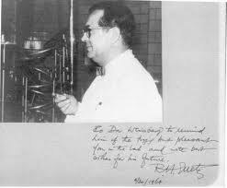
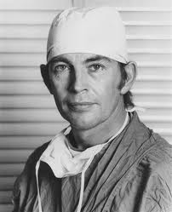
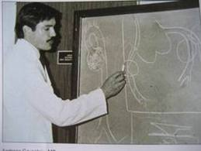
Cardiology Pioneers
CABG/BYPASS: 1960
Transplant:1967
Angioplasy:1977
GOETZ
BARNARD
GREUNTZIG
Notes:
Which lead to the first cardiac bypass surgery, transplant, and angioplasty--extending the lives of many

Slide 33
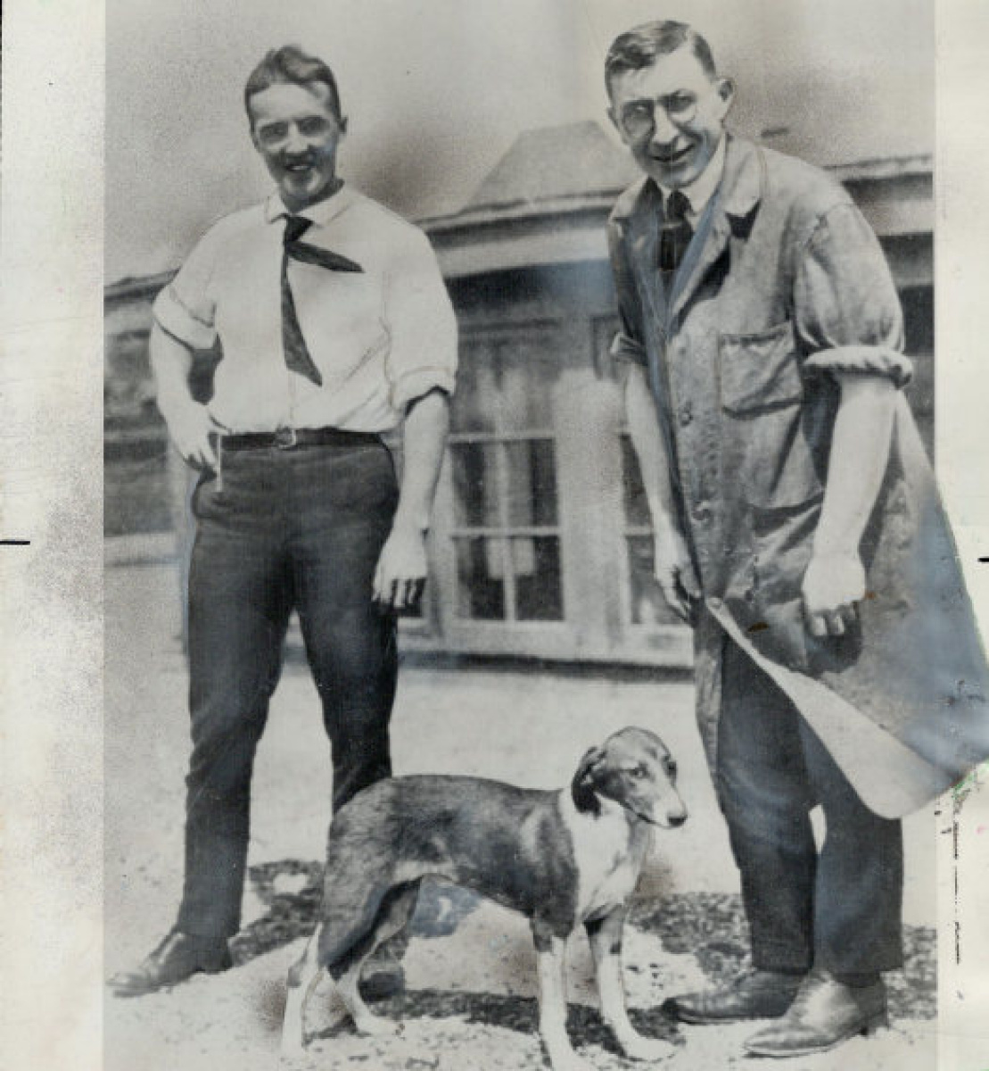
Insulin: 1921 – Banting, Best and Marjorie
Given poor equipment, supplies and a lowly medical student (instead of proper help)
Med student turned out to be biochem major, saved the day, but gets passed over for Nobel prize
Lab director changes name from Iletin to insulin, and gets share of Nobel
Best and Bant injected themselves first, before dog
Notes:
Canadians Banting and Best discovered the relationship of the pancreas to diabetes
and produced the 1st insulin treatment for diabetes with the help of Majorie the diabetic dog
--- by proving injections of the pancreatic extract insulin lowered her high blood sugars

Slide 34
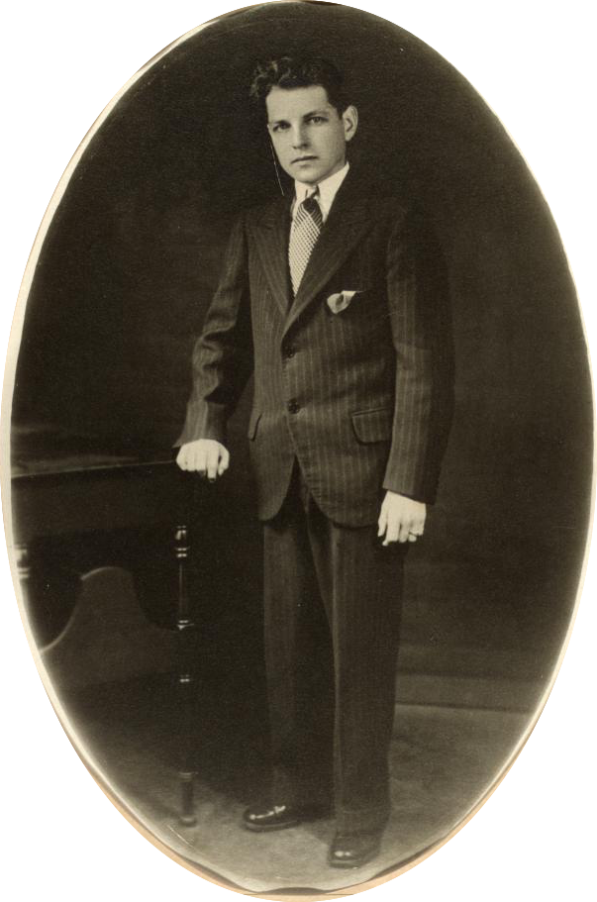
Leonard Thompson:
1st Human Diabetic Patient to Receive Insulin
Age 14
Notes:
Which leading to the first human to receive insulin, a 14 y/o boy.
(NOTICE “YOUNG BOY THEME” in human medical experiments? )

Slide 35
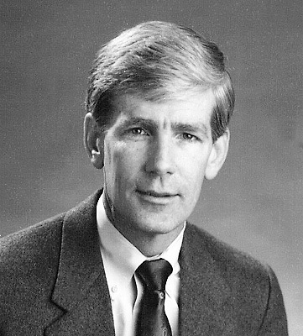
Dr. Willem Kolff
Notes:
Then inWW2 Holland :1943 – Dutch physician who was mad about losing his young patient to kidney disease
He “McIvers” a dialysis machine after reading about 1913 ANIMAL hemodialysis experiments.
1913—animals had dialysis 30 years before humans.
Animals>>humans

Slide 36
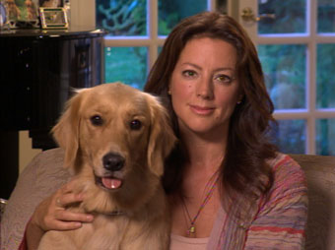
Animals Have Advocates
Notes:
Thats because animals have advocates

Slide 37
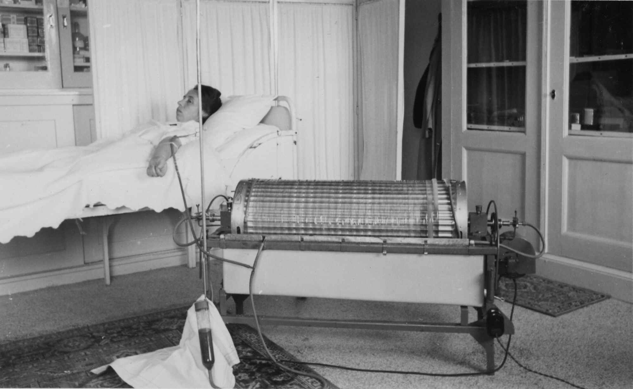
First (human) Dialysis Machine
Notes:
Here it is the 1st dialysis machine made from sausage casings, orange juice cans, and a washing machine motor and basin.

Slide 38
“What were the first words from the first patient who awoke from uremic coma after being treated with first successful dialysis”
Choose (A) or (B)
“Thank you (provider)…You saved my life”
“I want to divorce my husband”
Notes:
Upon awakening from uremic coma, the first successfully treated dialysis patient said which sentence?
A or B ?
Answer is B
She lived for 7 additional happy years.

Slide 39
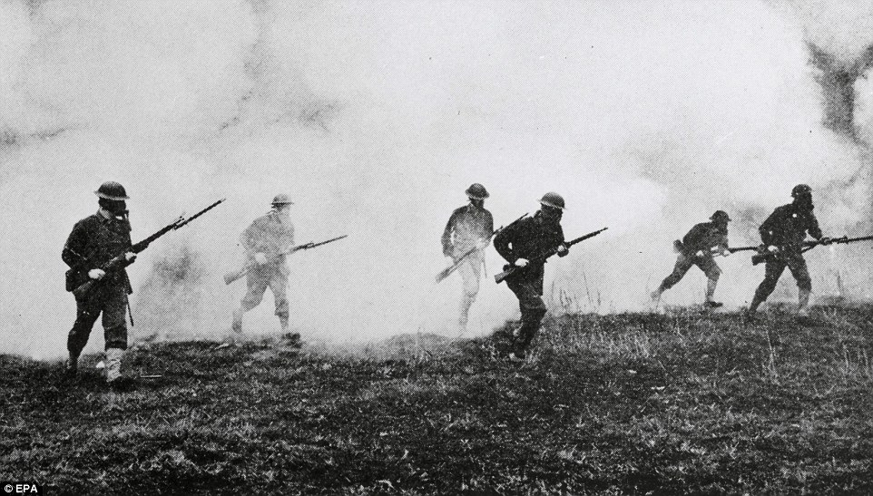
Chemotherapy and WAR
Notes:
War has always had significant influence upon medicine….even cancer treatment

Slide 40
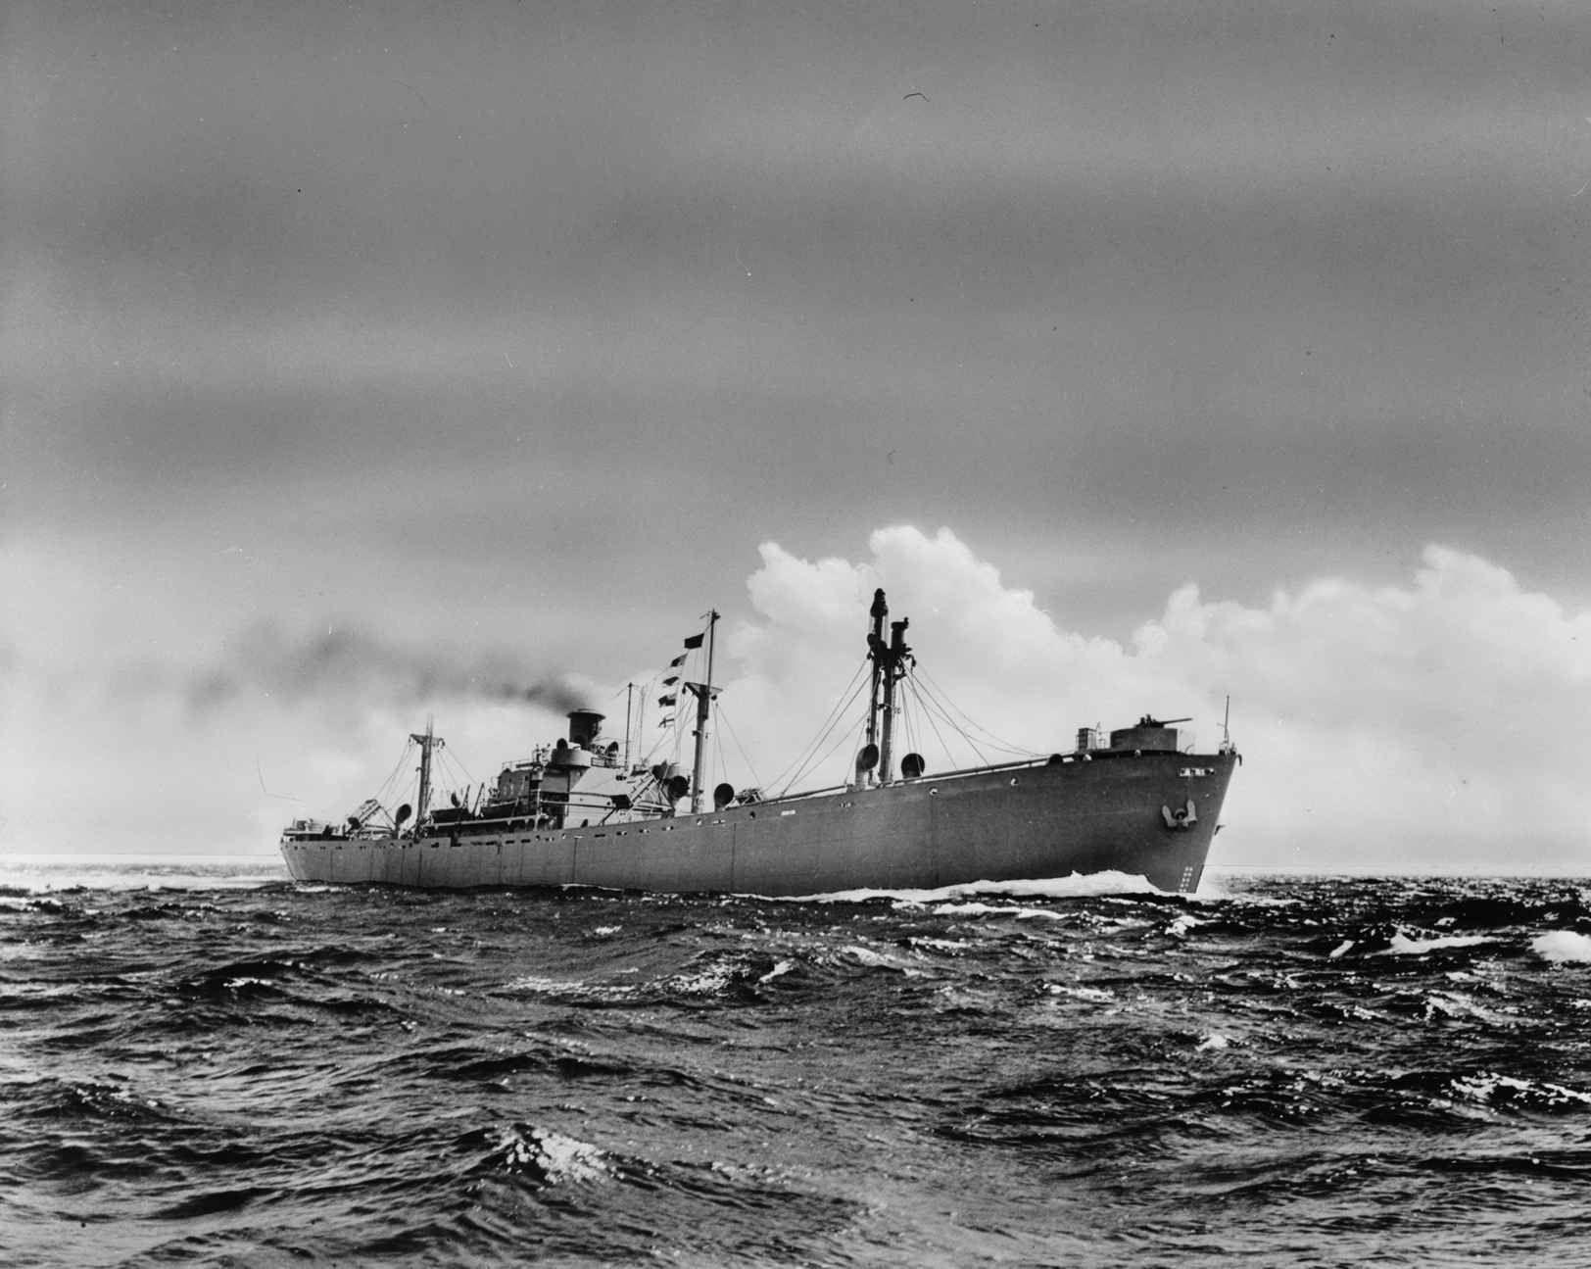
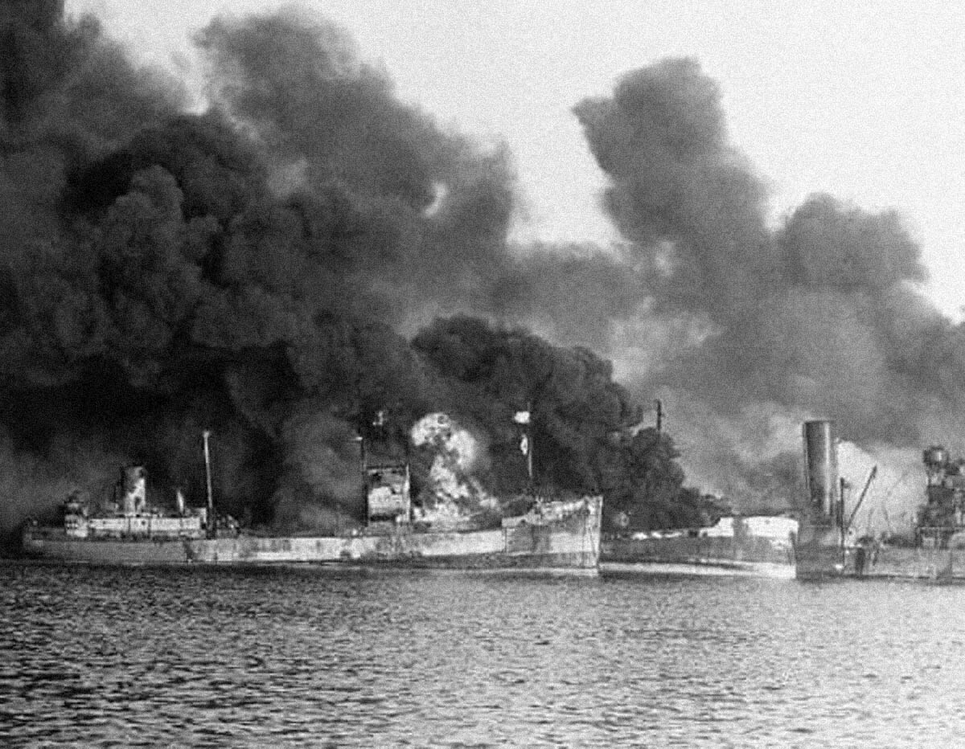
SS John Harvey: WW II Secret Chemical Weapons
And Discovery of Chemotherapy for Cancer
Notes:
mustard gas bombs were transported by this liberty ship to Italy.
the ship was attacked,
releasing a toxic cloud killing hundreds hundreds of people.
autopsies on the victims to lead to the first successful chemotherapy
---treating non Hodgkins Lymphoma
Therapy out of tradgedy

Slide 41
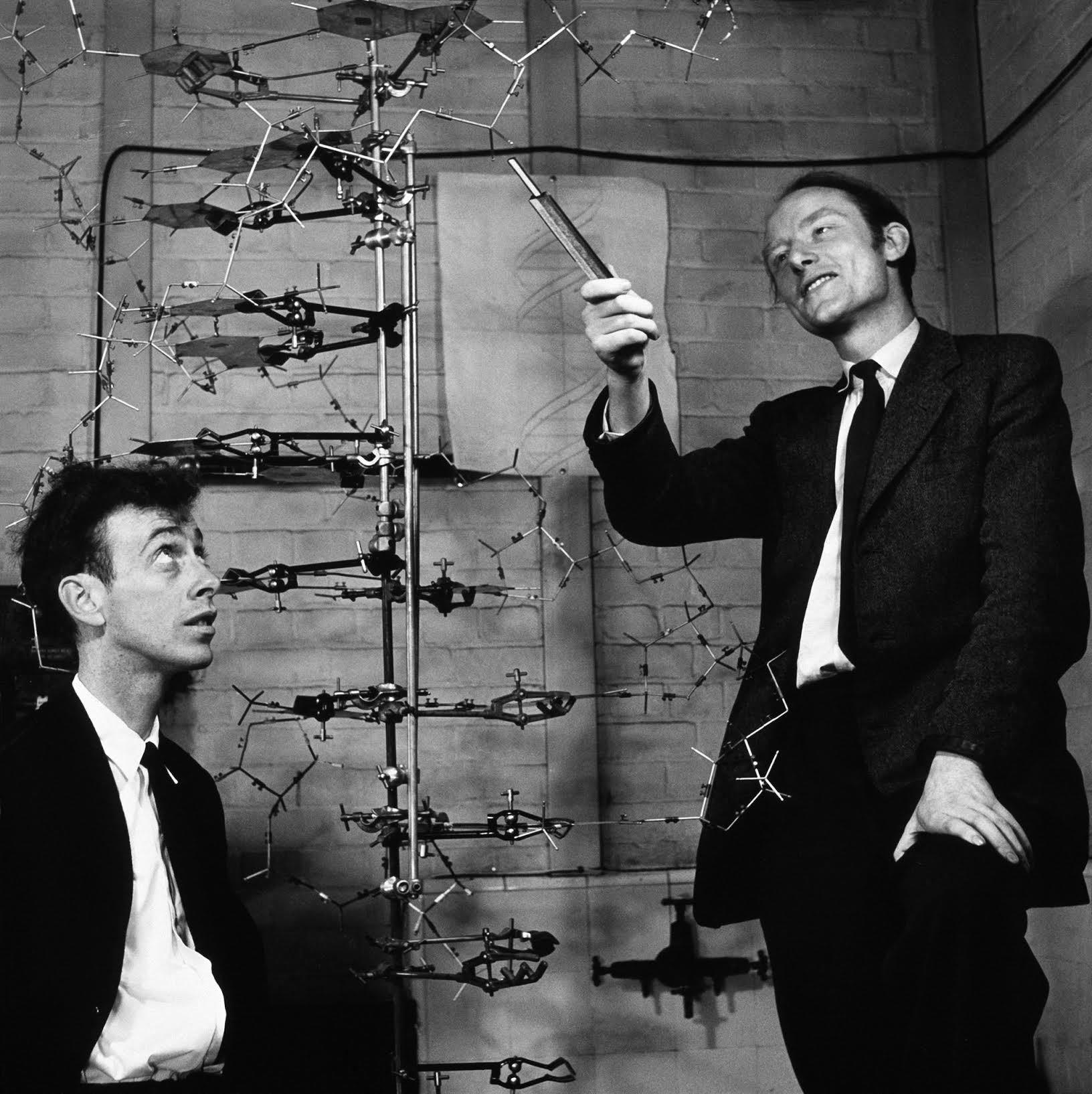
DNA: The Double Helix-Watson & Crick (1953)
Notes:
Then in 1953, the British and American team of Watson & Crick discover DNA structure

Slide 42
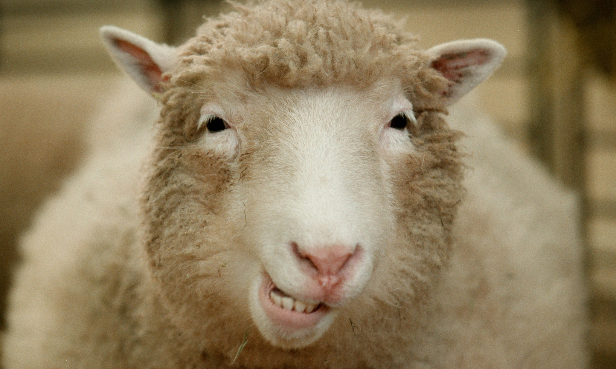
DNA: The Double Helix-Watson & Crick (1953)
”Hey Now !”
Notes:
DNA structure discovery leads to molecular biology, cloning, immunotherapy, and Dolly the cloned sheep

Slide 43
Miracle of Modern Medicine: 1900-2000
Life expectancy nearly doubles: 40s to high 70s
Some cancers “cured”
Surgery, pharmacology, imaging all advance medicine rapidly
Biotech seems to promise of endless life
Notes:
Science helps medicine tremendously with doubling life expectancy, improved life quality, and hope

Slide 44
Miracles of Modern Medicine: 1900s
Development of antibiotics
Discovery and use of insulin to treat diabetes
Antihypertensive medications
The first kidney dialysis and transplants
The first chemotherapies for cancer
Notes:
Unfortunately despite the miracle->

Slide 45
Miracle of Medicine, But…
90 % of US will die slowly
Life expectancy has plateaued, or even in decline
50% of Americans die in pain
43% die in hospitals
While 66% of Americans fear being told they have a life-threatening illness, 83% say their biggest fear is dying in pain
Notes:
No major shift in life expectancy in the last 30+ years
Half of us die in pain and ½ in hospitals
And we fear dying in pain more than death itself

Slide 46
Miracle of Medicine, But…
50% of Medicare budget spent on care in last few weeks of life
Notes:
The costs of care in not sustainable

Slide 47
So medicine said to science…
Notes:
so medicine said to science...

Slide 48
Notes:
you' doing it wrong!

Slide 49
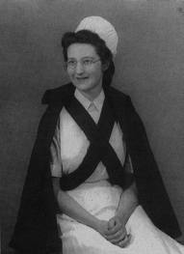
Palliative Care Origins: Dame Cicely Saunders
Notes:
Enter British WW2 nurse Cicely Saunders who goes to medical school specifically driven to care for the dying patient
---which scientific medicine has forgotten.
The founder of the modern hospice movement

Slide 50
Palliative Medicine Origins
1974: first US hospice
Early 1980s: Medicare Hospice benefit
2008: Palliative care recognized as specialty by ABMS as a distinct medical specialty
Fellowship training programs created early 2000s
Current ratios : Cardiologists: patients = 1:71 Palliative Medicine Physicians: patients= 1:1700
Notes:
we then quickly get the hospice benefit in 1982,
and later palliative medicine and hospice as a specialty

Slide 51
All this history for what?
Notes:
All this history for what?
I am not sure, but I like history.
Maybe one point : these impressive figures went against the grain, were active mindful physicians and scientists, stood up for patient care,

Slide 52
HOSPICE PRESENT

Slide 53
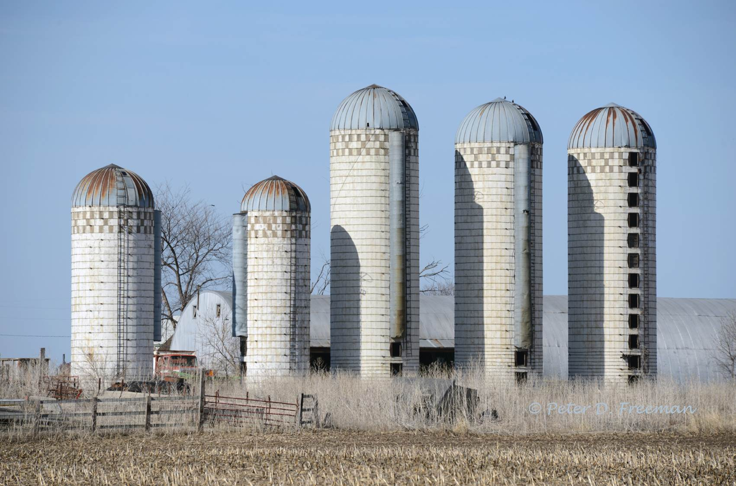
Previous Millennium Hospice Model
Previous Millennium Hospice Model
P
A
T
I
E
N
T
P
A
T
I
E
N
T
P
H
Y
S
I
C
I
A
N
I
N
S
U
R
A
N
C
E
I
N
S
U
R
A
N
C
E
P
H
Y
S
I
C
I
A
N
E
M
P
L
O
Y
E
R
H
e
A
L
T
h
c
A
R
e
H
O
S
P
I
C
E
H
e
A
L
T
h
c
A
R
e
S
Y
S
T
E
M
S
Y
S
T
E
M
Notes:
This representsthe siloed hospice in the fee for service era

Slide 54
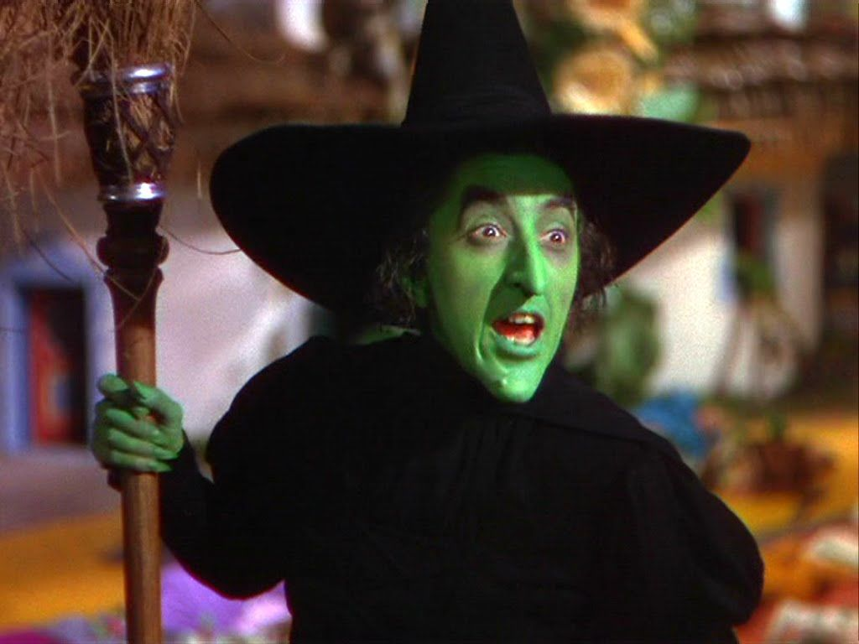
Fee-for-Service Model Hospice Decision Makers:
Hospital System Case Managers
HOSPICE?
SNF?
REHAB?
Notes:
The non-coordinated fee for service healthcare model is subject to external influences

Slide 55
Fee-for-Service Hospice Decision Makers
Notes:
“What ya got for Me?”…rather than..who provides the best care?

Slide 56
Previous millennium hospice
When hospice decisions get tough,
extreme measures are required…
Notes:
-->

Slide 57
But…
Notes:
-->

Slide 58
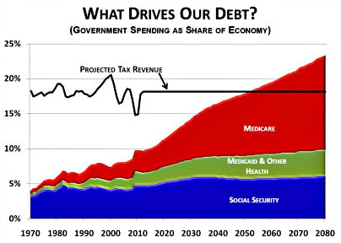
Healthcare Change: All About the Benjamins
Notes:
Healthcare costs are out of control so things are changing

Slide 59
Notes:
we're doing it wrong again

Slide 60
HOSPICE FUTURE
“Ask not what your hospice
can do for you, but what you
can do for your hospice”
Notes:
Hospice now and moving into the future requires active engagement by us physicians

Slide 61
Hospice Access is Not as Easy as Feeding Your Children
Notes:
Its not as easy as merely feeding our children

Slide 62
Palliative Medicine and the Future Hospice
Healthcare
Palliative medicine
Hospice
EOL
Care
Notes:
Palliative Medicine is a large part of the hospice future universe, a much larger patient base than hospice.
The size of the base alone demands our attention.

Slide 63
“Why should I care about connecting to palliative medicine?”
Notes:
so why should I care about connecting to palliative medicine from hospice?

Slide 64
The Need for Enhanced Palliative Medicine-Hospice Connection
Notes:
This is why...

Slide 65
Fee-for-Service vs. Value-Based Contracting
Symptom: __(pain)___
Office Visit: $100
Urgent Care/Walk-in Clinic: $500-800
Emergency Room: $2400
Free-standing ED: $3300
Notes:
Prime example of the problem
US Healthcare cannot afford the $3000 office visit.

Slide 66
The Changing Nature of Healthcare Reimbursement
Value-based healthcare purchasing
Fee-for-service
Notes:
One major insurance carrier: $10 B spent on VB purchasing in 2015, projected to spend $80B in 2018.
Value based purchasing is making money for payors, and cutting costs.

Slide 67
Growth of Inpatient Palliative Medicine: 2000-2013 (C.A.P.C. data)
Hospitals (50 or more beds) with a palliative care team increased from 658 to 1,744 – a 165% increase from 2000 to 2013.
2000: < 25% of U.S. hospitals (658) 2013: 75% (1,744) in 2013 2017: 80% (projected)
Notes:
There is significant growth in PM field
Inpatient PM is tip of the iceberg
Outpatient growing at faster rate

Slide 68
Palliative Med Outcomes: Financial
“Cost savings associated with U.S. Hospital Palliative Care Consultation Programs”
RS Morrison, et al, Arch Internal Medicine, 2008 (Multi-Center Study)
PCC Patients | Direct Cost Savings/ADM | Savings/Day
Live Discharge | $1,696 | $174
Inpatient Deaths | $4,908 | $374
Notes:
Palliative medicine saves the healthcare system money. Palliative medicine is part of Value based purchasing healthcare contracts.
To be successful however, palliative medicine needs a strong and actively managed hospice partner

Slide 69
Palliative Medicine/Hospice Outcomes
Clinical: Both QOL and in some cases survival data beats “standard therapy”
Patient Satisfaction: Best of all healthcare fields
Financial: Significant $$$$ saved
Notes:
Palliative Medicine and Hospice TOGETHER makes financial, clinical, and qualitative sense for patients

Slide 70
Future Hospice: Clinically Integrated Networks…Join or Die
Not all hospices will play in the future healthcare sandbox
Shift in referral to hospice entities that provide high performing, quality outcomes & demonstrate value
Notes:
There is a problem however in that not all licensed hospice entities will be able to participate in these clinically integrated networks.

Slide 71
ACO/Clinically Integrated Network Example: Austin, TX
80 + hospices in area
200,000+ ACO members in one group of care
26 hospice entities applied for network
2 selected
Notes:
This is an example, in my area, which is extremely under-developed with respect to value based purchasing contracts,
.
Only a small fraction of the registered hospice players have qualified to participate.

Slide 72
Hospice MD action plan
Gather intelligence/situational awareness
Local palliative medicine practices: inpatient and outpatient, what’s in your palli-hood?
HCMD certification or PM fellowship?
Notes:
So, look around and see what’s happening.
Everyone’s local situation is different, but it is NOT static.
If you enjoy hospice and palliative care encounters consider modifying your career, adding certifications, exploring alternative employment options.

Slide 73
Hospice MD action plan
Connect to the network or bundled payment program
Connect to palliative medicine
Career opportunities in palliative medicine
C.A.P.C./IPAL resources
Notes:
More professional options are opening in palliative medicine than can be serviced with graduating fellowship trained physicians.
Perhaps you can exploit that gap in your area.
Your future and your site’s future may rest upon your interaction with these clinically integrated networks

Slide 74
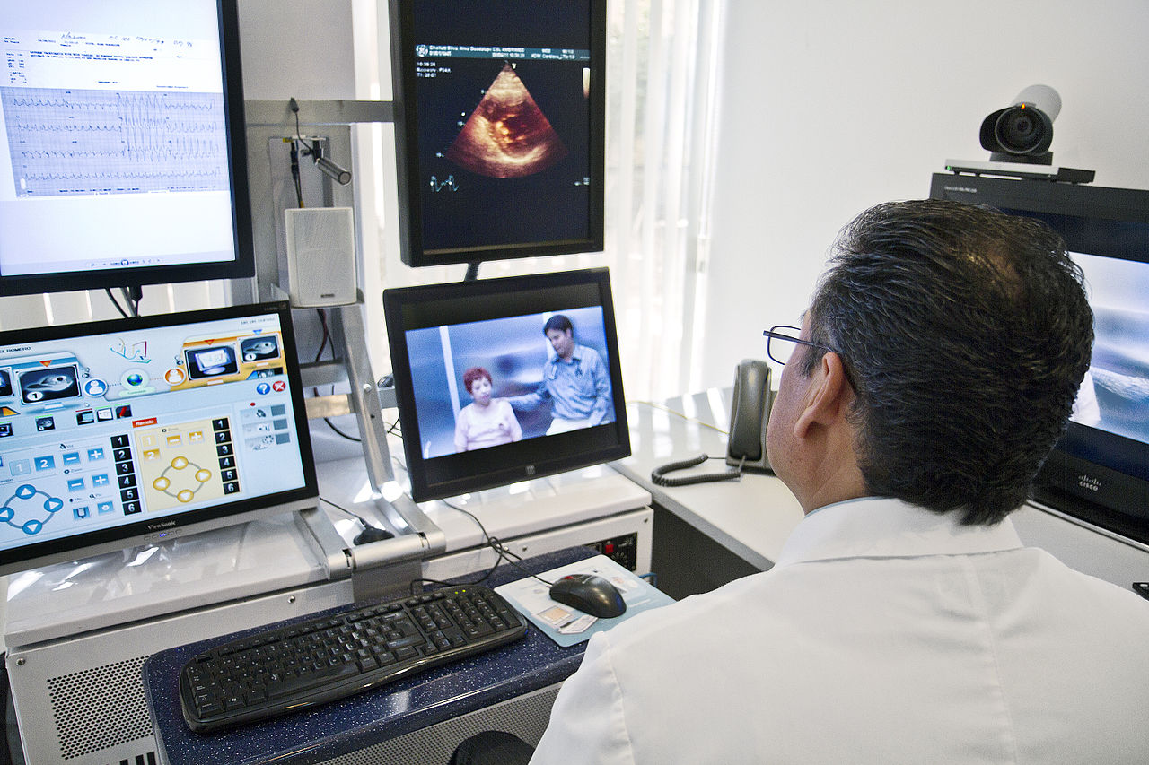
Future Hospice Access: Telemedicine (“It’s not just for the boonies anymore”)
Notes:
On a different note,
If ever there was a field of medicine that could potentially benefit from telemedicine right now, its hospice.

Slide 75
Future Hospice: The Virtual MD Visit
Rural AND congested urban environments: efficiency
F2F requirements
Opioid prescribing demands?
Increase physician satisfaction by increasing clinical contact in hospice?
Notes:
Multiple issues we face may have virtual visit solutions:
distance, traffic, certifications, and now possibly opioid rxs

Slide 76
Future Hospice: Telemedicine Benefits Supported by Literature
Enhanced patient satisfaction
Enhanced outcomes vs. 2nd or 3rd hand reporting to MD
Increased access to care
Decreased costs in certain disease states
Notes:
healthcare systems are looking to expand telemedicine use
patients are accepting and it may help with costs in certain diseases
Access to care also increases
Thank you

Slide 77
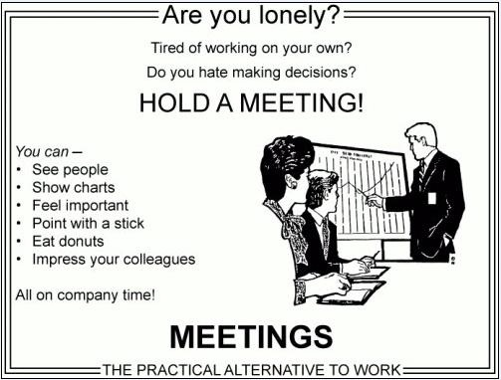
Meeting Benefits
Notes:
Thank you

Slide 78
The End?
Thank You!

